Slide 1
A lesson on Inertia using the Common Core State Standards in ELA as a means to deepen science understanding
The lesson uses the Science Literacy Framework as the model for constructing the lesson

Slide 2
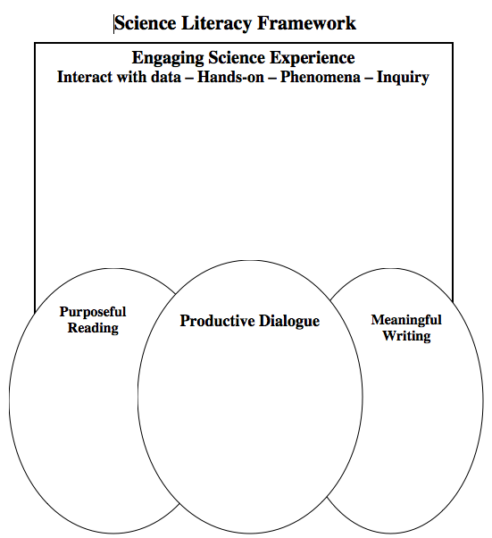
Sacramento Area Science Project – Science Literacy Framework ©

Slide 3
Entering the Content
Think about the statements in the Anticipatory Set (page 1 of handout)
Fill in your responses (A for agree, D for Disagree).
Once you and your partner have finished filling in your responses have a partner conversation explaining your thinking to each other.

Slide 4
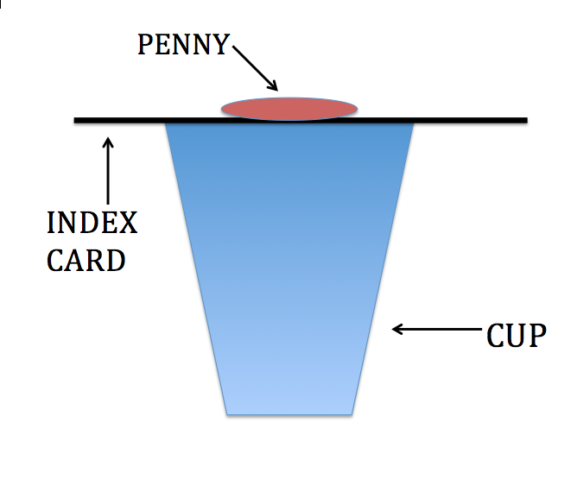

Slide 5
Using the Think-Pair-Share organizer
Fill in the Think box with what you think will happen. (page 2 of handout – top portion)
Once you and your partner have completed the Think portion, have a brief conversation in which you listen to each other and summarize each other’s thoughts in the Pair box.
Lastly, record in the ideas you can share in the Share portion.

Slide 7
Experiencing a Phenomena
Set up the cup, index card and penny as was previously shown.
Rapidly flick the index card sideways
Observe what happens
Repeat a few times

Slide 8
Using the Think-Pair-Share organizer
Fill in the Think box with your explanation of why what you observed happened. (page 2 of handout – bottom portion)
Once you and your partner have completed the Think portion, have a brief conversation in which you listen to each other and summarize each other’s thoughts in the Pair box.
Lastly, record in the ideas you can share in the Share portion.

Slide 9
Obtaining Information from Text
Use a Paired Reading protocol, where –
Partner A reads a paragraph
Partner B summarizes
Switch roles, B reads and A summarizes
Continue until finished with the assigned sections
(handout page 3)
Use you “partner” voice ☺

Slide 10
Try it Again – a different way
Set up the cup, index card and penny.
Come up with a different way of obtaining the same result.
To a pair next to you, explain why the new way yields the same result as the original way, include the role of inertia.

Slide 11
Formative Assessment
Odd One Out
Science Formative Assessment (page Keeley)
Have a dialogue with others at your table about which term in each set you would consider as not belonging there. Explain your thinking and rationale to one another.
Which is the Odd One? Why is it the Odd One?
Force
Inertia
Object
Friction
Which is the Odd One? Why is it the Odd One?
Motion
Inertia
Mass
At rest (handout page 4)

Slide 12
Potential Writing Tasks
You have been studying inertia and are showing your mother the penny on the card on the cup activity. Your little brother who is 10 comes into the room just as you flick the card. He thinks it is magic. Write a note to him explaining the science behind the phenomenon (why the penny did what it did, use your science words).
At a birthday party a friend shows you a trick. She puts a glass of water on a towel on the table. Then she quickly pulls the towel out from under the cup without tipping it over or spilling any water. She claims she can do this because of friction. Write an email to her either agreeing or disagreeing with her (include claims and evidence you might use to make your point).
            (handout page 4)

Slide 13
Lesson Sequence
Anticipatory Set
Think–Pair–Share (what do you think will happen?)
Phenomenon
Think–Pair–Share (why do you think it happened)
Paired Reading from text
Try it a different way – phenomenon and writing
Formative Assessment (Odd One Out)
Writing Task
Sacramento Area Science Project

Slide 14
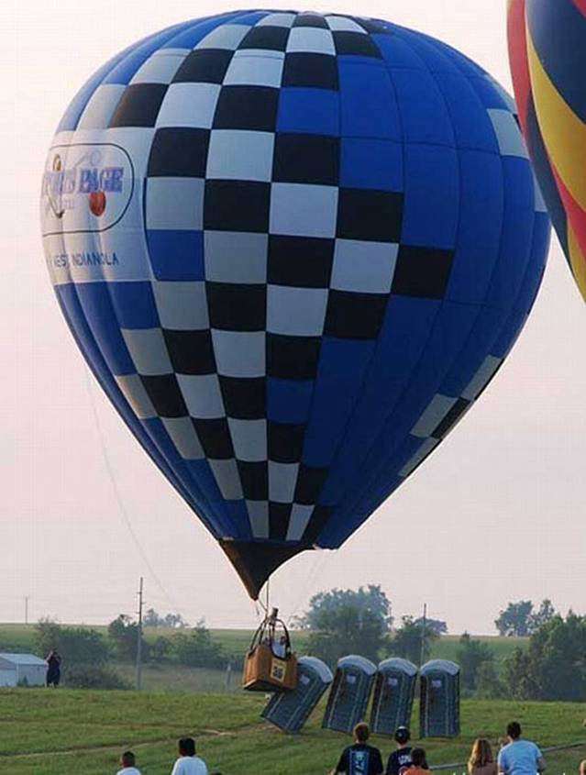
What Did We Hit?

Slide 15
What do NGSS and Common Core ask for?
Common Core | NGSS
Speaking and Listening: • Engage effectively in a range of collaborative discussions (one-on-one, in groups, and teacher-led) with diverse partners on topics and texts, building on others’ ideas and expressing their own clearly. Reading: • Ask and answer questions to demonstrate understanding of text, referring explicitly to the text as the basis for the answers. • Quote accurately from a text when explaining what the text says explicitly and when drawing inferences from the text. Writing: • Write informative/explanatory texts in which they introduce a topic, use facts and definitions to develop points, and provide a concluding statement or section. • Write arguments to support claims in an analysis of substantive topics or texts using valid reasoning and relevant and sufficient evidence. | Performance Expectations MS-PS2-2 Plan an investigation to provide evidence that the change in an object’s motion depends on the sum of the forces on the object and the mass of the object. MS-ETS1-2 Evaluate competing design solutions using a systematic process to determine how well they meet the criteria and constraints of the problem. Cross Cutting Concepts Cause and Effect relationships may be used to predict phenomena in natural or designed systems. Other PEs • Plan and carry out investigations … • Make observations and collect data … • Gather and make sense of information • Construct an argument supported by evidence
Handout page 5

Slide 16
Sacramento Area Science Project – Science Literacy Framework ©

