Slide 1
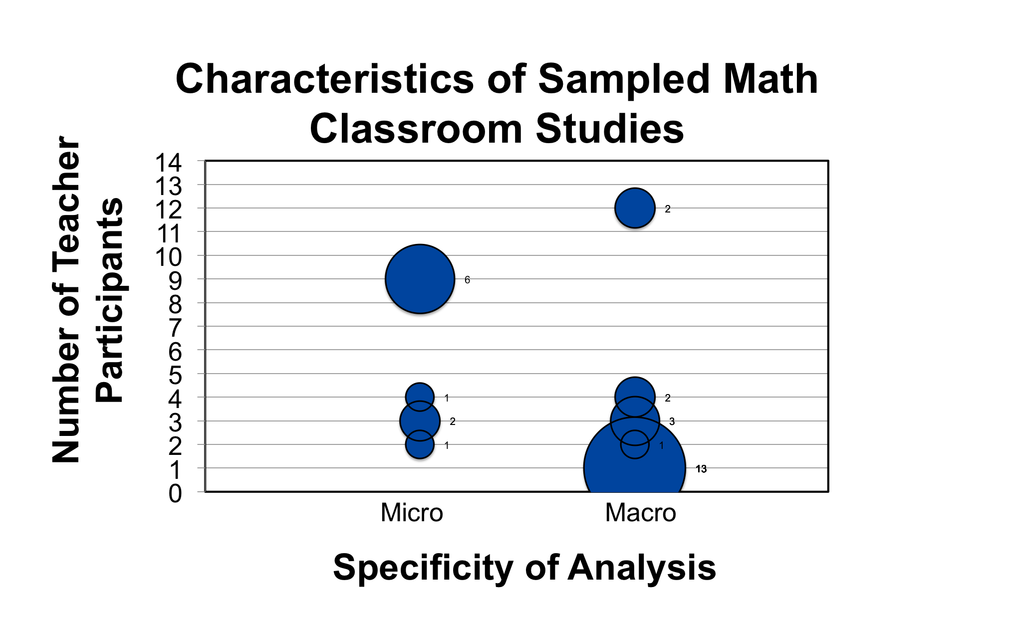
CLASSROOM DISCUSSION OBSERVATION INSTRUMENT
Rachel Restani, Rebecca Ambrose, Leslie Banes, and Heather Martin
University of California, Davis
Motivating Question
Number of Teachers & Level of
Analysis Vary in Studies
Pilot Observations
Our Conditions
Which methods of observation are currently used to measure effective mathematics classroom discussions?
Researchers spent 5 months piloting the instrument using 7 classrooms and 4 video clips of mathematic classroom discussions
Based on the pre-existing literature, we scored each category on a scale of 0 to 4. Zero meant the element did not occur at all. Low level scores were more teacher-centered. High level scores were more student centered.
Our sample size of teachers was larger than any of the other studies (n=20).
Unlike QUASAR teachers (Stein et al., 1996), ours did not have choice of tasks because mandated text book with pacing guide.
Akkus & Hand (2010) focused on cognitive demand and teacher questioning. We wanted to include attention to students mathematical thinking.
Unlike Truxaw and DeFranco (2008), we did not transcribe, so we did not code utterances.
Effective Math Class Discussions
Students actively participate by listening, speaking and engaging in thinking about mathematical ideas (Forman et al.1998).
Bubble size corresponds to number of studies with same characteristics
Discussion Central to Learning
Social interactions can cause cognitive conflicts in kids, forcing them to reorganize their mathematical ways of knowing (Cobb, 1993).
Elements of Observation Instrument
Why Measure Classroom Discussion?
Variety of approaches | Explanations | Opportunities to speak | Equitable participation | Connections
Quantity of distinct student-chosen approaches and tools used across the classroom to complete the task. | Quality of mathematical explanations by teacher and students. Degree to which they are conceptual, meaningful, and thorough. | Frequency and length of turn in partners or whole-class discussion. | Number of students who shared independent thinking verbally and non-verbally in whole-class discussion | Quality of connections between ideas, strategies, concepts, or representations by teacher and students.
Eventually to correlate characteristics of discussion related to student and teacher learning.
*Snowball search method, not exhaustive.
* TIMSS studies-
Observation Instrument Needed
Macro analytical studies capture the overall content of the conversation.
Micro analytical studies focus on the frequency and types of phrases being said by individuals. (Requires transcripts of discussion).
To analyze the amount of student talk
To compare discussions across classrooms
Participating in classroom discussions does
not ensure student learning (Kosko &
Miyaski, 2012). Examining the content quality of mathematics discussion is important.
To determine the impact of professional development
Characteristics of Other Instruments
Authors | Grade | # of Observations | Emphasis
Stein et al. 1996; Hennigsen et al. 1997 | Middle | 27 per teacher over 3 years (12 teachers) | Cognitive demand of task (memorizing facts to doing math)
Truxaw & DeFranco, 2008 | Middle (5-8) | 23 (3 teachers) | Univocal to dialogic types of talk
Hufferd-Ackles, 2004 | 3rd | 2 times per week for 1 year (1 teacher) | Teacher centered to student centered math talk
Akkus & Hand, 2011 | Algebra | 30 per teacher over 1 year (3 teachers) | Amount of teacher questioning
Future Math Classroom Studies
References
Need larger sample size for statistical significance
Consistent, metrics capturing multiple factors of discussion
Akkus, R., & Hand, B. (2011). Examining teacher’s struggles as they attempt to implement dialogical interaction as part of promoting mathematical reasoning within their classrooms. International Journal of Science and Mathematics Education, 9, 975-998.
Hufferd-Ackles, K., Fuson, K. C., & Sherin, M. G. (2004). Describing Levels and Components of a Math-Talk Learning Community. Journal for Research in Mathematics Education, 35(2), 81-116.
Stein, M. K., Grover, B. W., & Hennigsen, M. (1996).
Building student Capacity for Mathematical Thinking and Reasoning: An Analysis of Mathematical Tasks Used in Reform. American Educational Research Journal, 33(2), 455-488.
No Consensus on Metrics
Each study has constraints that interfere with replicating another’s methods ie. cognitive demand, teacher constraints, video-taping, number of observations, etc.
Some researchers entered with a well-developed rubric while others created a post-hoc framework (ie. Hufferd-Ackels et al., 2004).
This project was funded by California Department of Education’s Improving Teacher Quality State Grants Program (ITQ) State Agency for Higher Education (formerly the California Postsecondary Education Commission).

