Slide 1
Making Sense, Attending to Precision and Gaining Fluency with Numbers
UCDMP 11/3/2012
Julie Orosco
Gail Standiford
Jessica Balli
Wireless access: moobilenet
email address: ucdmp@wireless.com
password: wireless

Slide 2
King Arthur’s Round table

Slide 3
King Arthur’s Round Table
If you knew how many knights were going to be at the table, how could you quickly determine where to stand so that you would win?
Interactive Mathematics Program Small World, Isn’t It?

Slide 4
Common Core State Standards for Mathematics
Two Types of Standards:
Mathematical Practice (recurring throughout the grades)
Mathematical Content (different at each grade level)
Notes:
4
4
The CCSS includes two types of standards.
The Standards for Mathematical Practice are eight standards that recur at each grade level from kindergarten through high school.
The Standards for Mathematical Content are different at each grade. They are organized into grade-level standards for kindergarten through grade eight, and into conceptual categories in high school.

Slide 5
Standards for Mathematical Practice
Make sense of problems and persevere in solving them.
Reason abstractly and quantitatively.
Construct viable arguments and critique the reasoning of others.
Model with mathematics.
Use appropriate tools strategically.
Attend to precision.
Look for and make use of structure.
Look for and express regularity in repeated reasoning.
Notes:
5
5
A summary of the eight Common Core State Standards for Mathematical Practice are listed on the slide.
The “Mathematical Practice” standards define how students develop mathematical understanding as they make sense of a problem, reason abstractly, construct arguments, model with mathematics, use tools strategically, attend to precision, and look for structure and repeated reasoning. These eight standards apply to the study of mathematics at all grades, from kindergarten through high school.

Slide 6
CCSS Mathematical Practices
REASONING AND EXPLAINING
2. Reason abstractly and quantitatively
3. Construct viable arguments are critique the reasoning of others
OVERARCHING HABITS OF MIND
1. Make sense of problems and perseveres in solving them
6. Attend to precision
OVERARCHING HABITS OF MIND
1. Make sense of problems and perseveres in solving them
6. Attend to precision
MODELING AND USING TOOLS
4. Model with mathematics
5. Use appropriate tools strategically
SEEING STRUCTURE AND GENERALIZING
7. Look for and make use of structure
8. Look for and express regularity in repeated reasoning

Slide 7
Standards for Mathematical Practice
Make sense of problems and persevere in solving them.
Reason abstractly and quantitatively.
Construct viable arguments and critique the reasoning of others.
Model with mathematics.
Use appropriate tools strategically.
Attend to precision.
Look for and make use of structure.
Look for and express regularity in repeated reasoning.
Notes:
7
7
A summary of the eight Common Core State Standards for Mathematical Practice are listed on the slide.
The “Mathematical Practice” standards define how students develop mathematical understanding as they make sense of a problem, reason abstractly, construct arguments, model with mathematics, use tools strategically, attend to precision, and look for structure and repeated reasoning. These eight standards apply to the study of mathematics at all grades, from kindergarten through high school.

Slide 8
SMP 1: Make Sense of Problems and persevere in Solving THem
What does it mean to:
“Make sense of problems and persevere in solving them”?
At your table, Round Robin* your thoughts about what this SMP means.
*Round Robin: moving around the table clockwise, each person at the table states one thought/answer to a prompt.

Slide 9
SMP 1: Make Sense of Problems and persevere in Solving THem
Mathematically proficient students:
start by explaining to themselves the meaning of a problem and looking for entry points to its solution.
analyze givens, constraints, relationships, and goals.
make conjectures about the form and meaning of the solution.
plan a solution pathway rather than simply jumping into a solution attempt.

Slide 10
SMP 1: Make Sense of Problems cont.
consider analogous problems, and try special cases and simpler forms of the original problem in order to gain insight into its solution.
monitor and evaluate their progress and change course if necessary.
check their answers to problems using a different method.
continually ask themselves, “Does this make sense?”
understand the approaches of others to solving complex problems and identify correspondences between approaches.

Slide 11
Making Sense of Problems and Persevering
In 6th – 8th grades, students solve real world problems through the application of algebraic and geometric concepts. They ask themselves, “What is the most efficient way to solve the problem?”, “Does this make sense?”, and “Can I solve the problem in a different way?”

Slide 12
Making Sense of Problems and Persevering
High school students analyze givens, constraints, relationships, and goals. They make conjectures about the form and meaning of the solution and plan a solution pathway rather than simply jumping into a solution attempt. By high school, students can explain correspondences between equations, verbal descriptions, tables, and graphs or draw diagrams of important features and relationships, graph data, and search for regularity or trends.

Slide 13
SMP 6: Attend to precision
What does it mean to:
“Attend to precision”?
At your table, Round Robin* your thoughts about what this SMP means.
*Round Robin: moving around the table clockwise, each person at the table states one thought/answer to a prompt.

Slide 14
SMP 6: Attend to precision
Mathematically proficient students:
try to communicate precisely to others.
try to use clear definitions in discussion with others and in their own reasoning.
state the meaning of the symbols they choose, including using the equal sign consistently and appropriately.
carefully specify units of measure and label axes to clarify the correspondence with quantities in a problem.
calculate accurately and efficiently, express numerical answers with a degree of precision appropriate for the problem context.

Slide 15
Attending to precision
In grades 6 – 8, students continue to refine their mathematical communication skills by using clear and precise language in their discussions with others and in their own reasoning. Students use appropriate terminology when referring to rates, ratios, geometric figures, data displays, components of expressions, equations or inequalities, probability models, the number system and functions.

Slide 16
Attending to precision
High school students try to communicate precisely to others by using clear definitions in discussion with others and in their own reasoning. They state the meaning of the symbols they choose, specifying units of measure, and labeling axes to clarify the correspondence with quantities in a problem. They calculate accurately and efficiently, express numerical answers with a degree of precision appropriate for the problem context. By the time they reach high school they have learned to examine claims and make explicit use of definitions.

Slide 17
Grade 7 Mathematics Sample ER Item
Consider a circle that has a circumference of 28𝜋centimeters (cm).
Part A What is the area, in cm², of this circle? Show all work necessary to justify your response.
Part B What would be the measure of the radius, in cm, of a circle with an area that is 20% greater than the circle in Part A? Show all work necessary to justify your response.
Standard(s): 7.G.4, 7.RP.3
Mathematical Practice(s): 1, 2, 6

Slide 18
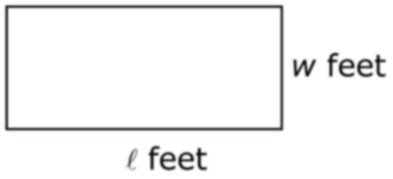
HS Mathematics Sample ER Item
The length, , and width, w, of the rectangle shown below have values that are rational numbers.
Construct an informal proof that shows that the value of the area, in square feet, of the rectangle must be a rational number.
Standard(s): N-RN.3
Mathematical Practice(s): 1, 3, 6

Slide 19
Postage Stamps
The post office has only 5¢ and 7¢ stamps. By combining different number of 5¢ and 7¢ stamps, customers can usually get the amount of postage they need.
Which amounts of postage is it impossible to make using only 5¢ and 7¢ stamps?

Slide 20
K-8 Domains
The Number System
High School Categories
Number and Quantity
And MODELING!

Slide 21
Grade 6: The Number System
Conceptual understanding and fluency with operations involving whole numbers, fractions, and decimals are critical for students’ success in mathematics at later grades.
In the CCSS, sixth-grade students apply and extend their previous understanding of numbers to the system of rational numbers, which includes negative numbers.
Sixth-graders apply properties of operations to add and subtract rational numbers.

Slide 22
Grades 7-8: The Number System
Seventh-grade students apply and extend previous understandings of operations with fractions to add, subtract, multiply, and divide rational numbers, which include negative numbers.
Students understand that properties of operations, such as the distributive property, apply to all rational numbers.
Ultimately, students use the four operations with rational numbers to solve real-world and mathematical problems.
Irrational numbers are introduced in seventh grade. Students use rational approximations of irrational numbers.

Slide 23
High School-Number and Quantity
Students will be exposed to the complex numbers. The commutative, associative, and distributive properties extend the properties of operations to the integers, rational numbers, real numbers, and complex numbers. Extending the properties of exponents leads to new and productive notation.
Students encounter a wider variety of units in modeling, e.g. acceleration, currency conversions, derived quantities such as person-hours and heating degree days, social science rates such as per-capita income, and rates in everyday life such as points scored per game or batting averages. They also encounter novel situations in which they themselves must conceive the attributes of interest.

Slide 24
Number in the CCSS-M
Look at the Number and Quantity standards at your grade level.
How are they the same as your old standards?
How are they different?
Where they are different…
Which of these new concepts can you easily integrate into your current teaching? With what old standards do they fit?
Which current number standards are not included in the CCSS? Can these standards be deemphasized to make room for the inclusion of new content?

Slide 25
Smarter Balanced Assessment
The Smarter Balanced Assessment Consortium is creating next-generation assessments aligned to the Common Core State Standards (CCSS) in English language arts/literacy and mathematics.
Just as the CCSS describe the knowledge and skills students need to be prepared for college and career, the system of computer adaptive assessments—including summative and formative tests—will provide important information about whether students are on track, as well as resources and tools for teachers to help students succeed.
http://www.smarterbalanced.org/wordpress/wp-content/uploads/2012/02/Smarter-Balanced-Teachers.pdf

Slide 26
SBAC Mathematics Assessment Claims
Claim 1: Concepts and Procedures (40%)
Students can explain and apply mathematical concepts and interpret and carry out mathematical procedures with precision and fluency
Claim 2: Problem Solving (20%)
Students can solve a range of complex well-posed problems in pure and applied mathematics, making productive use of knowledge and problem solving strategies
Notes:
The Mathematics Content Specifications describe the four claims and provide a set of assessment targets for each claim.
{+}
The first claim is Concepts and Procedures, which requires students to explain and apply mathematical concepts to interpret and carry out mathematical procedures with precision and fluency.
{+}
The second claim focuses on Problem Solving and requires students to solve complex mathematical problems using knowledge and problem solving strategies.
{+}
Claim 3 addresses communicating reasoning and requires students to clearly and precisely construct viable arguments to support their reasoning and to critique the reasoning of others.
{+}
And Claim 4 focuses on modeling and data analysis and requires students to analyze complex, real-world scenarios and construct and use mathematical models to interpret and solve problems.
Let’s take a closer look at an example of an assessment target.

Slide 27
SBAC Mathematics Assessment Claims
Claim 3: Communicating Reasoning (20%)
Students can clearly and precisely construct viable arguments to support their own reasoning and to critique the reasoning of others
Claim 4: Modeling and Data Analysis (20%)
Students can analyze complex, real-world scenarios and can construct and use mathematical models to interpret and solve problems
Notes:
The Mathematics Content Specifications describe the four claims and provide a set of assessment targets for each claim.
{+}
The first claim is Concepts and Procedures, which requires students to explain and apply mathematical concepts to interpret and carry out mathematical procedures with precision and fluency.
{+}
The second claim focuses on Problem Solving and requires students to solve complex mathematical problems using knowledge and problem solving strategies.
{+}
Claim 3 addresses communicating reasoning and requires students to clearly and precisely construct viable arguments to support their reasoning and to critique the reasoning of others.
{+}
And Claim 4 focuses on modeling and data analysis and requires students to analyze complex, real-world scenarios and construct and use mathematical models to interpret and solve problems.
Let’s take a closer look at an example of an assessment target.

Slide 28
Assessment Targets
Claim 1: Students can explain and apply mathematical concepts and interpret and carry out mathematical procedures with precision and fluency.
Grade Level | Number of Assessment Targets
3 | 11
4 | 12
5 | 11
6 | 10
7 | 9
8 | 10
11 | 16
Notes:
The number of Claim 1 assessment targets varies across grade levels. The assessment targets for each grade level are presented in detail in the Content Specifications and are explored in greater detail in the Grade Level Considerations training modules. For now, note that careful thought went into examining the progression of mathematical knowledge and skills as students progress from early elementary grades through high school and as students develop college and career readiness. This progression informed the development of each grade level assessment target. Also note that for high school, assessment targets are established for grade 11 only and reflect the skills and knowledge students are expected to demonstrate in order to be college and career ready.
To help use assessment targets to inform the development and review of items and tasks, let’s take a closer look at the structure of an assessment target.

Slide 29
Assessment Targets for Number
6th Grade: The Number System
B. Apply and extend previous understandings of multiplication and division to divide fractions by fractions.
C. Compute fluently with multi-digit numbers and find common factors and multiples.
D. Apply and extend previous understandings of numbers to the system of rational numbers.

Slide 30
Assessment Targets for Number
7th Grade: The Number System
B. Apply and extend previous understandings of operations with fractions to add, subtract, multiply, and divide rational numbers.
8th Grade: The Number System
A. Know that there are numbers that are not rational, and approximate them by rational numbers.

Slide 31
Assessment Targets for Number
High School: Number and Quantity
A. Extend the properties of exponents to rational exponents.
B. Use properties of rational and irrational numbers.
C. Reason quantitatively and use units to solve problems.

Slide 32
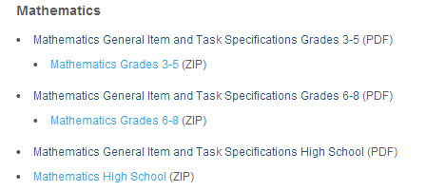
SBAC Item/Task Specifications
http://www.smarterbalanced.org/smarter-balanced-assessments/

Slide 33
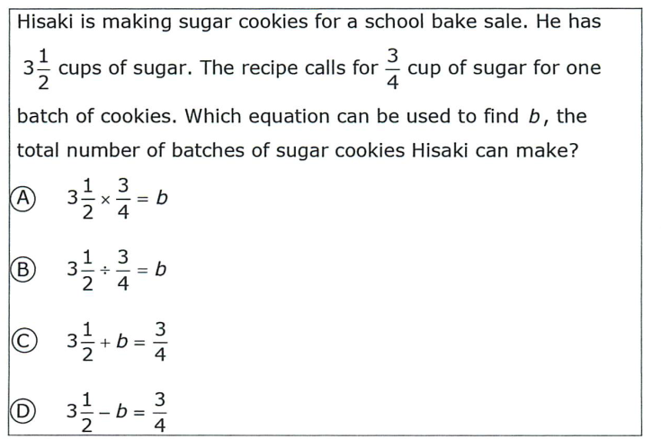
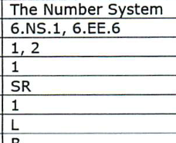
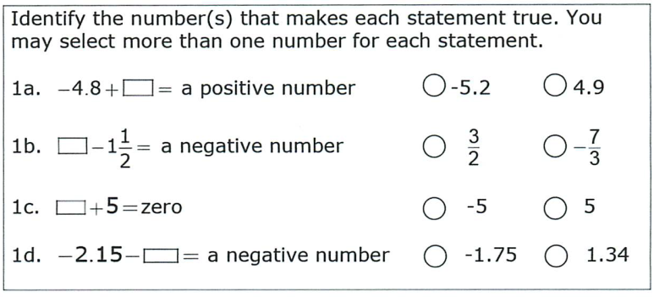
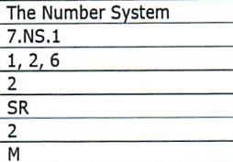

Slide 34
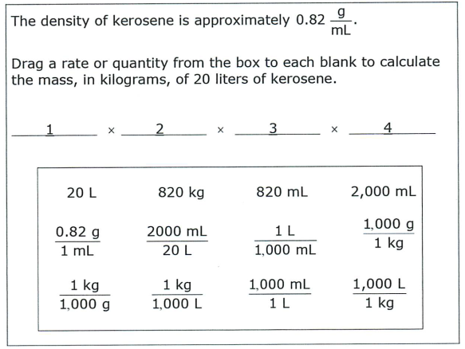
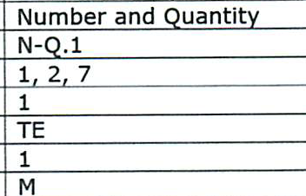
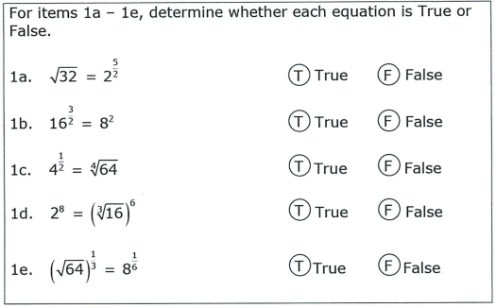
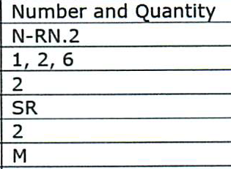

Slide 35
Smarter Balanced Assessment
Let’s take a look at some of the sample items and performance tasks recently released by SBAC
http://www.smarterbalanced.org/

