Slide 1
UCDMP Saturday Series 2013-14
The Vision of the Common Core:
Changing Beliefs,
Transforming Practice
Kindergarten – 6th Grade
Saturday, November 2, 2013
Notes:
1

Slide 2
Agenda
Introductions and Overview
Problem Solving: Equation Challenge
“Stoplight” the Content Standards
Assessment and Balance
MARS Task – Buttons
SBAC Items
LUNCH

Slide 3
Agenda
Grades K-2: Room next to us
Grades 3-5: Remain in this room
Using Games to Teach and Review Math Skills and Concepts
Planning for the CCSS-M
Sharing and Reflections

Slide 4
Wireless Access
Go to Moobilenet
Sign in information
Email address: wireless@ucdmp.edu
Password: wireless

Slide 5
Equation Challenge
Look over the problems on the page. DO NOT begin to solve anything!
Are there any questions that you want to ask BEFORE you begin to solve the problems?

Slide 6
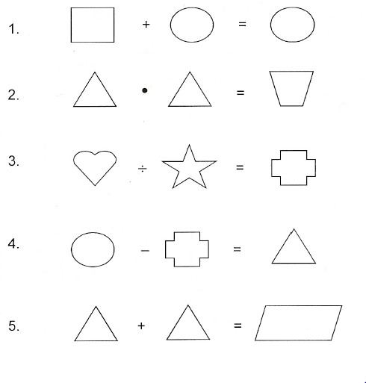

Slide 7
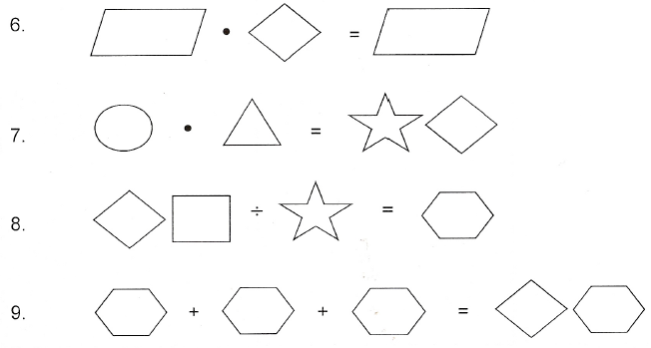

Slide 8
Equation Challenge
Work for 2 minutes on your own

Slide 11
Equation Challenge
SMP #3: Construct viable arguments and critique the reasoning of others”
Based on your work on Equation Challenge, what are characteristics of a “viable argument”?

Slide 12
AB 484
AB484 establishes the California Measurement of Academic Performance and Progress (CalMAPP) assessment system.

Slide 13
2013-2014
Field test of SBAC summative assessments for ELA and math in grades 3-8 and 11 (March 18 - June 6, 2014)
Each participating student will take either an ELA or math field test.
Grade-level science assessments (CST or alternate) in grades 5, 8, and 10
CAPA for ELA and math in grades 2-11

Slide 14
SBAC Field Test
What item types will the FT include?
A computer-based component and performance task component.
Item types will include multiple-choice, matching, fill-in tables, drag and drop, graphing, short text, long essay.
Each FT will include a performance task.

Slide 15
SBAC Field Test
Will the FT be adaptive?
No. it will give students an experience similar to that of the test
Computer based summative assessment
Performance task.
Same mix of content, item types, and cognitive complexity that will be present on the 2015 operational test.

Slide 16
SBAC Field Test
Will there be a paper-and-pencil version of the FT?
No. The FT is meant to “test the test” mimicking as close as possible the operational testing conditions.
However, beginning in the 2014-15 school year, a paper-and-pencil version will be available for up to three years

Slide 17
Stoplight the Standards
Work in grade level groups
Common Core State Standards
Former California Standards
Create a chart that shows the relationship between the CCSS-M and the previous standards

Slide 18
Stoplight the Standards
As you read each CCSS, find the former CA standard(s) that relate to that standard
Highlight in green the CC standard or parts of standards that are the same
Highlight in yellow the CC standards or parts of standards that are similar but need modifications to match
Highlight in pink the CC standards or parts of standards that are NOT the same

Slide 19
CCSS-M
Former CA
Create a poster
The first column are the (highlighted) CCSS
The second column are the former standards that are basically the same as the CCSS (green) and the former standards that are similar to the CCSS but require modification (yellow)
Set aside those standards that DO NOT match

Slide 20
Stoplight the Standards
Look at the standards that are not on the poster
What are the topics/skills that you can stop teaching right now?

Slide 21
Stoplight the Standards
Look at the standards highlighted in yellow
What are the topics/skills that you can stop teaching now?
What are the topics/skills that you need to find additional materials or lessons to teach?

Slide 22
Buttons
Inside Mathematics
Tasks and Assessments Aligned with Common Core State Standards for Mathematics
Materials and tasks for use with students
Developed by the Mathematics Assessment Resource Service (MARS)

Slide 23
Buttons
Generate and analyze patterns.
4.OA 5. Generate a number or shape pattern that follows a given rule. Identify apparent features of the pattern that were not explicit in the rule itself. For example, given the rule “Add 3” and the starting number 1, generate terms in the resulting sequence and observe that the terms appear to alternate between odd and even numbers. Explain informally why the numbers will continue to alternate in this way.

Slide 24
Buttons
Standards for Math Practice
#3 Construct viable arguments and critique the reasoning of others.
#7 Look for and make use of structure.

Slide 25
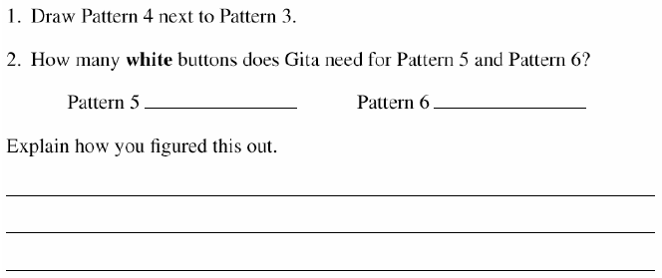

Slide 26
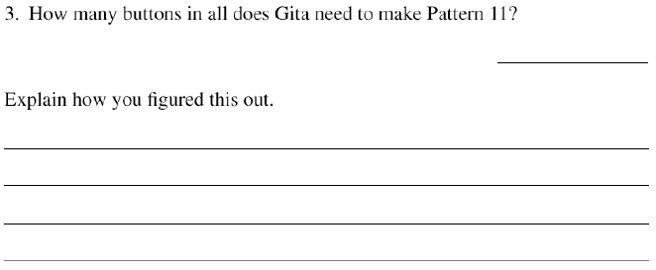

Slide 27
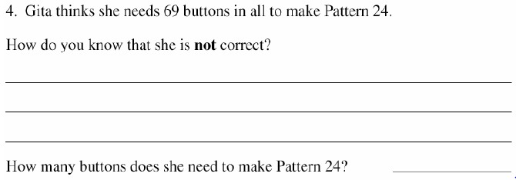

Slide 28
Balanced Assessment

Slide 29
Balanced Math Program
Conceptual Knowledge
“Why” the math works
Procedural Skills
“How” the math works
Mathematical Reasoning/Problem Solving
“Where the math works

Slide 30
Conceptual Understanding
Provides understanding of basic rules or principles that underlie the mathematics
Creates flexibility in using a variety of approaches
Enables students to detect procedural errors
Facilitates representation and translation

Slide 31
Procedures and Computation
Practice is required to become proficient
Develops over time and increases in depth and complexity
Distinguishes among different basic procedures by understanding what the procedures do

Slide 32
Mathematical Reasoning
The process of problem solving involves
Making conjectures
Recognizing existing patterns
Searching for connections to known mathematics
Translating the gist of a problem into mathematical representation

Slide 33
Mathematical Reasoning
The process of problem solving involves
Putting together different pieces of information
Developing a range of strategies to use
Verifying the correctness of the solution
Applying skills that require and strengthen student’s conceptual and procedural competencies

Slide 34
Balanced Assessments
So let’s look at a typical fraction problem
Write an assessment question that assesses a student’s conceptual understanding of division of fractions.

Slide 35
Conceptual Understanding
Show by using a drawing, model, or some other method what it means to divide by .
3 whole groups of
plus of another group.

Slide 36
Procedural Skills
Solve . Be sure to show all of your work.

Slide 37
Mathematical Reasoning
Kathy has yards of ribbon. She is making bows that use yard of material. How many bows can she make?

Slide 39
Adding 2-digit numbers
Miguel – 1st Grade
30 + 16
Connor – 1st Grade
39 + 25
Are the students’ explanations clear?
What can you tell about what they understand about adding 2-digit numbers?

Slide 40
Balanced Assessments
Grade Alike Groups
Create 3 questions, problems or tasks.
Conceptual understanding
Procedural Skill
Mathematical Reasoning / Application

Slide 41
CCSS-M SMARTER Claims
Claim #3: Communicating Reasoning
“Students can clearly and precisely construct viable arguments to support their own reasoning and to critique the reasoning of others.”

Slide 42
Smarter Balanced Assessment Consortium
Problem Types
SR – selected-response item
CR – constructed-response item
ER – extended-response item
TE – technology-enhanced item
PT – performance task

Slide 43
SBAC Items – Claim 3
3rd Grade – Number and Operations – Fractions
4th Grade – Operations and Algebraic Thinking
5th Grade - Operations and Algebraic Thinking
6th Grade – Statistics and Probability

Slide 44
SBAC
What classroom experiences do students need to have to prepare them for these types of assessment items?

Slide 45
Break-Out Groups
K-2:
3-5:

