Slide 1
School Leadership Teams
Session Four
March 2014
Educational Change Through Partnerships and Collaboration

Slide 2
Common Core and Change
“Adopting the Common Core State Standards is about change-changing curriculum, changing instruction, changing assessments, and changing the teacher’s role in the classroom.”
School Based Professional Learning for Implementing Common Core
Learning Forward 2013

Slide 3
Putting the Pieces Together
Implementation
For Deep Learning
Instructional Coherence and Consistency
Change Knowledge and Tools

Slide 4
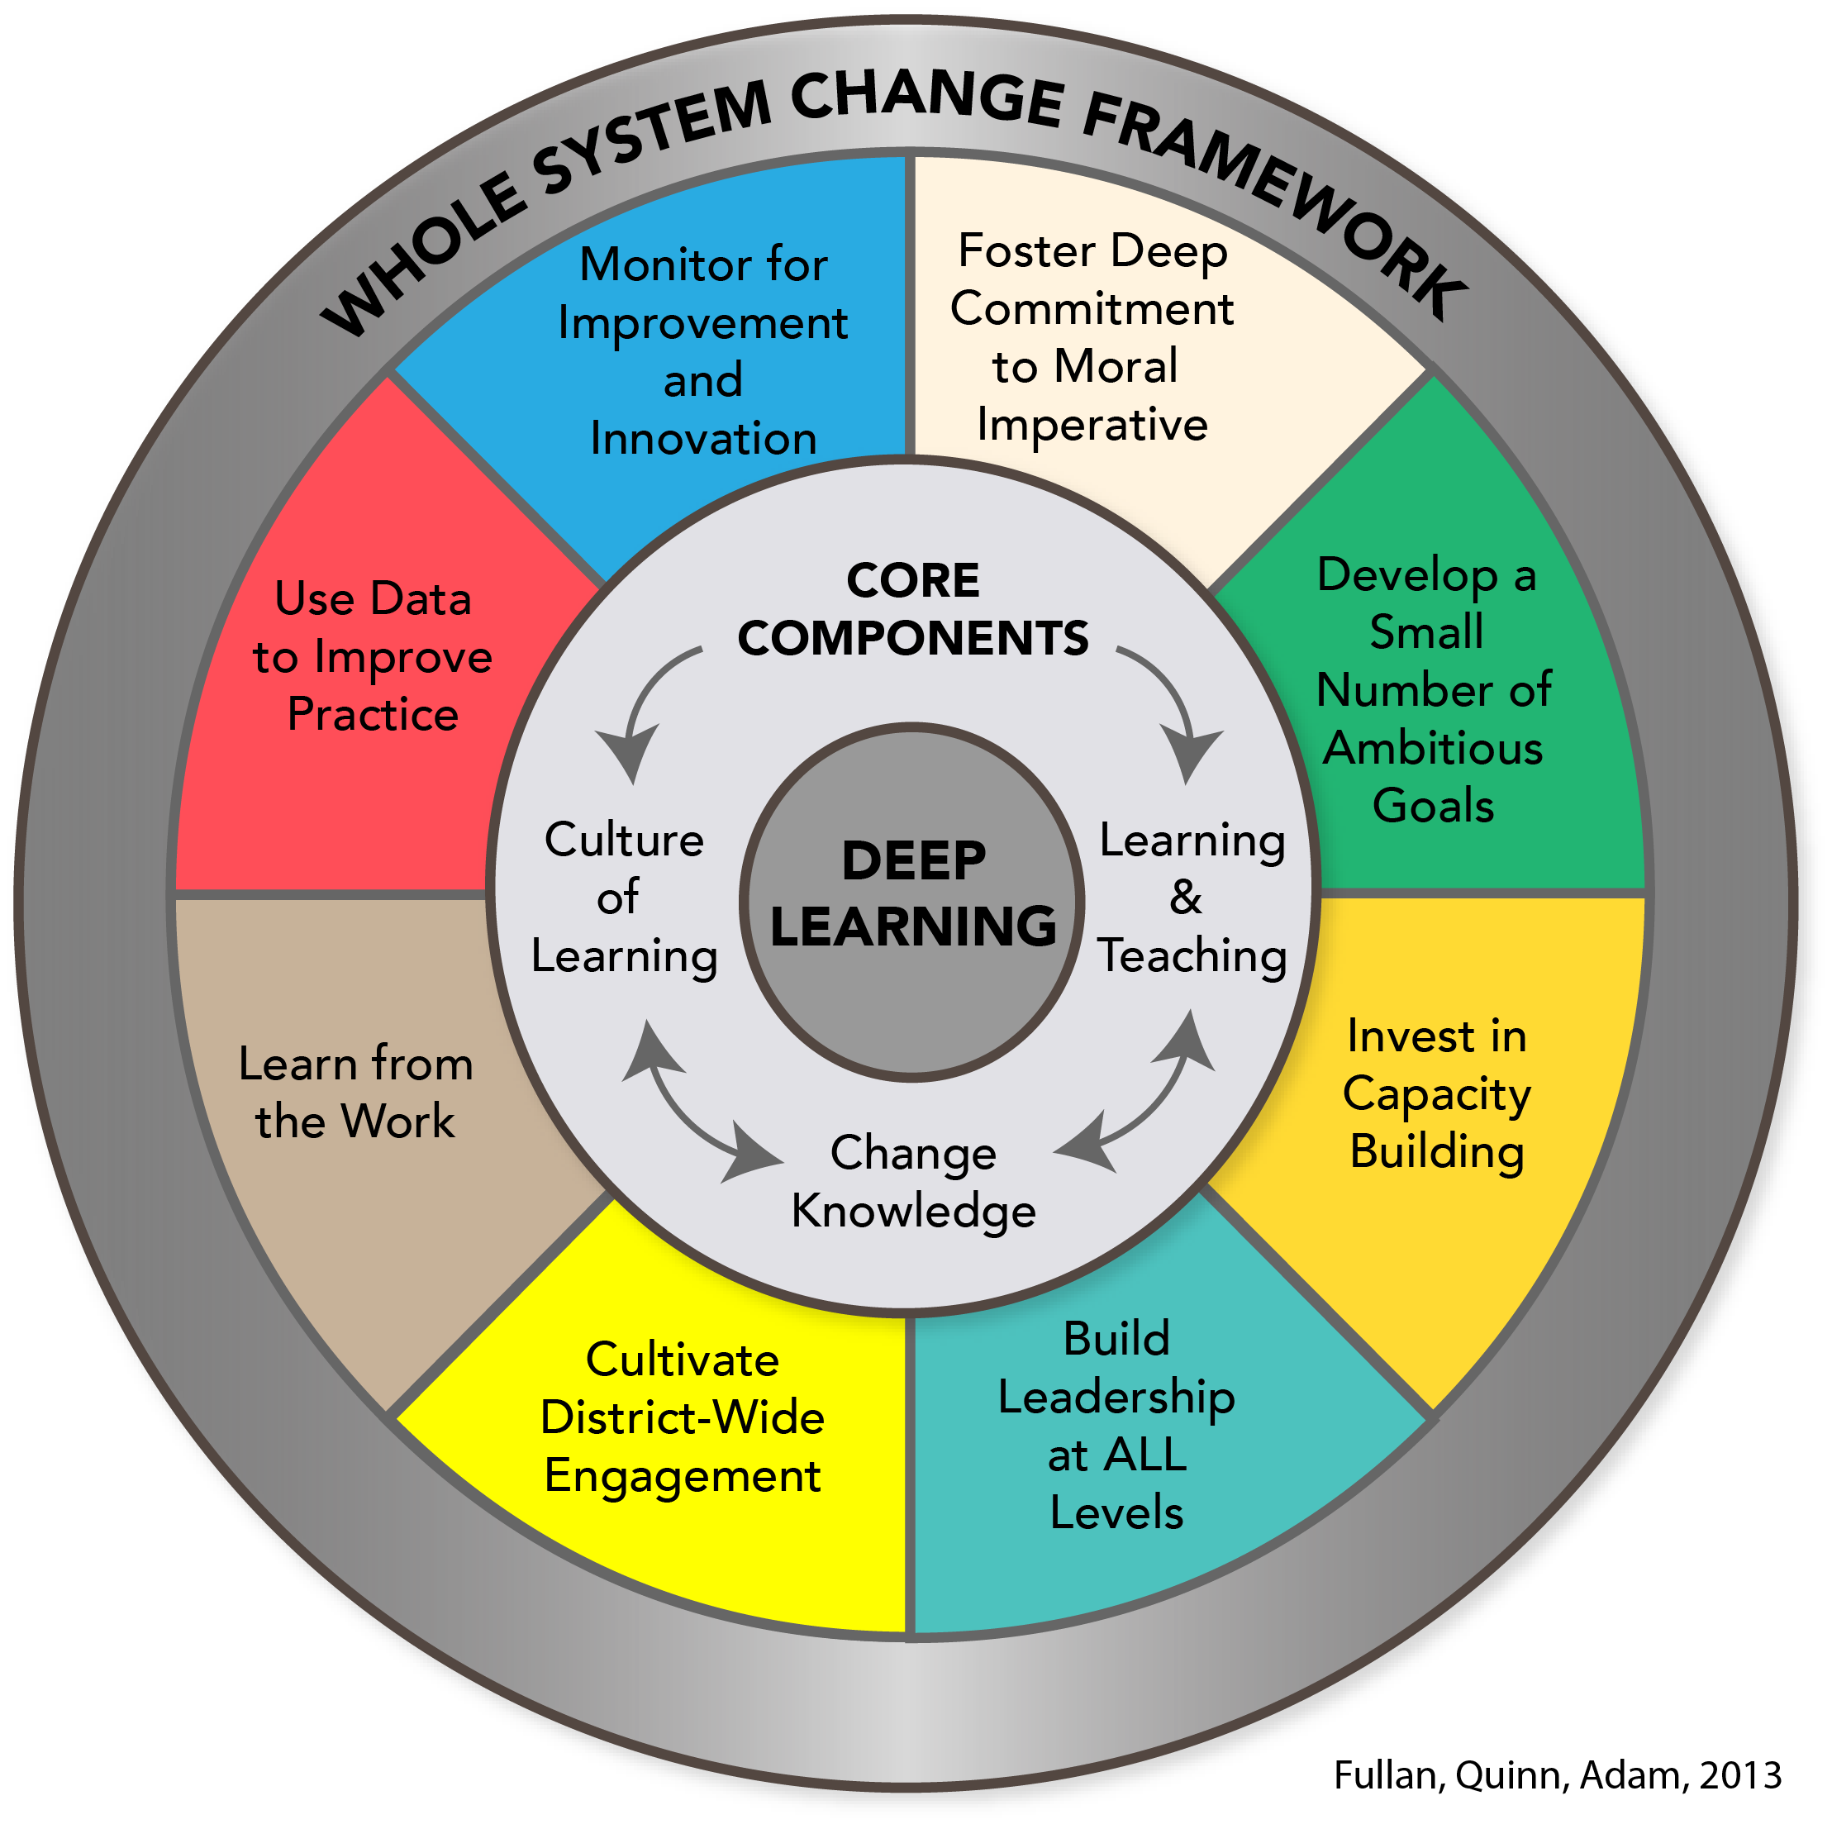

Slide 5
Agenda School Leadership Teams March 2014: Session 4
Building our Learning Community
Sharing Instructional Frameworks
Applying Change Knowledge to Implementation
4. Maximizing Impact of Professional Learning
5. Planning for Your School

Slide 6
Group Norms
Engage fully
Contribute productively
Be open to new information, possibilities
and perspectives
Respect confidentiality
Ask questions

Slide 7
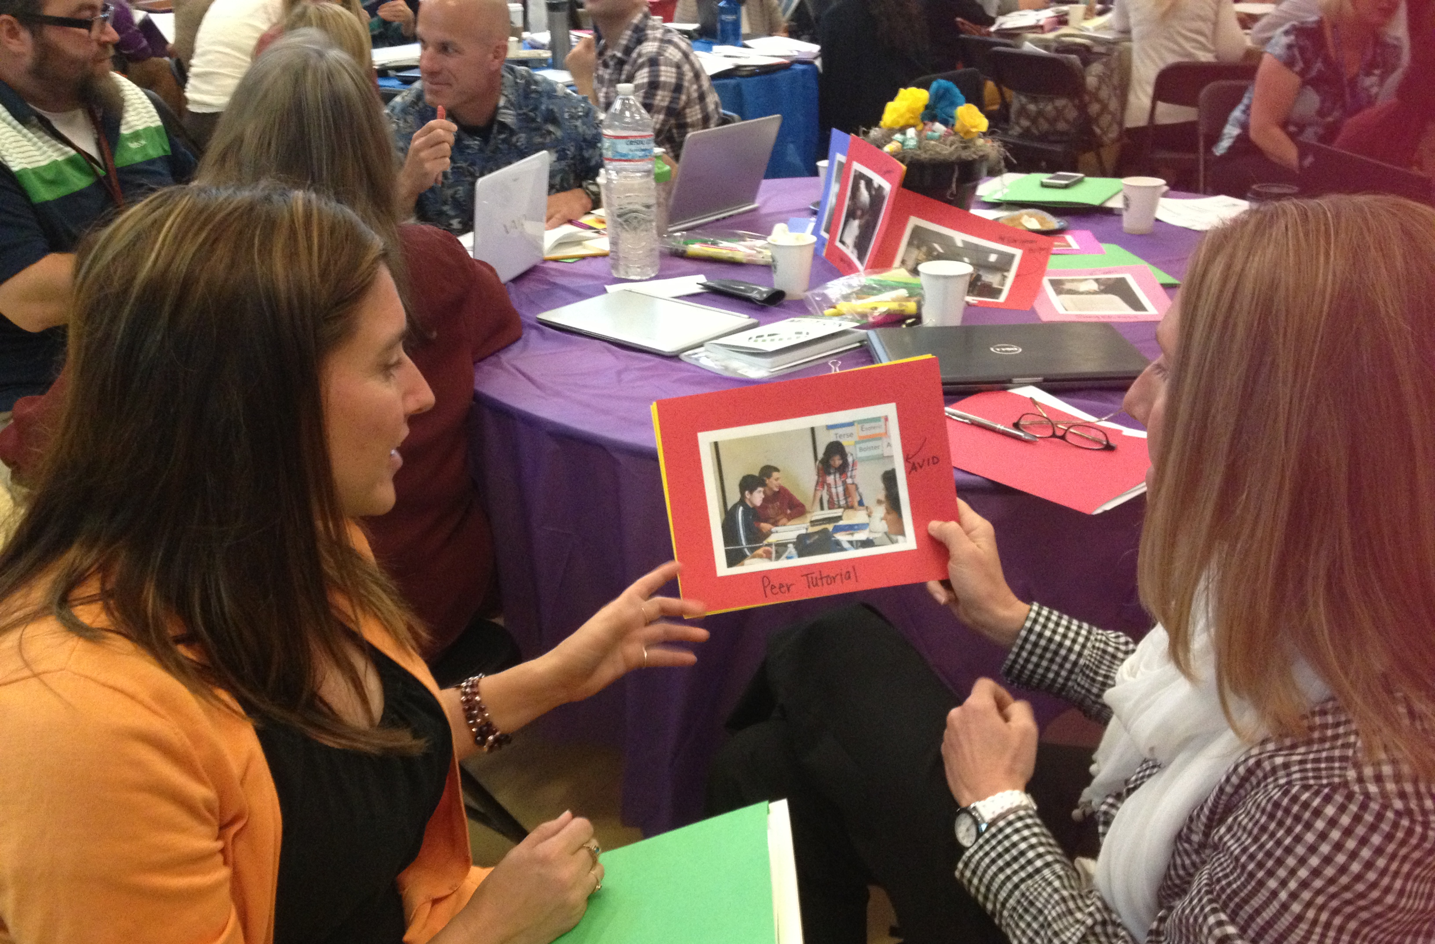
Building our Learning Community

Slide 8
Three Step Interview
Supporting the Implementation of the Common Core
Describe your school focus for implementing the common core.
Share a strategy or approach that has been successful.
What does your school need to focus on next in implementation?

Slide 9
Three Step Interview
A Interviewer
B Respondent
C Recorder
A
C
B
C Interviewer
A Respondent
B Recorder
B Interviewer
C Respondent
A Recorder

Slide 10
Three Step Interview Recording Guide
Page 3
 | Person 1 | Person 2 | Person 3
Describe your school focus for implementing the common core.
Share a strategy or approach that has been successful.
What does your school need to focus on next in implementation?

Slide 11
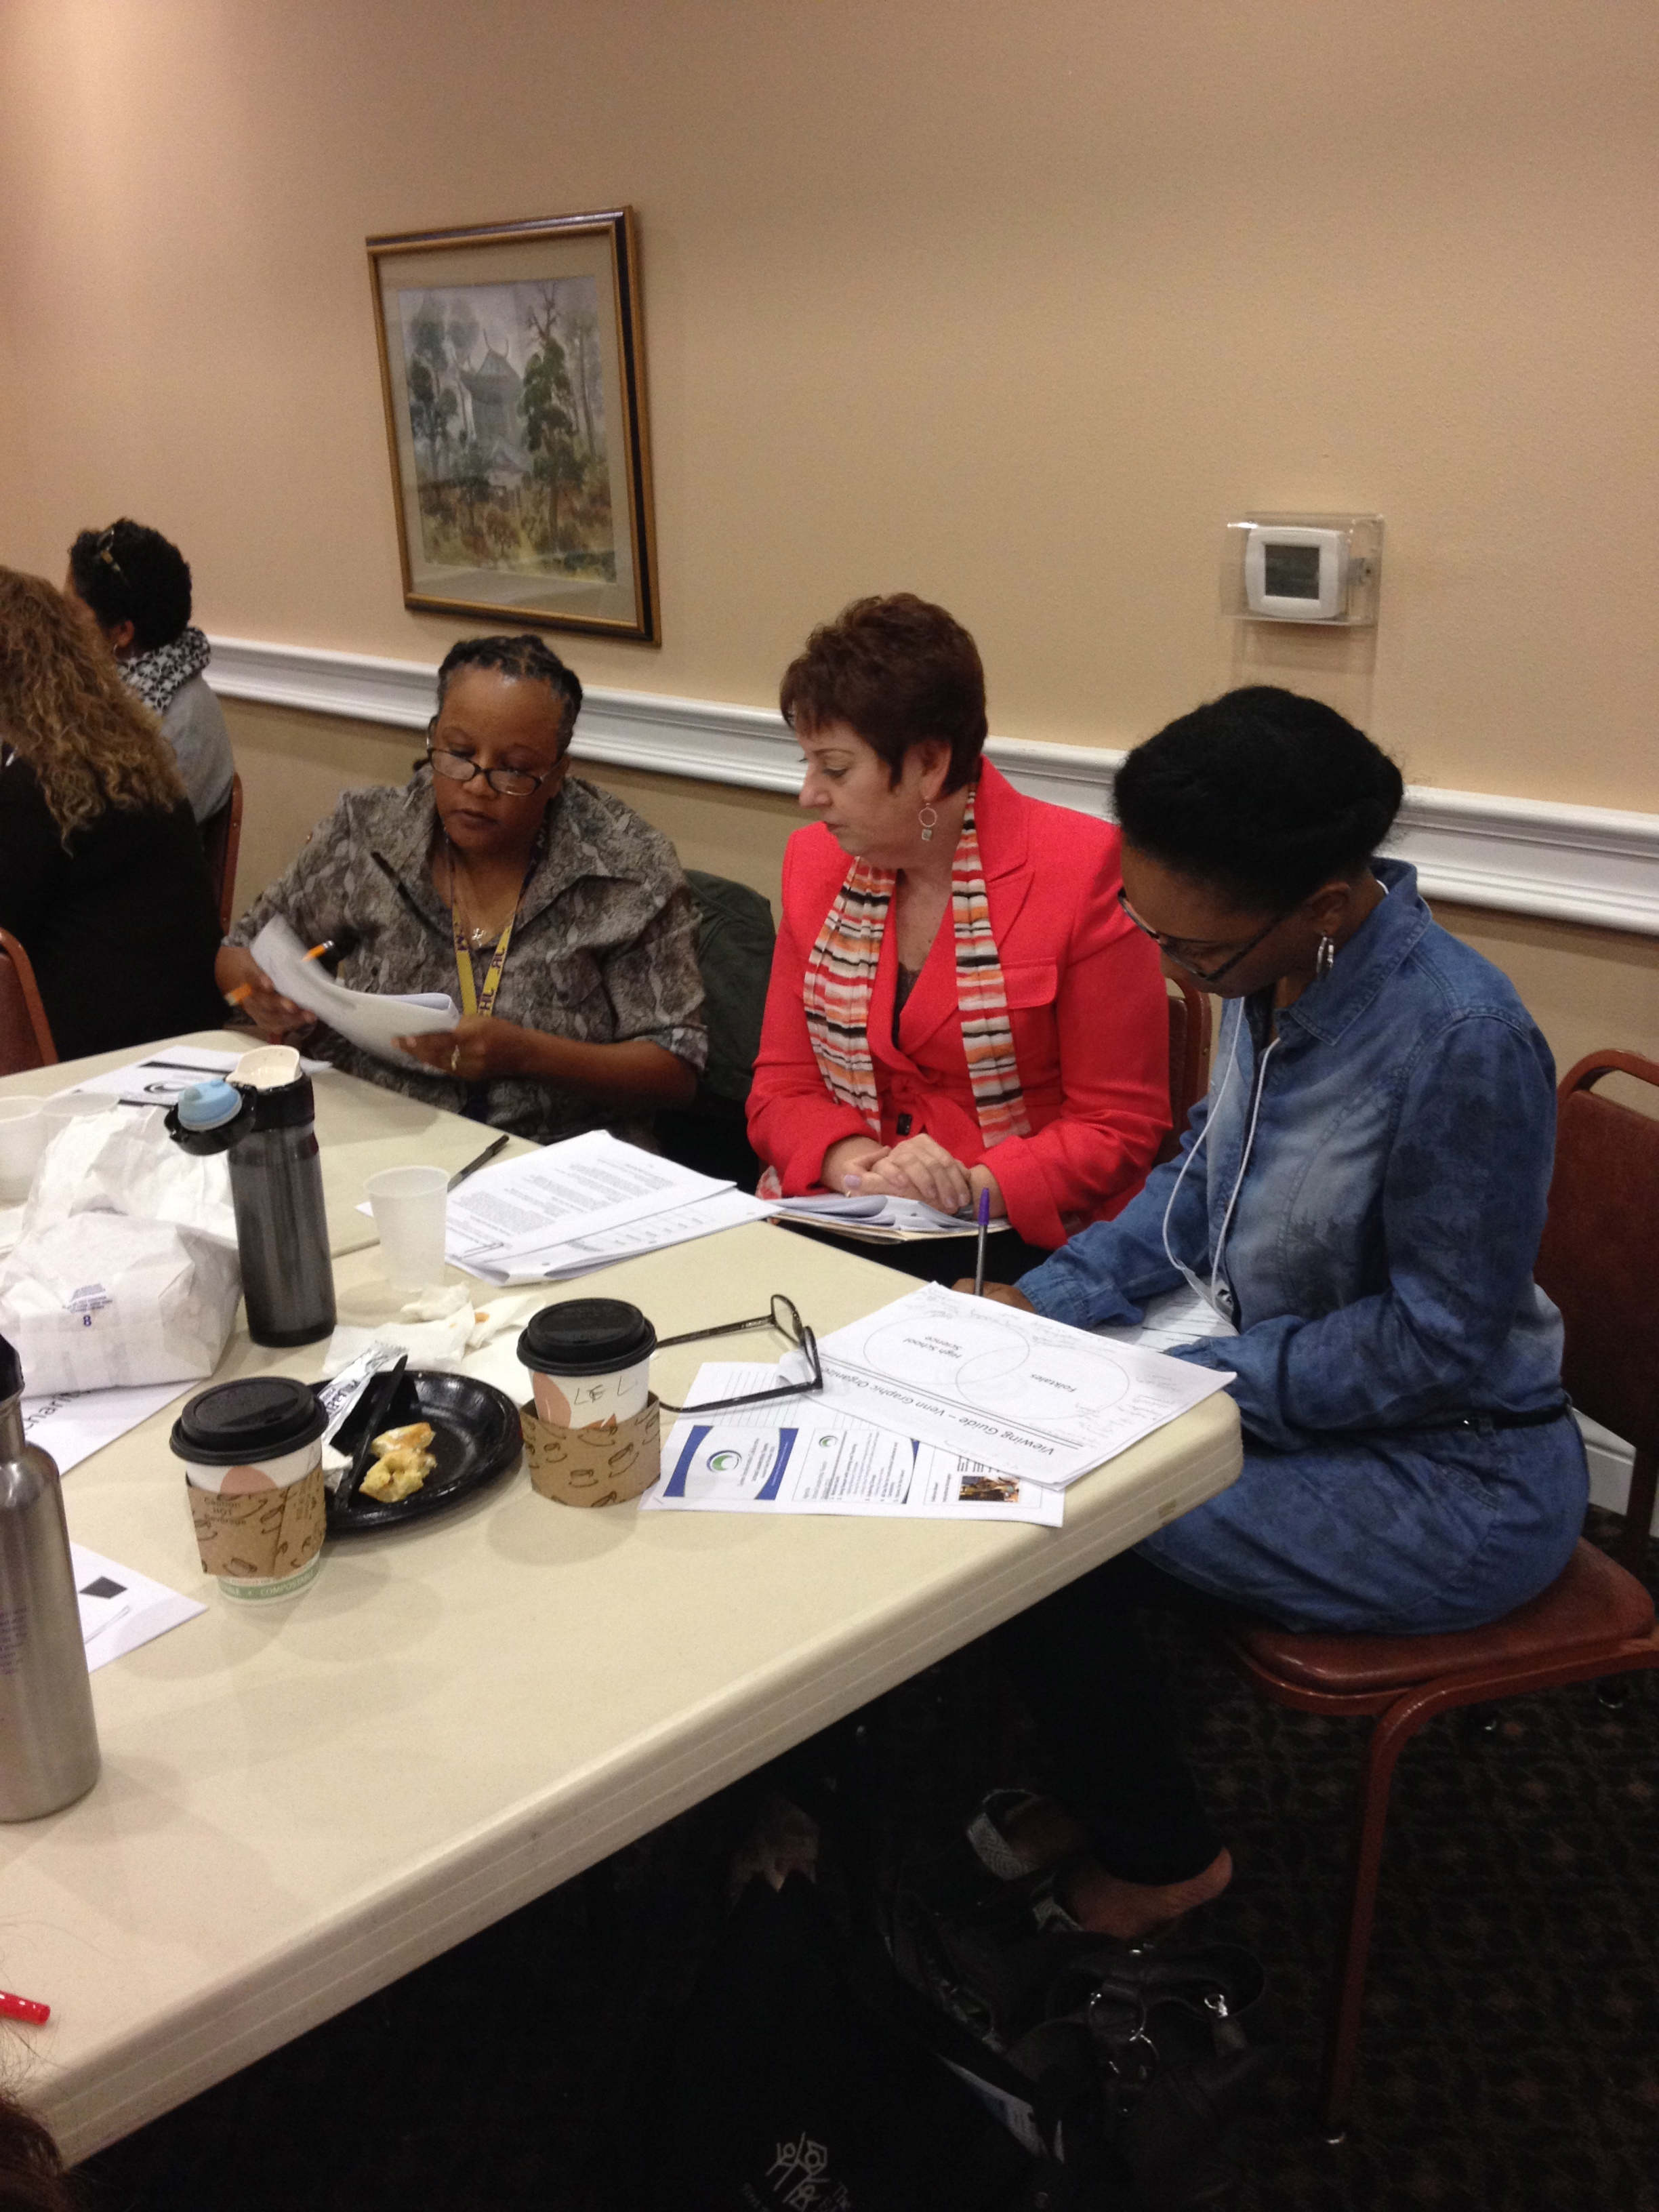
Learning From the Work

Slide 12
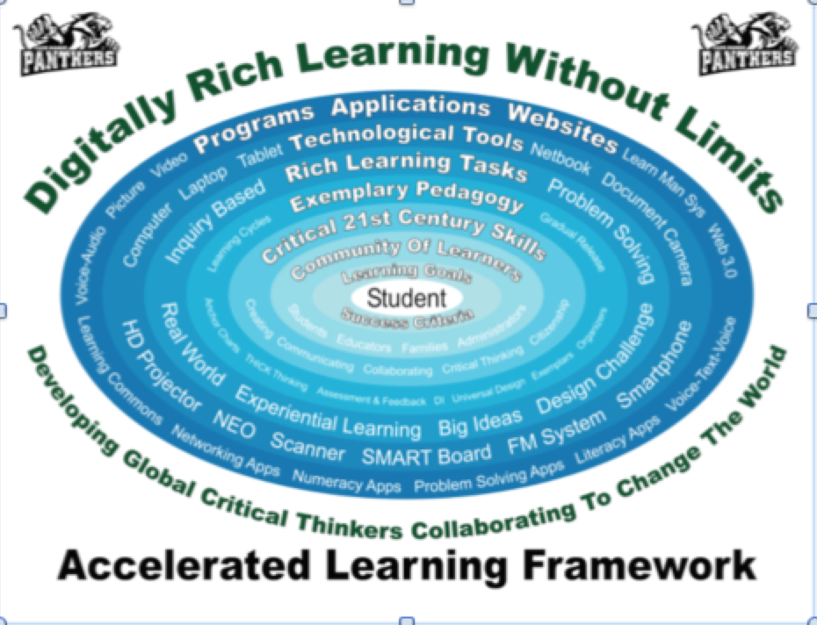
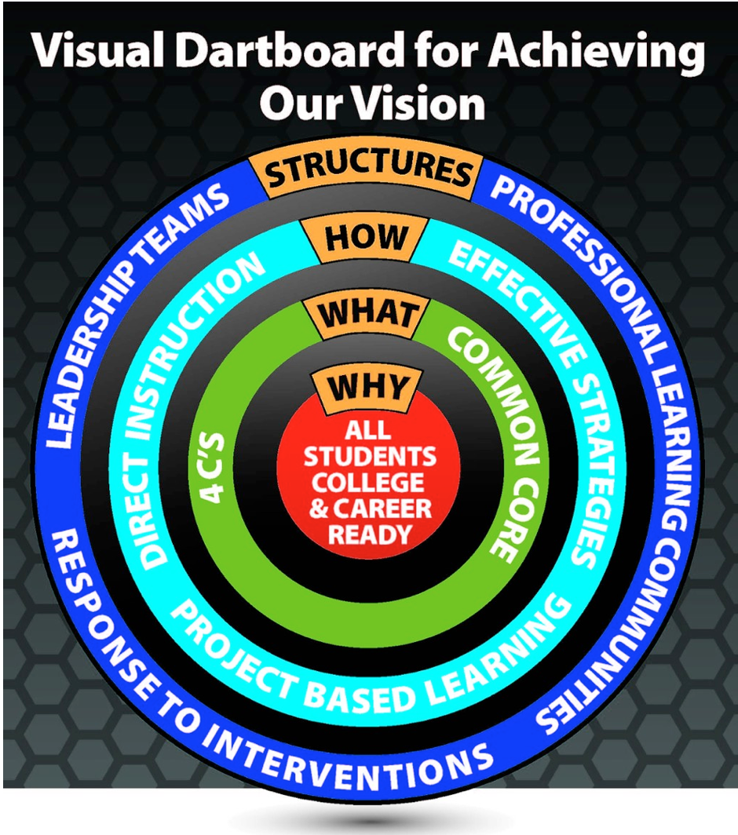
Learning from the Work
Sharing your School’s Instructional Framework

Slide 14
Learning from the Work
Take five minutes to review your Framework for Instruction.
Think about:
How does your school’s framework link to your district’s framework?
Who did you involve in creating the framework? Describe the learning in this experience.
What are the benefits in having a framework?
How will you implement with teachers?

Slide 15
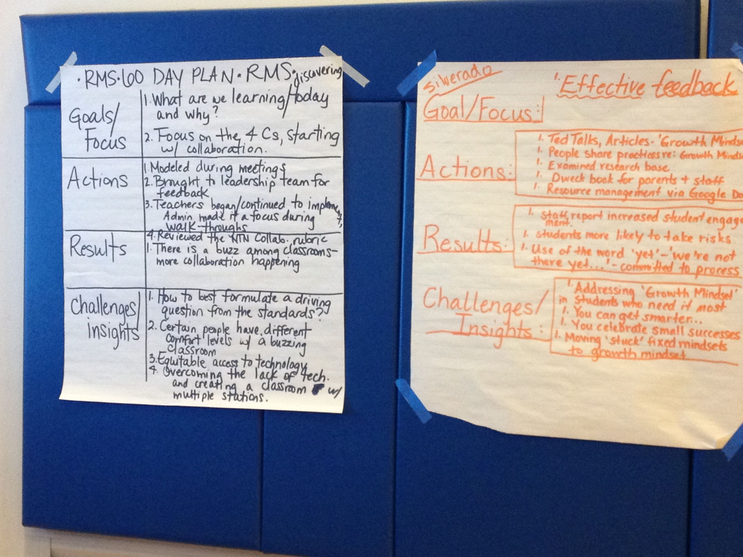
Learning from the Work
Partner with another school and post your charts side by side.
Take 5 minutes to explain your framework using the guiding questions.
Allow 3 minutes for questions
or comments.

Slide 16
Guiding Questions
Think about:
How does your school’s framework link to your district’s framework?
Who did you involve in creating the framework? Describe the learning in this experience.
What are the benefits in having a framework?
How will you implement with teachers?

Slide 17
Learning from the Work
Gallery Walk
Take 8-10 minutes to review all of the frameworks.
Use the advance organizer to record ideas you find in other frameworks.

Slide 18
Bright Ideas: Advance Organizer
Page 6
 | School | Bright Idea
1
2
3
4
5

Slide 20
Instructional Frameworks
With your team discuss how you might revise or refine your Instructional Framework.
Develop three strategies to implement the framework with faculty or a group of faculty.
Bring back your results to share at our session in May.

Slide 21
Send us your digital framework!
joannequinn08@gmail.com
eleanoradam8@gmail.com

Slide 22
Applying Change Knowledge to Implementation

Slide 23
The only person who likes change…
…is a wet baby

Slide 24
The Giant Leap….
Many policymakers and educators believe that if a school or district adopts a program…somehow it will be used effectively and student learning will improve in short measure.
This “giant leap” in thinking overlooks the significant work between adoption and student gains.
Change doesn’t just happen because we want it to or expect it to. What happens in the chasm spanned by the giant leap is implementation.
Adapted from Tobia and Hord, Making the Leap.

Slide 25
Making the Leap Jigsaw
Leadership, Learning and Successful Implementation
Edward F. Tobia and Shirley M. Hord, School Based Professional Learning for Implementing the Common Core
All Overview-v, vi & Introduction to
Making the Leap up to Creating An Atmosphere
Person One Creating an Atmosphere
Person Two Developing Shared Vision
Planning and Providing Resources
Person Three Investing in Professional Development
Checking progress
Person Four Continuing to Give Assistance
Sustainability

Slide 26
Four A’s
Text Protocol
Use this protocol to engage readers in responding to and analyzing text.
Steps:
Read individually your assigned section silently, making notes in the margin or on post its and highlighting to answer four questions:
What Assumptions do the authors of the text hold?
What do you Agree with in the text?
What do you want to Argue with in the text?
What part of the text would you like to take Action?
In a round, have each person share their assumption and citing the text as evidence.
Repeat for each of the A’s
End with an open discussion “ What are the implications of this for our work?”

Slide 27
Four A’s Text Protocol
Note-taking Organizer
Page 17
Assumptions | Agreements
Arguments | Actions

Slide 28
Change: A Personal Perspective
Turn and Talk
Think about a time you experienced a significant change in your professional life.
What was the change?
How did you deal with the change at the beginning, middle and end of the process?

Slide 29
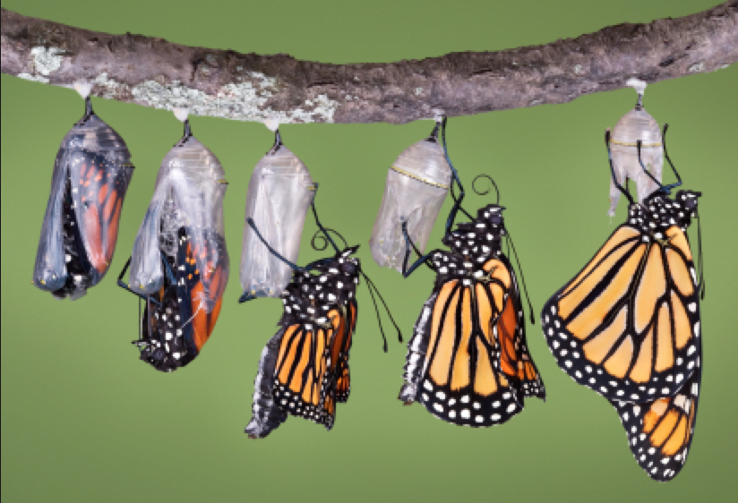
Change is….
^{CHANGE IS…}
^{A Process, not an event;}
made by individuals first, then institutions;
^{a highly personal experience.}
Change entails developmental growth in feelings and skills.
Intervention must be related to…
^{The people first,}
^{The innovation second.}

Slide 30
Reactions to Change
Feeling awkward or self-conscious.
Thinking first of what you will lose vs. what you will gain.
Feeling alone.
Overwhelmed by too many changes at once.
Experiencing different levels of readiness depending on the change.
Concerned that there will not be enough resources.
If the pressure is off, reverting back to old behaviors.

Slide 31
Concerns Based Adoption Model
Adopter Types
Stages of Concern
Innovation Configuration

Slide 32
Adopter Types
Type | Needs
“Trailblazers” or Innovators 8% of faculty | Vision and Support
“Pioneers” or Leaders 17% | Demonstration that it works
“Settlers” or Early Majority 29% | How to implement Information and Demonstrations
“Stay at Homes” or Late Majority 29% | Come for a visit but won’t stay
Resistors 17% | Don’t want to go on the journey and don’t want anyone else to go!

Slide 33
Round Robin Supporting Adopter Types
Trailblazers
Pioneers
Settlers
Stay at Homes
Resistors

Slide 34
Stages of Concern
 | CBAM | Indicators.
Non- Use | Awareness Information | Not sure what this involves? I need to know more.
Beginning | Personal | I’m not sure I can do this? How will this fit with the expectations?
Developing | Management Consequence | Where will I find time? Where will I get the resources? How is this going to impact my students? Are the students learning better?
Mastery | Collaboration Refocusing | I want to work with others on this. I have some ideas of how this can work better if we integrate…
Adapted from Hall & Hord, 1992

Slide 35
Assessing Implementation
Use the Innovation Configuration Map to assess Implementation of the Common Core in your school.
Where are you on each dimension?
Where are most teachers in your school on each dimension?
Notes:
DIFFERENCE: We will be working our brains as opposed to our abs.

Slide 36
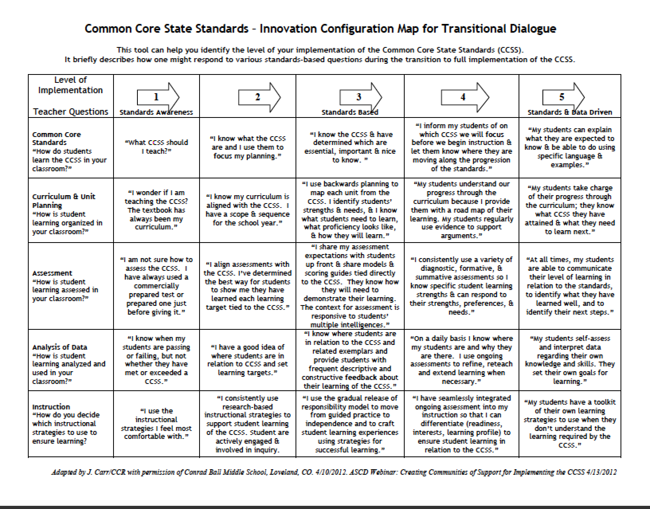
Strategies to Change Practice
Select either:
one stage of concern
(a column) or
one element of common core implementation (a row)
Identify strategies that will help teachers move from one level to the next.

Slide 37
Page 21

Slide 38
Strategies to Change Practice
Page 22
 | 1 | 2 | 3 | 4 | 5
Common core standards
Curriculum and unit planning
Assessment
Analysis of data
Instruction

Slide 39
Maximizing Impact of Professional Learning
Strengthening the Core

Slide 40
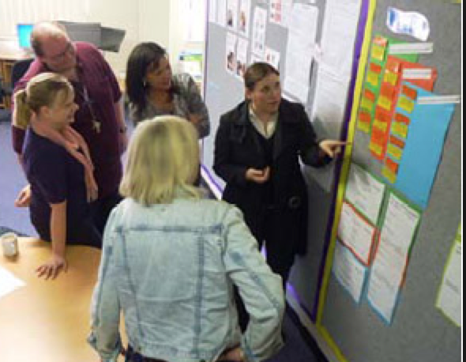
Strategies for Change
Designing Effective Professional Learning
Cultivating a Culture of Learning

Slide 41
Relationship Between Levels of Impact and Components of Learning
B. Joyce and B. Showers

Slide 42
Relationship Between Levels of Impact and Components of Learning
85% 15% 5-10%
85% 18% 5-10%
85% 80% 10-15%
90% 90% 80-90%
B. Joyce and B. Showers

Slide 43
One Step at A Time Pages 25-29 Parry Graham and Bill Ferriter JSD Summer 2008

Slide 44
Lasting Impressions Jeff Nelsen & Amalia Cuderio JSD December 2009
Pages 30-33

Slide 45
Creating a Culture of Learning
Form a group of three with colleagues from other schools.
Match up with another group of three.
Lasting Impressions
by Jeff Nelsen and Amalia Cudeiro
JSD December 2009
One Step at a Time by Parry Graham and Bill Ferriter
JSD Summer 2008

Slide 46
Before Reading Strategy Predicting: Four Corner Placemat
Page 24
Read the title and make some predications about the content. | 2. Scan the text and make a few more predictions.
3. Read the first and last paragraphs. Any new predictions? | 4. Finalize your prediction. What is this text all about?
AVID Critical Reading: Deep reading Strategies for Expository Texts
Teacher Guide 7-12 2009 San Diego

Slide 47
One Step at A Time Parry Graham & Bill Ferriter
Number off 1, 2, & 3
All: Read the introduction
Person 1: Stages 1, 2, & 3
Person 2: Stages 4 & 5
Person 3: Stages 6, 7 & conclusion

Slide 48
Lasting Impressions Jeff Nelsen & Amalia Cudeiro
Number off 1, 2, & 3
All: Read the introduction up to Making a Culture Shift
Person 1: Making a Culture Shift and Target A Few Instructional Practices
Person 2: The Model- Repeated Cycles up to Observing Colleagues
Person 3: Observing Colleagues to the conclusion

Slide 49
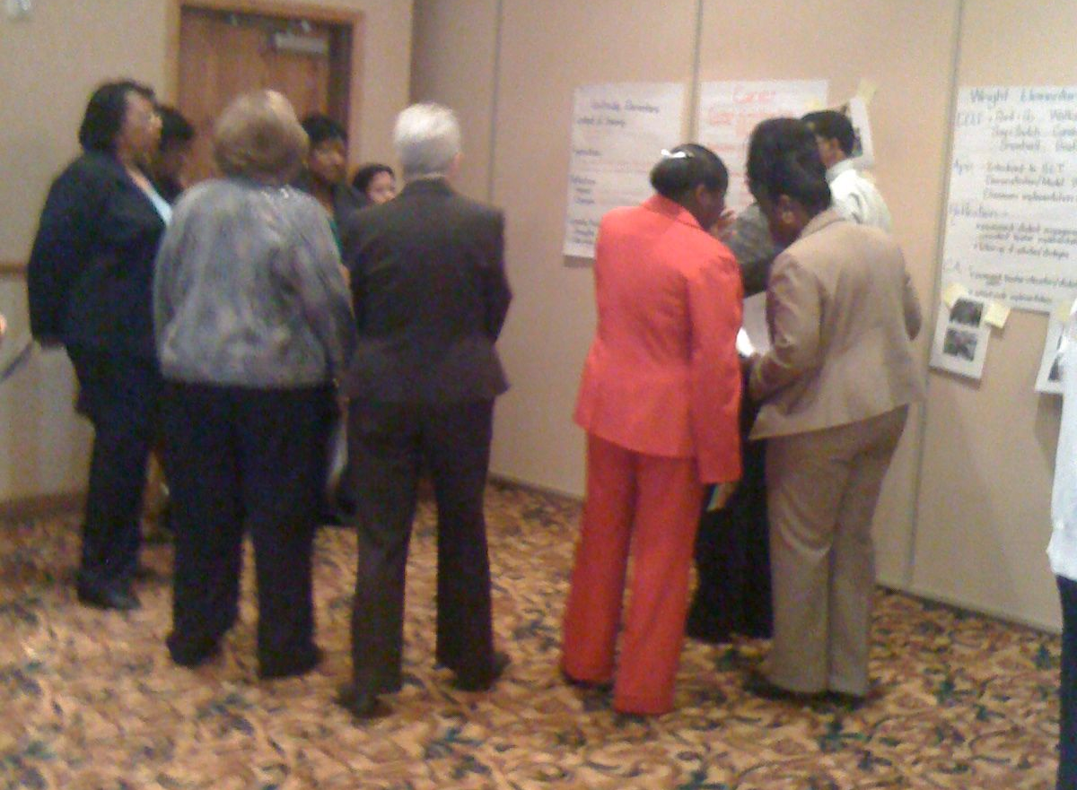
Go to the Wall
Go to the Wall is effective in chunking large amounts of content and provides for discussion and movement.
Each team is accountable for ensuring that all team members know all of the material.

Slide 50
Go to the Wall
1. As a team decide on the key ideas.
2. Create a graphic organizer to summarize the article you read.
3. Be prepared to teach the article to your colleagues.

Slide 51
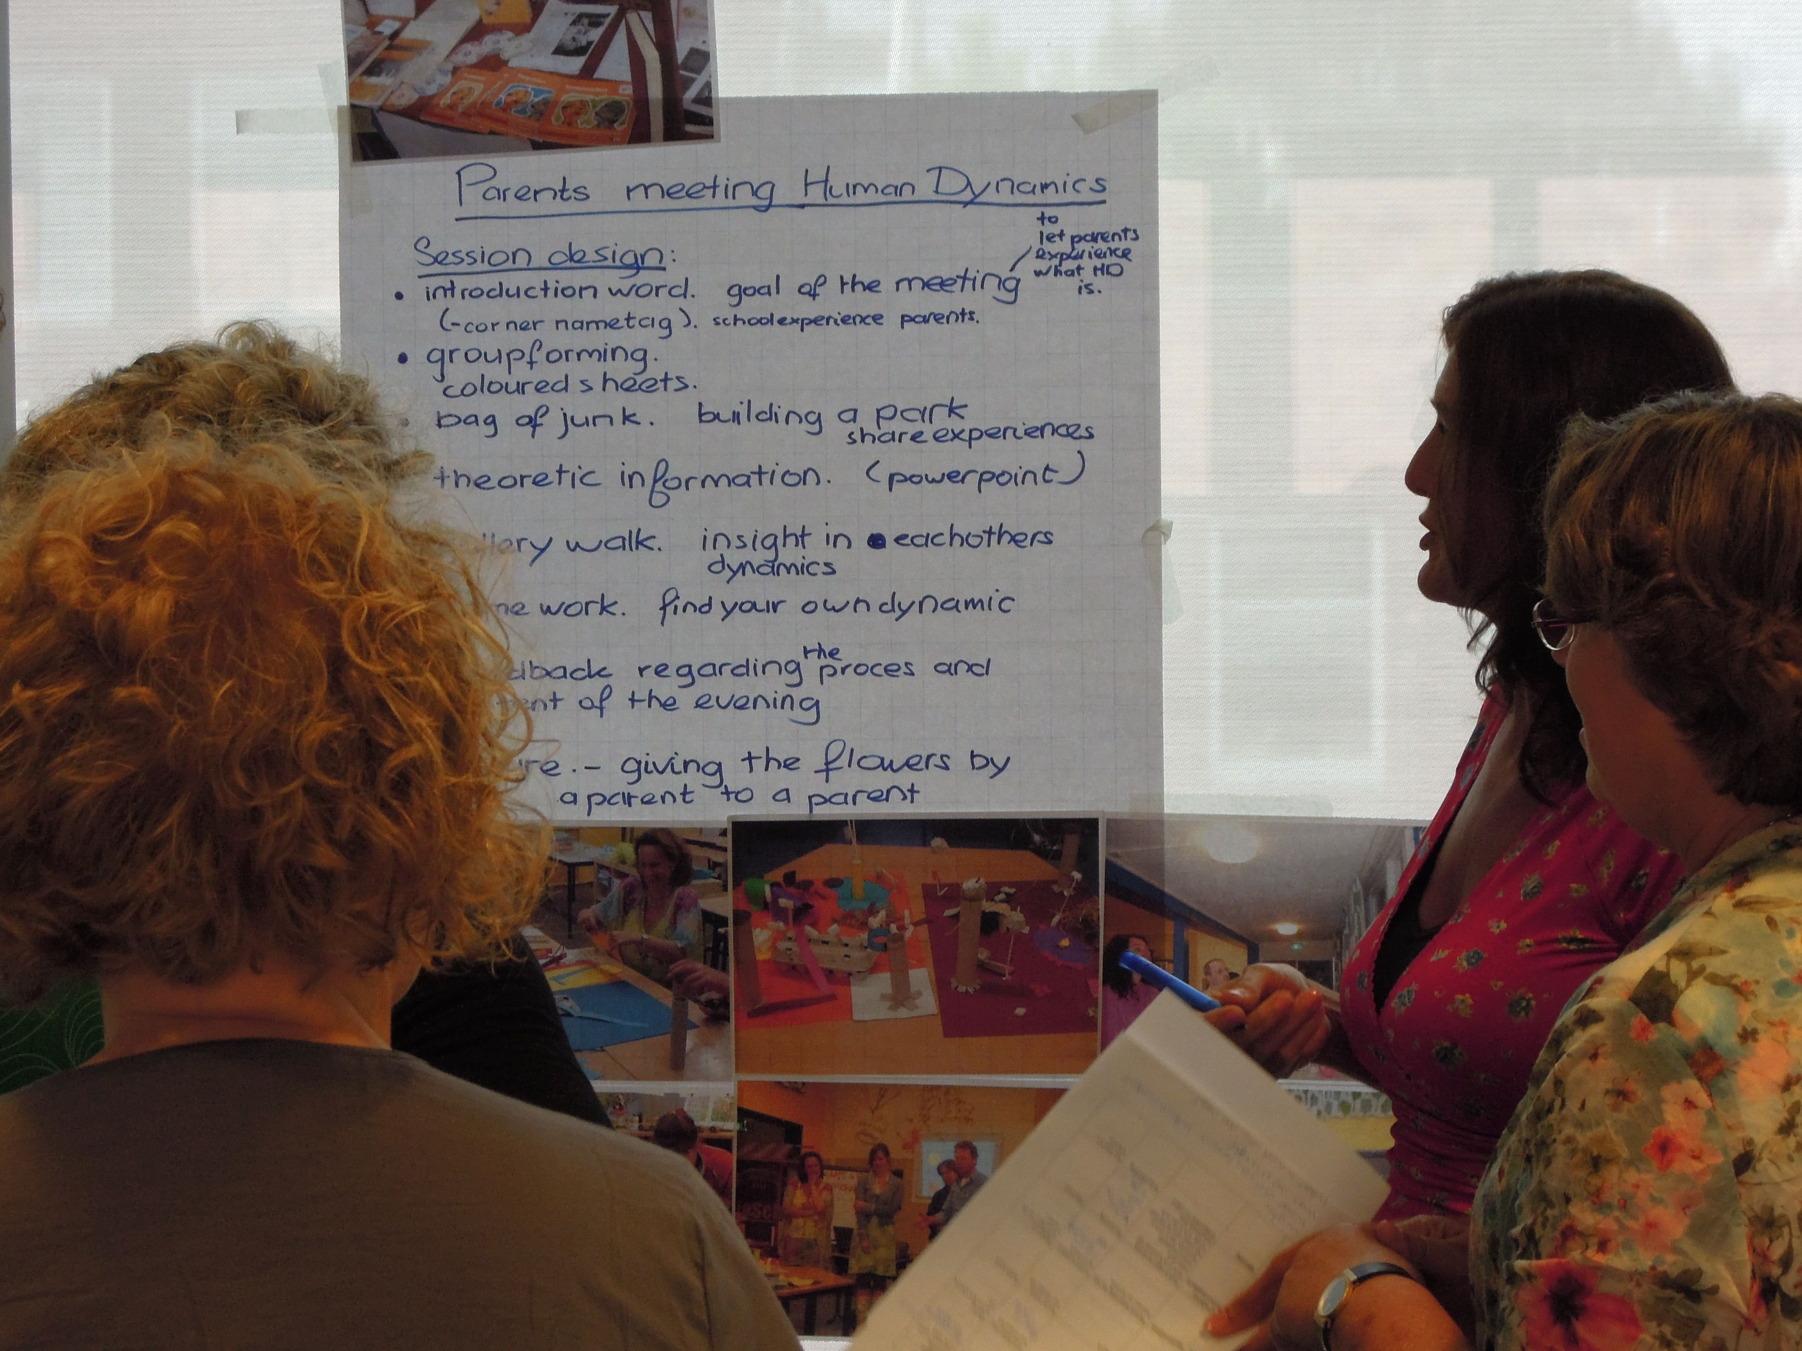
School Leadership Teams
How might your school use the articles to deepen the culture of learning and design more effective professional learning?

Slide 52
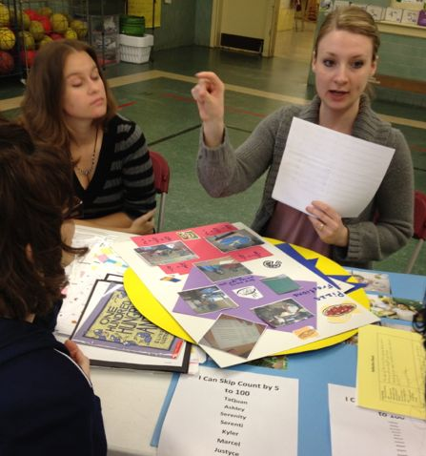
Team Planning Time

Slide 53
School Leadership Study Assignments
1. Instructional Framework
Decide on any refinements for your Instructional Framework.
Develop three strategies to implement the framework with faculty or a group of faculty to support common core.
Bring back your results to share at our session in May.
2. 60 Day Plan Continued
Continue to develop your 60 day plan incorporating change knowledge and tools.

Slide 54
Individual Study Assignments
Use one of the following deep learning strategies. Depending on your role, you may use with faculty or with students.
Bring samples of your work. Photos would be great!
Three Step Interview
Gallery Walk
Jigsaw
Four A’s Protocol
Predicting Placemat
Go to the Wall

Slide 55
Focus: Instructional Coherence and Consistency
A 60 Day School Plan Page 38
Actions | Participants | Lead | Timeline
1.
2.
3.

Slide 56
SLT Meeting
Tuesday May 20
We look forward to seeing you!

Slide 57
Thank you for making a difference!

