Slide 1
The Vision of the Common Core: Changing Beliefs, Transforming Practice
Secondary Session:
Using Manipulatives
January 26, 2013

Slide 2
Why Teachers Don’t Use Manipulatives
Management
Time
Mess
Behavior
Money
Cost to purchase

Slide 3
Why Teachers Should Use Manipulatives
Research-based studies show that students who use concrete materials develop more precise and more comprehensive mental representations, often show more motivation and on-task behavior, understand mathematical ideas, and better apply these ideas to life situations (Harrison & Harrison, 1986; Suydam & Higgins, 1977).

Slide 4
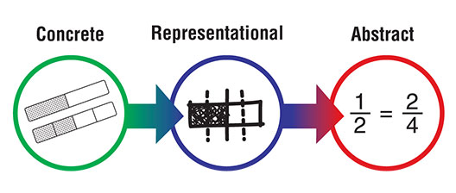
Concrete→ Representational → Abstract
Concrete: The “doing” stage using concrete objects to model problems
Representational: The “seeing” stage using representations of the objects to model problems
Abstract: The “symbolic” stage using abstract symbols to model problems

Slide 5
Manipulatives in Algebra
Flip chips
Tile Spacers
Cups and tiles
Algebra Tiles
Algebra Models
Just like Algebra Tiles but with “y” pieces
Why use Algebra Models?
Multiplying and factoring polynomials, adding and subtracting integers and polynomials, solving equations

Slide 6
Let’s Look at Algebra Models
1
x
y
1
x²
y²
xy
1
5
1
1
1

Slide 7
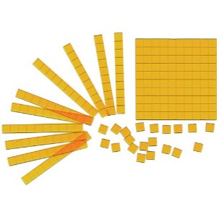
Multiplying and Factoring Polynomials-a Quick Look
Let’s First Look at Base Ten Blocks

Slide 8
Multiplying With Base Ten Blocks-Area Model
Use base ten blocks to model 12•22
200+20+40+4=264
•
Using the Multiplication Algorithm
1 2
• 22
4
20
40
20 0
264
+

Slide 9
Extending the Model
Use expanded notation and a generic rectangle to model 12•22
=200+20+40+4=264
10 + 2
20
+
2
200
40
20
4

Slide 10
Multiplying With Algebra Tiles- Area Model
Remember to sketch your answer
Let’s look at a four quadrant model
(x+2)(x+3)
(2x-1)(x+3)
+
+
-
•
+
-
•
+
x²+2x+3x+6
x²+5x+6
Remove opposite pairs (and/or combine like terms).
2X²+6x+⁻x+⁻3
2X²+5x+⁻3
-
-

Slide 11
Extending the Model
Use a rectangle to model
(2x-3)(x-2)
(6a+5)(a²-2)
2x²+⁻3x+⁻4x+6
2x²+⁻7x+6
6a³+5a²+⁻12a+⁻10
x
-2
a²
-2
-3x
2x²
6a³
5a²
-3 2x
•
6a + 5
•
6
-4x
-12a
-10

Slide 12
Extending the Model
Use a generic rectangle to model
(x+2)(2x+5)
(6a+11)(a-5)
2x²+4x+5x+10
2x²+9x+10
6a²+11a+⁻30a+⁻55
6a²+⁻19x+⁻55
5
+
2x
5x
10
a
+ -5
6a²
11a
2x²
4x
-30a
-55
x + 2
6a + 11

Slide 13
Multiplying Polynomials with Tiles Leads Directly to Factoring (and Completing the Square)

Slide 14
Factoring With Algebra Tiles- Area Model
Remember to sketch your answer
Algebra Tiles can be used to factor polynomials by creating rectangles.
To factor x²+5x+6, create a rectangle with your problem, and find it’s dimensions.
2 + x
So x²+5x+6= (x+3)(x+2)
•
x + 3

Slide 15
Completing the Square
Let’s look back at x² +6x +4=0
⇨(x+3)² + ⁻5=0
So we have “almost a square.”
1) Add opposite pairs to “complete the square.”
2) Find the factors of the square.
3) Rewrite the quadratic equation.
4) Now can we solve this?
Is the left side “a Square”?
Can we add or subtract something to make it a square? (i.e. is it “almost a square” or “a square and a little more”)
•
3 + x
x + 3
+⁻5

Slide 16
Adding and Subtracting Integers and Polynomials… a Part-Part-Whole Approach
Let’s First Look at Base Ten Blocks

Slide 17
An Addition Model
Part-Part Whole
15+28

Slide 18
An Addition Model
Part-Part Whole
107+34

Slide 19
A Look at Subtraction
Part-Part Whole
32 - 14

Slide 20
A Look at Subtraction
Part-Part Whole

Slide 21
Polynomials-Addition
Part-Part Whole
(x² + 3x +2) + (2x² + x + 3)

Slide 22
Polynomials-Subtraction
Part-Part Whole
(3x² + x + 2) – (x² + 2x + 3)

Slide 23
Try a few on your own
Make up a couple problems you could use in your classroom
Whole numbers
Fractions and Mixed Numbers
Integers
Polynomials

Slide 24
A Quick Look at Solving Equations with Algebra Models

Slide 25
Solving Equations in One Variable
Record your steps!
Algebra Tiles or Algeblocks
+
-
+
-
=
Notes:
In order to find the values of x that make the statement true, we need to balance “x” on one side with whatever it takes on the other side. In order to remove the 7 tiles that are with the x, I add -7 tiles so that I have zero pairs. But to keep the balance, I need to add -7 tiles to the other side as well. After removing all opposite pairs, I know what balances x and therefore what value makes the statement true.

Slide 26
Solving Equations in One Variable
Record your steps!
Algebra Tiles or Algeblocks
+
-
+
-
=
Notes:
In order to find the values of x that make the statement true, we need to balance “x” on one side with whatever it takes on the other side. In order to remove the 3 tiles that are with the x, I add -3 tiles so that I have zero pairs. But to keep the balance, I need to add -3 tiles to the other side as well. After removing all opposite pairs, I know that 8 balances 2x but if I take half of two x I get x and half of 8 is 4 so 4 balances x and makes the equation true.

Slide 27
Solving Equations in One Variable
Solve each of the following equations. Show the model for each one. Write your algebraic steps in words or symbols.
1)
+
-
+
-
=
2)
3)
4)
Notes:
Handout (next four)

