Slide 1
The Vision of the Common Core: Changing Beliefs, Transforming Practice
UCDMP Saturday Series
Secondary Session 4
March 16, 2013

Slide 2
Agenda
Welcome and Introductions and a Quick Problem
An Introduction to Geometry Across the Grades
Geometry and the CCSS: Transformational Geometry
Lunch
Session 1 (HS-Computers, MS-SMP)
Session 2 (HS-SMP, MS-Computers)
Feedback and Reflection

Slide 3
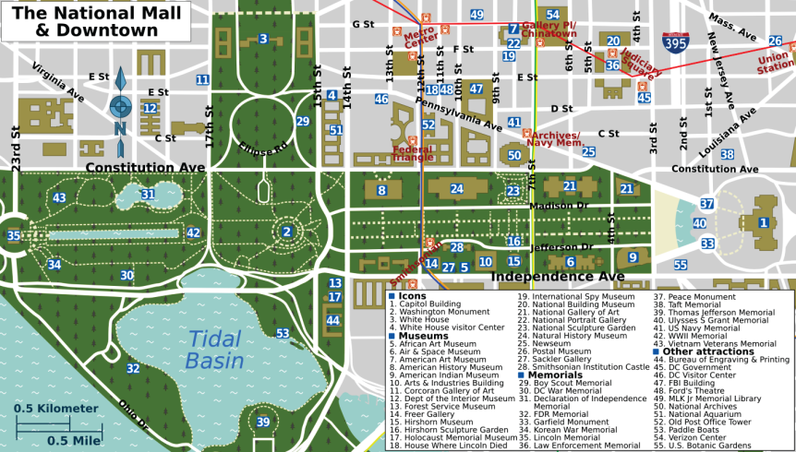
A Geometry Warm-Up

Slide 4
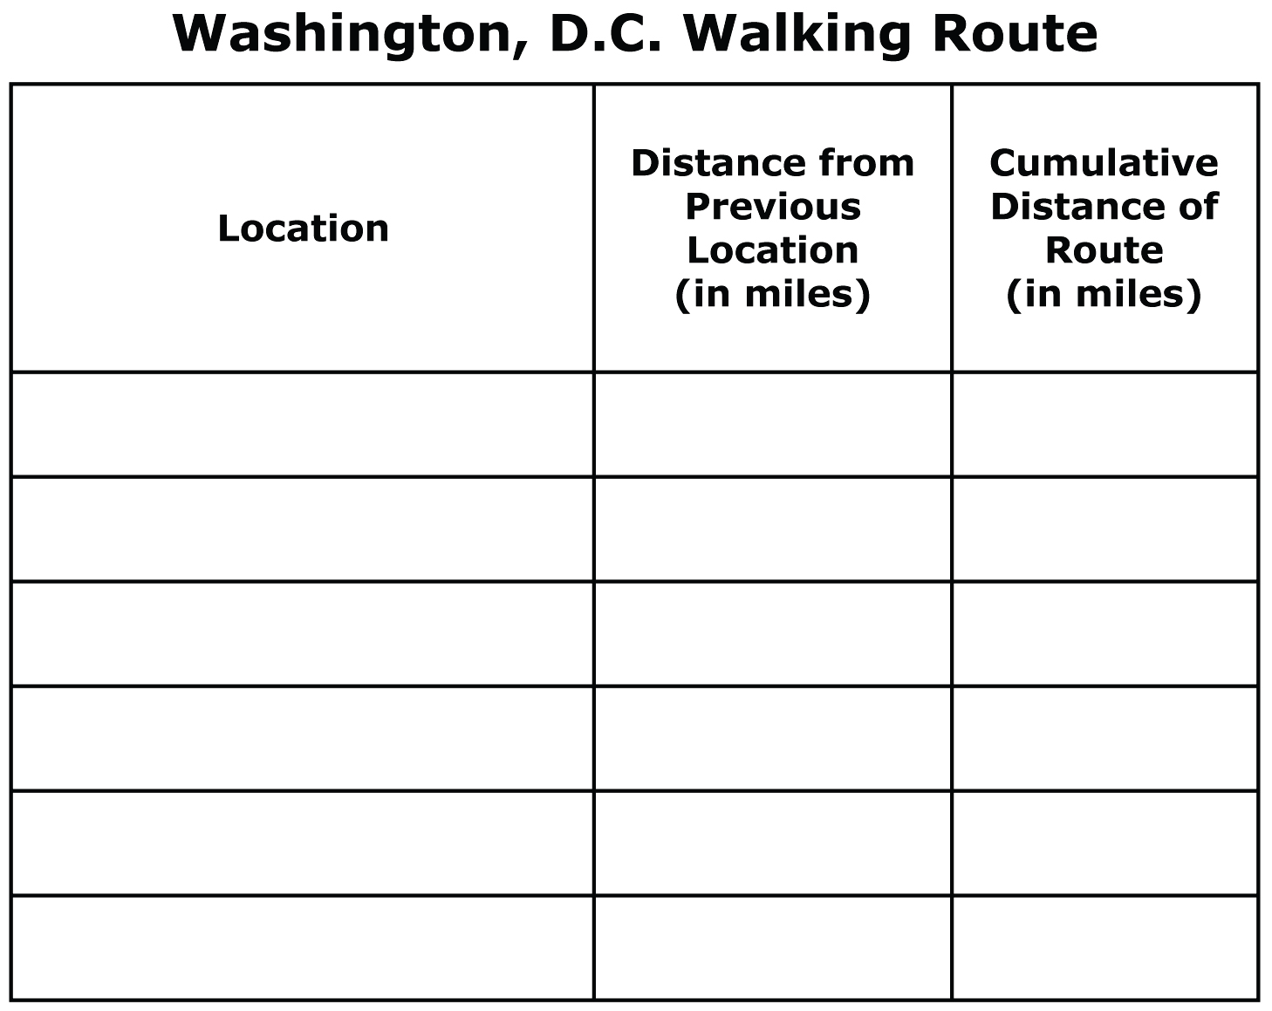
Plan a Walking Tour of the Area
The walking tour must be no more than 2 miles.
The walking tour must include 5 stops. The starting location does not count as a stop. However, the final location does count as a stop.
To improve the accuracy of your measurement, measure along streets (solid lines) and foot paths (dashed lines). Do not measure straight-line distances.
Use the table to organize the stops of your walking tour.

Slide 5
K-8 Domains
High School Categories

Slide 6
Geometry-Think-Pair-Share
When you hear the word Geometry, what are your thoughts?

Slide 7
What is Geometry?
ge·om·e·try
/jēˈämitrē/
Noun
The branch of mathematics concerned with the properties and relations of points, lines, surfaces, solids, and higher dimensional analogs.
A particular mathematical system describing such properties: "non-Euclidean geometries".

Slide 8
Exploring Geometry in the CCSS
In your table group, you will be assigned a grade span or domain to research. Using the handout, internet resources and your joint knowledge, determine what students need to know and understand about Geometry at that time in their lives.
Create a poster which gives an overview of the Geometry students need to know and understand as well as some specific examples. Please make sure that your grade level/domain is visible.
We will place the posters around the room in order to create a progression of Geometry, K-12.

Slide 9
Geometry in the CCSS
How is K-12 Geometry staying the same?
How is K-12 Geometry changing?
How do the changes effect your teaching?

Slide 10
Exploring Transformational Geometry

Slide 11
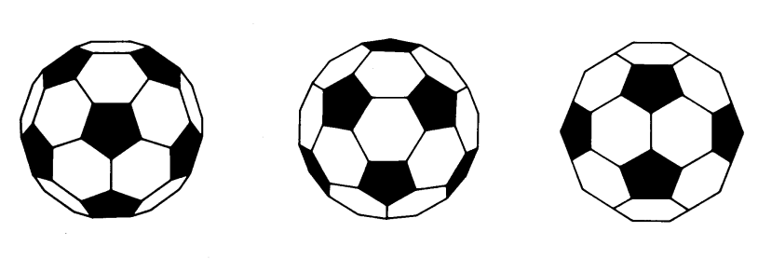
Piece it Together

Slide 12
Mathematical Practice
Make sense of problems and persevere in solving them.
Reason abstractly and quantitatively.
Construct viable arguments and critique the reasoning of others.
Model with mathematics.
Use appropriate tools strategically.
Attend to precision.
Look for and make use of structure.
Look for and express regularity in repeated reasoning.

Slide 13
CCSS Mathematical Practices
REASONING AND EXPLAINING
2. Reason abstractly and quantitatively
3. Construct viable arguments are critique the reasoning of others
SEEING STRUCTURE AND GENERALIZING
7. Look for and make use of structure
8. Look for and express regularity in repeated reasoning
OVERARCHING HABITS OF MIND
1. Make sense of problems and perseveres in solving them
6. Attend to precision
MODELING AND USING TOOLS
4. Model with mathematics
5. Use appropriate tools strategically
SEEING STRUCTURE AND GENERALIZING
7. Look for and make use of structure
8. Look for and express regularity in repeated reasoning

Slide 14
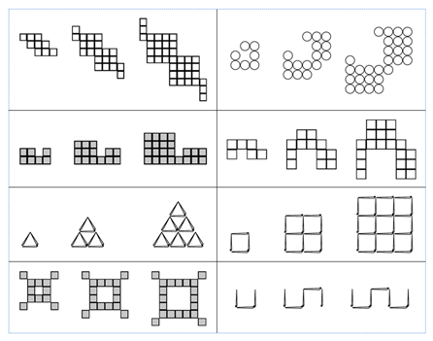

Slide 15
7: Look for and Make Use of Structure
Mathematically proficient students look closely to discern a pattern or structure. Young students, for example, might notice that three and seven more is the same amount as seven and three more, or they may sort a collection of shapes according to how many sides the shapes have. Later, students will see 7 x 8 equals the well remembered 7 x 5 + 7 x 3, in preparation for learning about the distributive property. In the expression x² + 9x + 14, older students can see the 14 as 2 x 7 and the 9 as 2 + 7. They recognize the significance of an existing line in a geometric figure and can use the strategy of drawing an auxiliary line for solving problems. They also can step back for an overview and shift perspective. They can see complicated things, such as some algebraic expressions, as single objects or as being composed of several objects. For example, they can see 5 – 3(x – y)² as 5 minus a positive number times a square and use that to realize that its value cannot be more than 5 for any real numbers x and y.

Slide 16
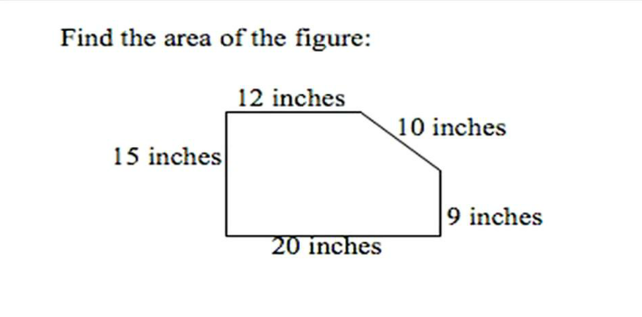
Making Use of Structure
Illustrative Mathematics 6.G

Slide 17
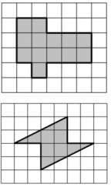
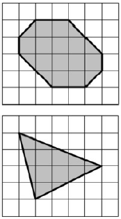
Making Use of Structure
Find the area that is shaded in each figure in at least two different ways.
Illustrative Mathematics 6.G

Slide 18
Making Use of Structure

Slide 19
Making Use of Structure
Solve the following equation:
(3x - 2)² = 6x - 4
PARCC: A-REI.4

Slide 20
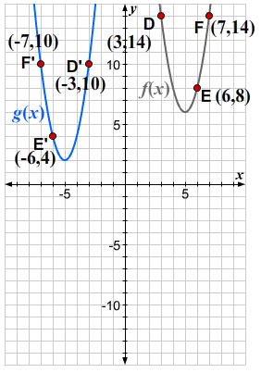
Making Use of Structure
The graph of the quadratic function f(x) = 2(x − 5)² + 6 is shown.
The graph of a new function, g(x), is obtained by applying a congruence transformation to the graph of f(x), which takes the points D, E, and F to the points D’,E’, and F’, respectively.
a. Describe a sequence of congruence transformations that gives the graph of the new function g(x).
b. Write an equation for g(x).
c. Compare your equation for g(x) to the equation of the original function, f(x). How do the differences in the equations reveal the transformations you described in part (a)?
PARCC: F-BF

Slide 21
Making Use of Structure
Suppose P and Q give the sizes of two different animal populations, where Q>P.
In (a)–(d), say which of the given pair of expressions is larger. Brieﬂy explain your reasoning in terms of the two populations.
Illustrative Mathematics A-SSE

Slide 22
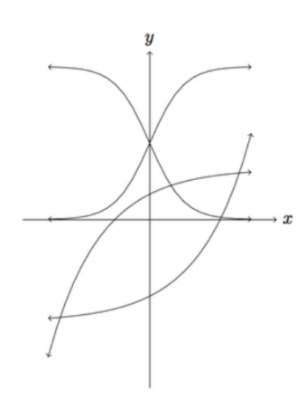
Making Use of Structure
Below are four graphs of functions shown for -2≤ x ≤ 2. Match each function with its graph and explain your choice:
Illustrative Mathematics F-IF

Slide 23
7: Look for and Make Use of Structure
What do you currently do to help students “look for and make use of structure”? Can you think of ways specific to Geometry?
Take a moment to write down things you either do or could now see yourself doing to help students “Look for and make use of structure”.
Share your ideas with the members of your table group.
We will share out ideas to the whole group after a few minutes.

Slide 24
Making Use of Structure
If
a+b=3 and ab=3
then
a²+b²=???

Slide 25
8: Look for and Express Regularity in Repeated Reasoning.
Mathematically proficient students notice if calculations are repeated, and look both for general methods and for shortcuts. Upper elementary students might notice when dividing 25 by 11 that they are repeating the same calculations over and over again, and conclude they have a repeating decimal. By paying attention to the calculation of slope as they repeatedly check whether points are on the line through (1, 2) with slope 3, middle school students might abstract the equation (y – 2)/(x – 1) = 3. Noticing the regularity in the way terms cancel when expanding (x – 1)(x + 1), (x – 1)(x² + x + 1), and (x – 1)(x³ + x² + x + 1) might lead them to the general formula for the sum of a geometric series. As they work to solve a problem, mathematically proficient students maintain oversight of the process, while attending to the details. They continually evaluate the reasonableness of their intermediate results.

Slide 26
Repeated Reasoning
Nina was finding multiples of 6.
She said,18 and 42 are both multiples of 6, and when I add them, I also get a multiple of 6:18+42=60.
Explain to Nina why adding two multiples of 6 will always result in another multiple of 6.
Illustrative Mathematics 6.NS

Slide 27
Repeated Reasoning
Marco and Seth are lab partners studying bacterial growth. They were surprised to find that the population of the bacteria doubled every hour.
The table shows that there were 2,000 bacteria at the beginning of the experiment. What was the size of population of bacteria after 1 hour? After 2, 3 and 4 hours?
Enter this information into the table:
Illustrative Mathematics 8.EE

Slide 28
Repeated Reasoning
If you know the size of the population at a certain time, how do you find the population one hour later?
Assuming the population doubled every hour before the study began, what was the population of the bacteria 1 hour before the students started their study? What about 3 hours before?
If you know the size of the population at a certain time, how do you find the population one hour earlier?

Slide 29
8: Look for and Express Regularity in Repeated Reasoning.
What do you currently do to help students “look for and express regularity in repeated reasoning”? Can you think of ways specific to Geometry?
Take a moment to write down things you either do or could now see yourself doing to help students “Look for and express regularity in repeated reasoning”.
Share your ideas with the members of your table group.
We will share out ideas to the whole group after a few minutes.

Slide 30
A Final Note: Algorithms and Shortcuts
Algorithms, shortcuts and rules were built on recognizing structure and repeated reasoning.
When we “teach” them, students don’t have the opportunity to “Look for and make use of structure” or “Look for and express regularity in repeated reasoning”
We need to provide opportunities for students to look and see for themselves.
Only after seeing the structure and patterns do the algorithms, shortcuts and rules make sense.

