Slide 1
School Leadership Teams
Session Three
December 2013
Educational Change Through Partnerships and Collaboration

Slide 2
Agenda School Leadership Teams December 2013
1. Welcome back!
Review of the Agenda, Framework, Norms
2. Working as a School Leadership Team
Team Problem Solving
Stages of Team Development
Learning From the Work
School and Individual Study Assignments
4. Building Instructional Coherence and Consistency
Case Studies
Developing an Instructional Graphic
Team Planning Time
5. Becoming Leaders of Change
Synectics

Slide 3
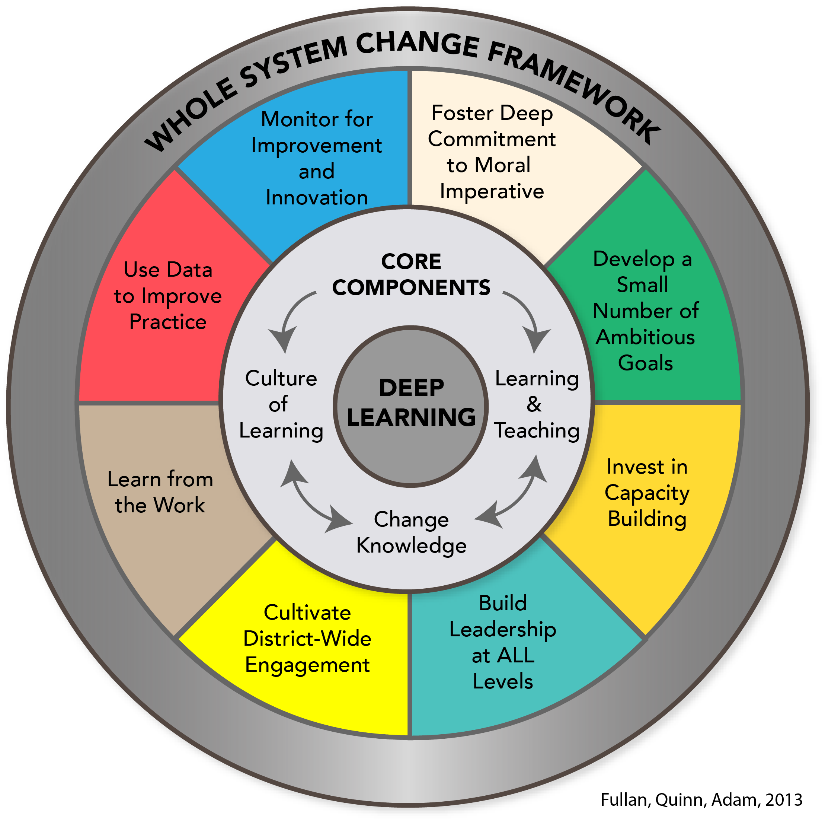

Slide 4
Driving Question:
How do we develop schools for the future that promote and support deep learning for students and staff?
Learning and Teaching
Culture of Learning
Change Knowledge
Deep Learning

Slide 5
Group Norms
Engage fully
Contribute productively
Be open to new information, possibilities
and perspectives
Respect confidentiality
Ask questions

Slide 6
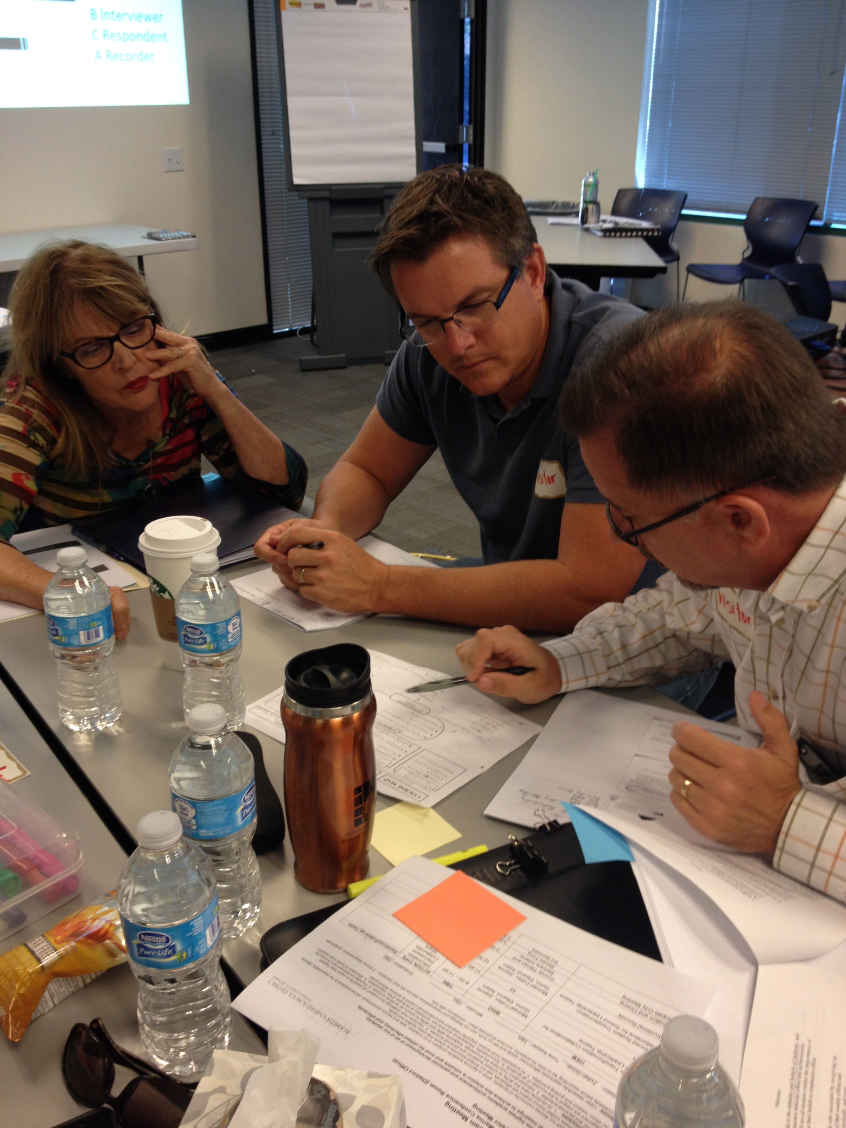
Working as a School Leadership Team
Your Team
Challenge!
A Cooperative
Group Task!

Slide 7
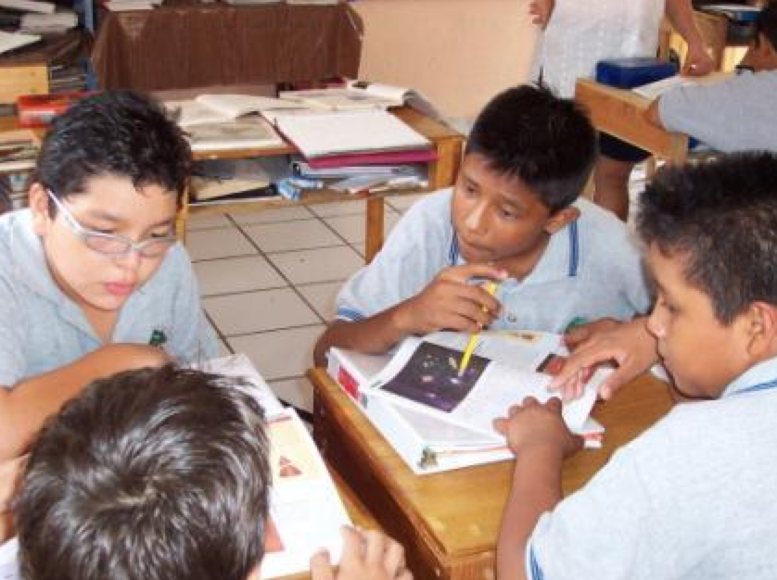
Cooperative Group Learning
.
Cooperative Group Learning uses five basic elements that distinguishes it from group work.

Slide 8
Cooperative Group Five Elements
Positive Interdependence
Individual Accountability
Group Processing
Social Skills
Face To Face
.

Slide 9
Team Challenge: A cooperative group task
Academic Task
Using the principles of problem solving, invent and build an awesome device that would support learning.
Name the device and be prepared to demonstrate it’s function to another school.

Slide 10
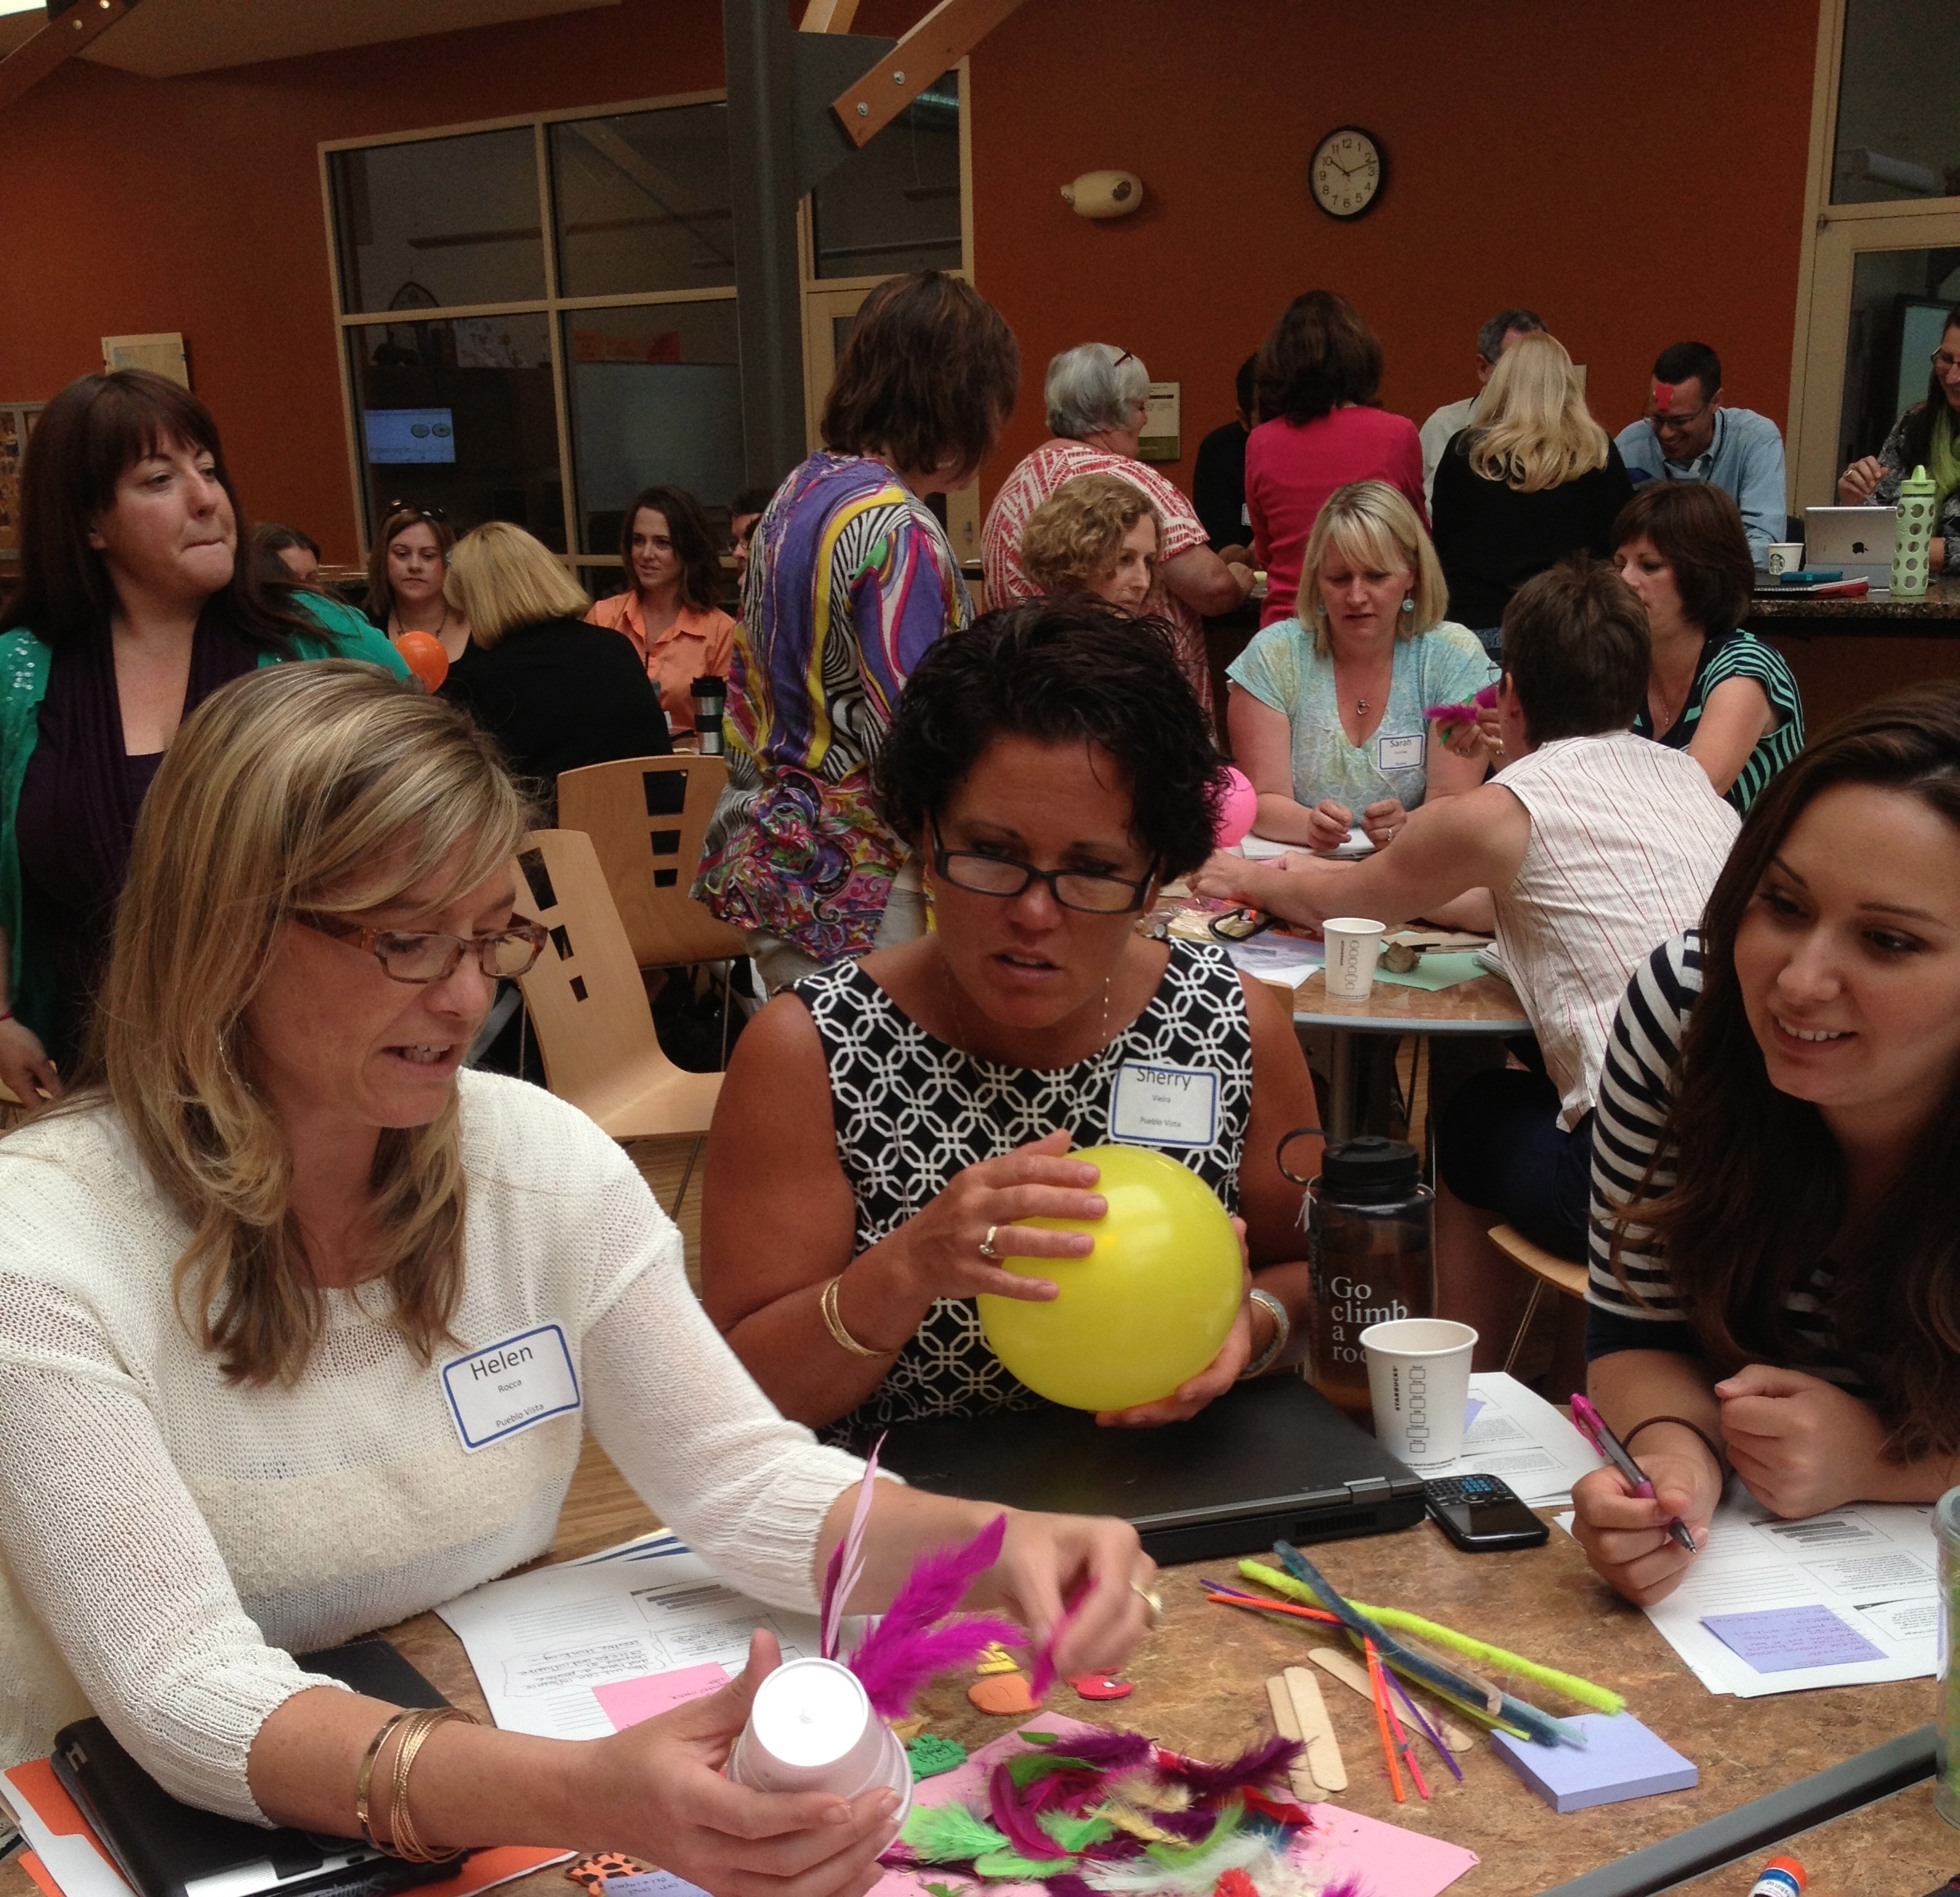
Team Challenge: A cooperative group task
Social Task
To build on the ideas of others.
To listen attentively.

Slide 11
Team Challenge: A cooperative group task
Roles:
Number off 1 to 4 in your School Leadership Team.
Person One: Monitor for Social Skill
Person Two: Resource Manager
Person Three: Scout
Person Four: Time Keeper

Slide 12
Team Challenge: A cooperative group task
Resources
Two pipe cleaners
Two index cards
Three paper clips
Four tooth picks

Slide 13
Share your Devices for Schools!
Partner up with another School Leadership Team and share your amazing new device!

Slide 14
Group Processing
As a School Leadership Team discuss how you worked collaboratively and cooperatively to achieve your Academic and Social tasks.

Slide 15
Working as a Team: Team Development
Forming
Storming
Norming
Performing

Slide 16
Team Development
Forming Stage
Polite
Impersonal
Watchful
Guarded
Storming Stage
Controlling
Confronting
Opting Out
Difficulties
Feeling Stuck

Slide 17
Team Development
Norming Stage
Developing Skills
Establishing Procedures
Giving Feedback
Confronting Issues
Performing Stage
Resourceful
Flexible
Open
Effective
Close and Supportive

Slide 18
Insert video Murphy Brown

Slide 19
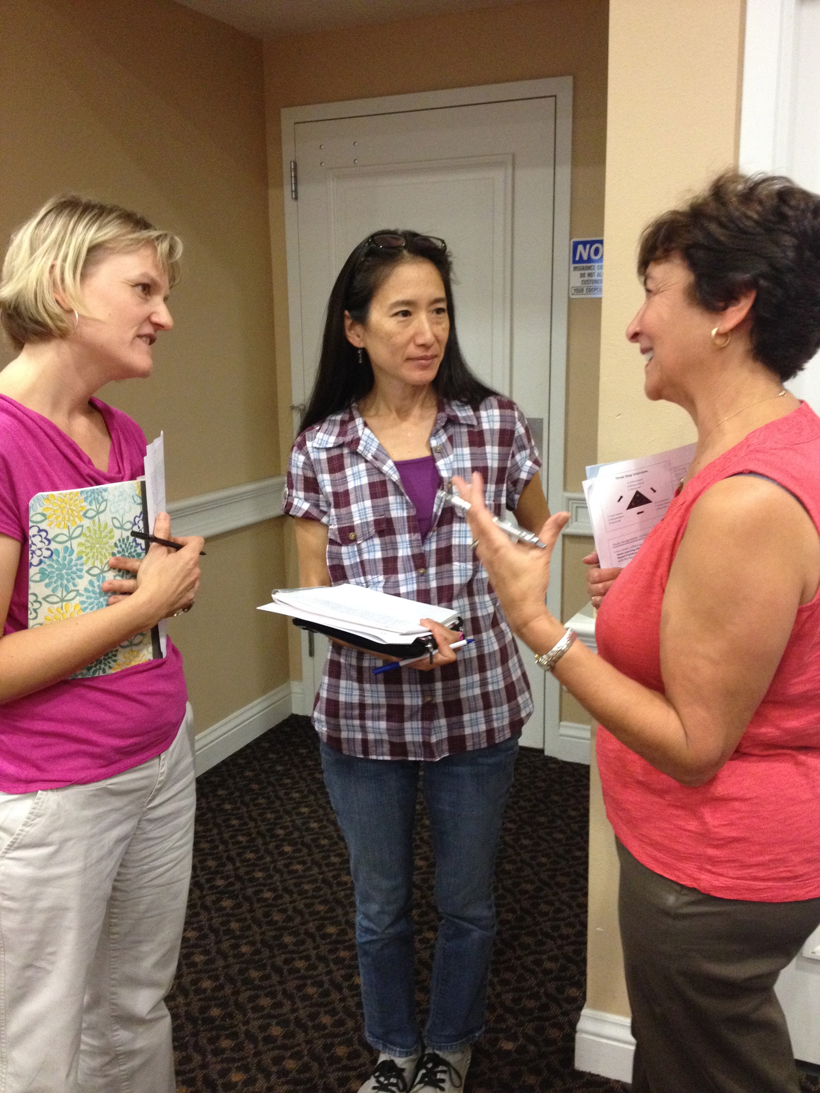
Stages of Team Development
As a School Leadership Team, think of two strategies you could use to develop your team or other teams in your school.

Slide 20
Learning from the Work – Part 1

Slide 21
Study Assignment for December
School Leadership Team
Develop a 60 Day Plan to increase the instructional consistency and coherence for deep learning.
Bring your plan and evidence of progress to our next session.

Slide 22
Learning from the Work 60 Day Plan for Instructional Consistency and Coherence
Summarize the highlights of your plan and implementation using the advance organizer provided.
Be prepared to share the plan and artifacts with your partner school.

Slide 23
Instructional Coherence Plan Advance Organizer
Goals/Focus
Actions
Results
Challenges & Insights

Slide 24
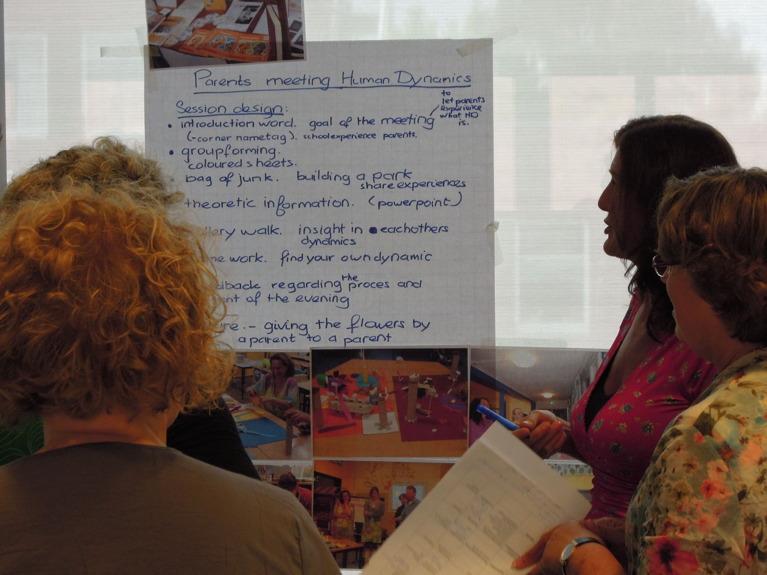
Sharing Protocol
Partner Schools post chart summaries side by side.
School A
Share the summary and artifacts 5 min
Questions and discussion 5 min
School B
Share the summary and artifacts 5 min
Questions and discussion 5 min

Slide 25
Great Ideas- Learning from the Work!
 | School A | School B
Goals/Focus
Actions
Results
Challenges & Insights

Slide 26
Deep Learning for Students
Teaching for deep learning
Professional learning needs
Instructional Coherence and Consistency
monitor it

Slide 27
Change Leadership for Instructional Coherence
“…make the instruction-assessment nexus the core driver, and back up this with a system that mobilizes the masses to make the moral imperative a reality. Change the very culture of the teaching profession. …It is time to embrace and relentlessly commit to the right drivers.”
Michael Fullan

Slide 28
Case Study: Park Manor Senior Public School
Say Something Strategy
Pair up with someone from another school. Agree on a place you will stop reading half way through the case. Each person reads independently.
Stop midpoint to reflect and discuss:
How did this school shift its practices?
What role did the Principal play?
Read to the end then have a discussion:
Identify the key insights on creating instructional coherence.

Slide 29
Video Case: “The Journey to Awesome”
How did this Principal engage others in change?
How did he strategize over the three years ?
How did he build capacity?

Slide 30
Video park Manor Story Part 1

Slide 31
Video Case: “The Journey to Awesome”
How did this Principal engage others in change?
How did he strategize over the three years ?
How did he build capacity?

Slide 32
Park Manor Story part 2

Slide 34
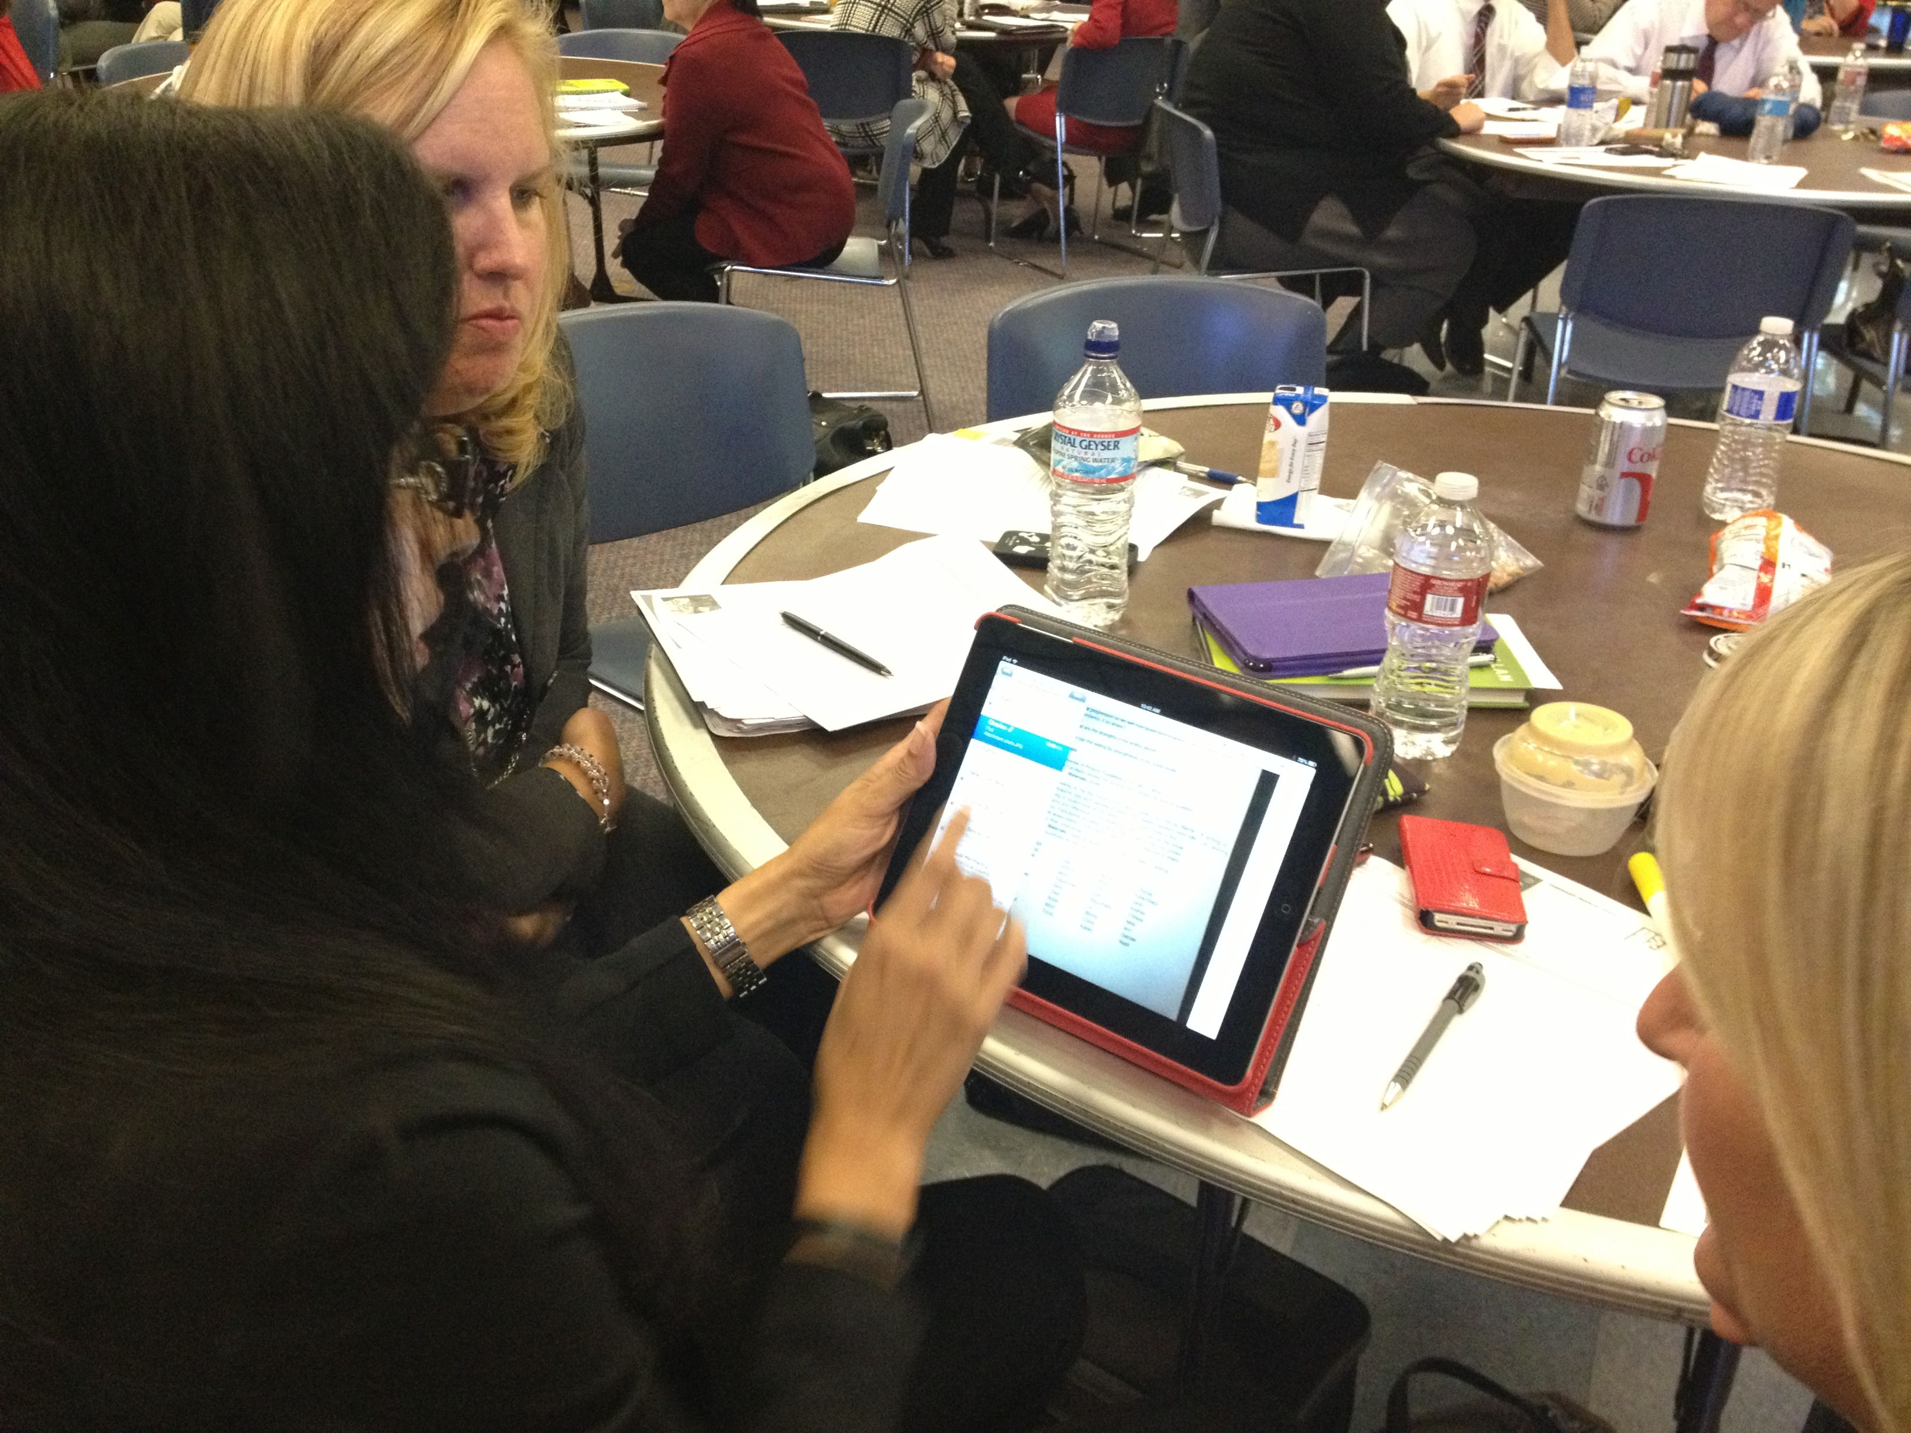
Learning from the Work Part 2

Slide 35
Study Assignment for December
Individual
Use one of the strategies from today and bring samples to share at the next session.
Turn & Talk
Venn Graphic Organizer
Three Step Interview
3-2-1
Quick Write
What? So What? Now What?

Slide 36
Four Corner Sharing
Move to the corner that best matches your role.
Meet up with a partner.
Take turns sharing your strategies and artifacts.
5 minutes each.
Elementary
Middle
High school
Principals , specialty roles

Slide 37
Designing an Instructional Coherence Framework
Central Peel 21st Century Learning Framework
Park Manor Accelerated Learning Framework

Slide 38
Reviewing Instructional Frameworks
PMI
P
M
I
luses
inuses
nteresting

Slide 39
Park Manor Designs an Accelerated Learning Framework
As you watch the video, identify the steps Park Manor took to develop the Accelerated Learning Framework.

Slide 40
Park Manor Corwin video

Slide 41
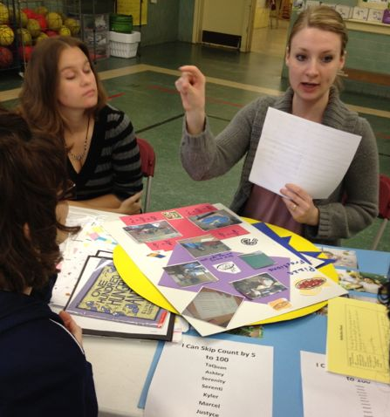
Team Planning Time

Slide 42
March Study Assignment
Design a graphic to represent what your school is working on to be more instructionally coherent and consistent. Consider the needs and priorities of your school within the context of the district goals.
60 days from now, what can you do to move one step closer to focusing on Instructional Consistency and Coherence for deep learning?

Slide 43
Change Leadership
What are the qualities of positive change leaders?

Slide 44
Synectics: A critical thinking strategy
Synectics (Gordon, 1961) is an approach to creative thinking that depends on understanding together that which is apparently different.
Its main tool is analogy or metaphor.
The approach, which is often used by groups, can help learners develop creative responses to problem solving, to retain new information, to assist in generating writing, and to explore social problems.
It helps learners break existing minds sets and internalize abstract concepts. (Couch, 1993)
)

Slide 45
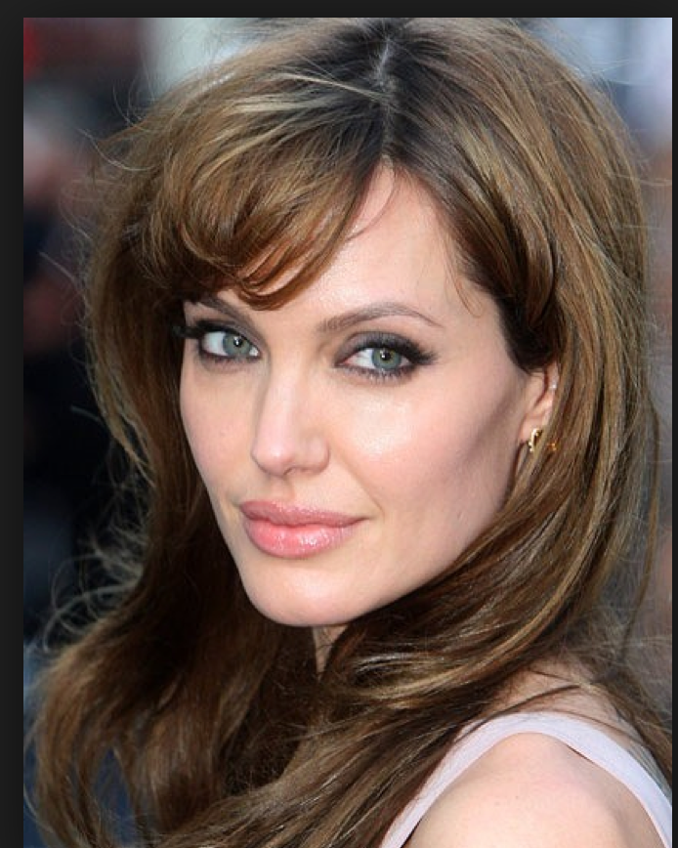
Synectics: Famous People

Slide 46
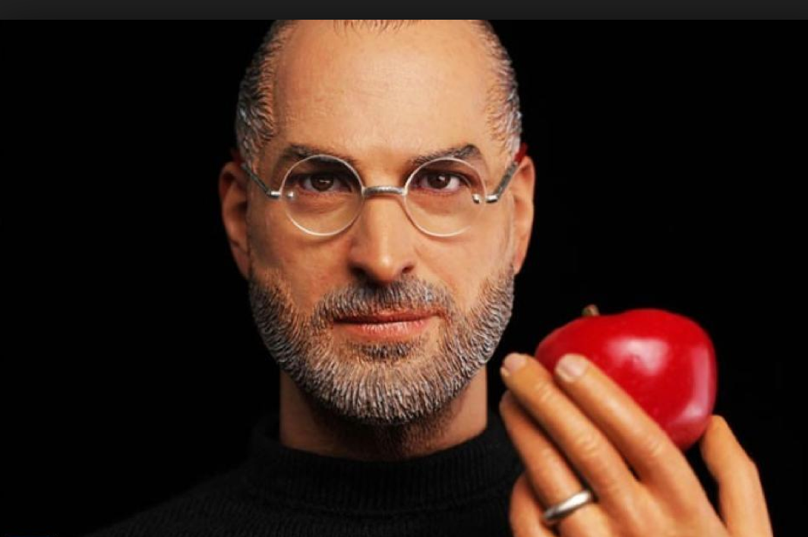
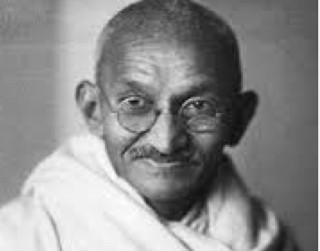
Synectics Famous People

Slide 47
Synectics: Famous People

Slide 49
Famous People Synectics
As an individual select one of your pictures …
“A change leader is like______
because…
- Adapted from B. Wellman, C. Rolheiser, OISE, 2007

Slide 51
Famous People Synectics
As an individual select one of your pictures …
“A skilled change leader is NOT like______
because…
- Adapted from B. Wellman, C. Rolheiser, OISE, 2007

Slide 52
Famous People Synectics
Share your picture selection and rationale using Round Robin.
- Adapted from B. Wellman, C. Rolheiser, OISE, 2007

Slide 54
Famous People Synectics
Choose 2 of your best team ideas.
Choose a spokesperson.
Be prepared to share your team choices and accompanying explanation.
- Adapted from B. Wellman, C. Rolheiser, OISE, 2007

Slide 55
Attributes of a Positive Change Leader
1. | _________________________________________________________
2. | _________________________________________________________
3. | _________________________________________________________
4. | _________________________________________________________
5. | _________________________________________________________
6. | _________________________________________________________
7. | _________________________________________________________
8. | _________________________________________________________
9. | _________________________________________________________
10, | _________________________________________________________

Slide 56
Study Assignment for December
School Leadership Team
Develop a 60 Day Plan to increase the instructional consistency and coherence for deep learning.
Bring your plan and evidence of progress to our next session.

Slide 57
May 2014 bring you
hope for a brighter future,
good health &
time for enjoying family &
friends!
Have a wonderful holiday!

