Slide 1
The Vision of the Common Core: Changing Beliefs, Transforming Practice
UCDMP Saturday Series
Secondary Session 5
May 4, 2013

Slide 2
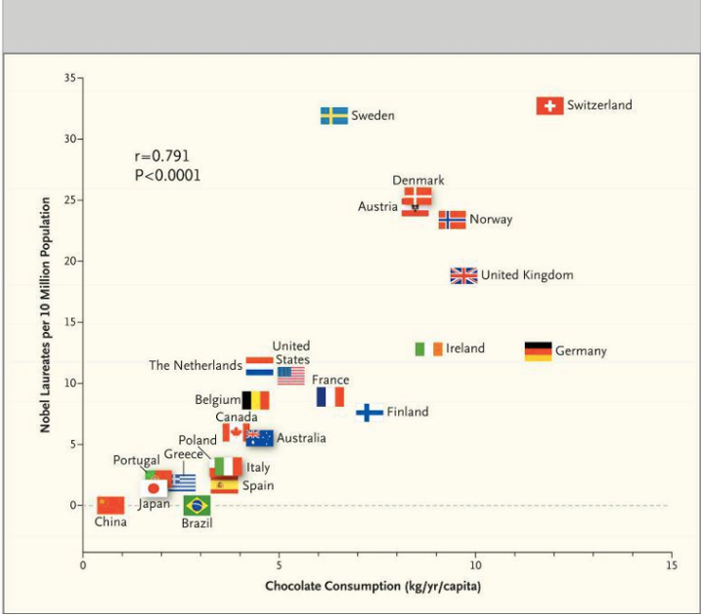

Slide 3
Agenda
Welcome, Introductions and a Survey
CCSS for Mathematical Practice: Reasoning and Explaining
A Birthday Party
An Introduction to Statistics and Probability 6-12
Lunch
Session 1
Afternoon Break
Session 2
Feedback and reflection

Slide 4
Collecting Data
Please move about the room and answer the survey questions posted. Please answer each question only once. When you are finished, return to your seat and read the handout entitled:
Let’s Talk: Promoting Mathematical Discourse in the Classroom

Slide 5
Mathematical Practice
Make sense of problems and persevere in solving them.
Reason abstractly and quantitatively.
Construct viable arguments and critique the reasoning of others.
Model with mathematics.
Use appropriate tools strategically.
Attend to precision.
Look for and make use of structure.
Look for and express regularity in repeated reasoning.

Slide 6
CCSS Mathematical Practices
REASONING AND EXPLAINING
2. Reason abstractly and quantitatively
3. Construct viable arguments are critique the reasoning of others
REASONING AND EXPLAINING
2. Reason abstractly and quantitatively
3. Construct viable arguments are critique the reasoning of others
OVERARCHING HABITS OF MIND
1. Make sense of problems and perseveres in solving them
6. Attend to precision
MODELING AND USING TOOLS
4. Model with mathematics
5. Use appropriate tools strategically
SEEING STRUCTURE AND GENERALIZING
7. Look for and make use of structure
8. Look for and express regularity in repeated reasoning

Slide 7
Reasoning and Explaining
Take a couple of minutes to read through the bullet points on the “Reasoning and Explaining” handout. While reading, think about the “Let’s Talk” article.
Thinking prompts:
In which areas do you feel confident?
In which areas do you need support?
In what ways does the “Let’s Talk” article support the highlighted mathematical practices?

Slide 8
Student Talk Brainstorm
Take two minutes to write down all the ways you encourage “reasoning and explaining” in your classroom.
With your table group:
Round robin your ideas, moving around the group with each person giving one idea from their list until all members lists are exhausted.
If you hear an idea that you want to remember or need more info on, make a note.
Once all ideas have been shared, discuss those ideas group members noted and/or brainstorm additional ideas.

Slide 9
The Birthday Party

Slide 10
What is a Statistical Question?
A well-written statistical question refers to a population of interest, a measurement of interest, and anticipated answers that vary.
For example, “How old am I?” is not a statistical question, but “How old are the students in my school?” is a statistical question.
Population:
Measurement:
Anticipated variation?

Slide 11
GAISE: Guidelines for Assessment and Instruction in Statistics Education Report
Partner Read: The Framework. Take turns reading the handout. Ask clarifying questions as needed.
What are the four components involved in Statistical problem solving?
Let’s see if we understand the levels:
Level A:
Level B:
Level C:

Slide 12
Developing Statistical Literacy
…a middle-school student who has had no prior experience with statistics will need to begin with Level A concepts and activities before moving to Level B. This holds true for a secondary student as well. If a student hasn’t had Level A and B experiences prior to high school, then it is not appropriate for that student to jump into Level C expectations.
…and teachers?

Slide 13
Let’s Look at Some Data-Tongue Rolling
Here is the data.
male: yes:15, no 5
female: yes: 21, no 8
What Statistical Question might you ask that would require you to collect this data?
How might you analyze the data?
How might you interpret the results?
What developmental level (from the Framework) does this question represent?

Slide 14
K-8 Domains
High School Categories

Slide 15
Which Statistics and Probability Standards did the activity address?
Look through the Statistics and Probability Standards in the CCSS-M Grades 6-HS and identify the standards addressed by each of the activities we have done. Also, make note of the standards for mathematical practice each activity would develop.

Slide 16
Statistics and Probability at Your Grade
Take a look at the standards for your grade level…
Code the standards based on your comfort level:
Place a ✔ next to those standards you feel completely comfortable incorporating into your classroom.
Place a  next to those standards you understand, but aren’t comfortable teaching.
Place a ✖ next to those standards which contain content with which you don’t really understand.

Slide 17
Statistics in High School
Beyond Alg 1/Int 1 (not including AP Stats ☺)

Slide 18
Analyzing and Reporting Data
Finding a new group:
You will be given a “graph piece” . You job is to find three new group members who have different “graph pieces” and form a new group.
Once you form a group, get an envelope from me and find a table.
Match all sets of “graph pieces”, titles and descriptions.

Slide 19
Types of Data
Qualitative: categorical
Nominal (names, no natural ordering)
Ordinal (judge size, but the distance between categories is not something we can measure)*
Quantitative: numerical
Discrete or Continuous
Sometimes called: Interval or Ratio
Now look at the different graphs from the matching exercise…what kind of data is represented?

Slide 20
Statistics After Algebra 1/Integrated 1
Pick a data poster and answer the following:
What Statistical Question might you ask that would require you to collect this data?
How might you analyze the data?
How might you interpret the results?
What developmental level (from the Framework) does this question represent?

Slide 21
Statistics After Algebra 1/Integrated 1
Look through the standards and identify those standards related to Statistics instruction after Algebra 1/Integrated 1
What are the main topics/concepts?
Looking back at your coding, with which topics are you the least familiar?
What resources might you use to gain familiarity?

Slide 22
Statistics After Algebra 1/Integrated 1
Do any of our data posters give you data to support the teaching and learning of these standards?
If so, which ones and how?
If not, what kind of data do you need?
Where might you get it?
Could the same survey questions be used?

Slide 23
S-IC 4: Use data from a sample survey to estimate a population mean or proportion; develop a margin of error through the use of simulation models for random sampling.
Let’s look at margin of error through the use of simulation models for random sampling to answer the question about the data from a sample survey

Slide 24
The Winter Formal
The principal of City High School cancelled the Winter Formal dance because he believed that students preferred an all-school trip to an amusement park during spring break. But he told the Student Council that if they could convince him that more than 50% of the school preferred the Winter Formal he would reinstate it. The Student Council randomly surveyed 25 students; 60% of them preferred to keep the dance. Even though a majority in the sample wanted the dance, the principal was not convinced. He said that due to natural sample-to-sample variability, the true proportion of dance supporters might not actually be more than 50%.

Slide 25
Let’s Simulate the Situation
In the bin you have a population with 60% red beads, 40% not red beads.
Collect 10 samples of 10 beads from your population (with replacement) and record your results on the table provided.
Collect 10 samples of 25 beads from your population (with replacement) and record your results on the table provided.
Collect 10 samples of 100 beads from your population (with replacement) and record your results on the table provided.

Slide 26
Let’s Analyze the Results
Write your percent red values on sticky notes and place them on the appropriate poster.
What conclusions can you draw looking at the simulation data?
How confident are you that more than 50% of the students actually prefer the Winter Formal? (Where does most of our data fall?)
The theoretical margin of error with a sample size of 25 is 16%

Slide 27
Statistics After Algebra 1/Integrated 1
What are some statistical questions students might ask that would allow them to practice with the HS statistics standards?

Slide 28
Statistics Resources
Please check the UCDMP resource page for documents and links to use as resources in your learning and teaching.
If you would be interested in attending a Secondary Statistics and Probability Institute in the summer of 2014, please state that on the feedback form at the end of the day today.

Slide 29
Statistics in 6th, 7th , 8th and Algebra 1
And Integrated 1 ☺

Slide 30
Analyzing and Reporting Data
Finding a new group:
You will be given a “graph piece” . You job is to find three new group members who have different “graph pieces” and form a new group.
Once you form a group, get an envelope from me and find a table.
Match all sets of “graph pieces”, titles and descriptions.

Slide 31
Types of Data
Qualitative: categorical
Nominal (names, no natural ordering)
Ordinal (judge size, but the distance between categories is not something we can measure)*
Quantitative: numerical
Discrete or Continuous
Sometimes called: Interval or Ratio
Now look at the different graphs from the matching exercise…what kind of data is represented

Slide 32
Statistics in 6th, 7th, 8th and Alg 1
Pick a data poster and answer the following:
What Statistical Question might you ask that would require you to collect this data?
How might you analyze the data?
How might you interpret the results?
What developmental level (from the Framework) does this question represent?

Slide 33
Statistics in 6th, 7th, 8th and Alg 1
Look through the standards and identify the standards related to Statistics instruction after Algebra 1/Integrated 1
What are the main topics/concepts?
Looking back at your coding, with which topics are you the least familiar?
What resources might you use to gain familiarity?

Slide 34
Statistics 6th, 7th, 8th and Alg 1
Do any of our data posters give you data to support the teaching and learning of these standards?
If so, which ones and how?
If not, what kind of data do you need?
Where might you get it?
Could the same survey questions be used?

Slide 35
Pets and Kids
Jacob surveyed 25 adults to ask whether they had at least one child under the age of 18 and whether they had at least one pet.
Complete this table using the data provided.
MAT.08.ER.3.000SP.B.134 Claim 3

Slide 36
Pets and Kids
Jacob made the conjecture that there is a possible association between whether an adult has at least one child under the age of 18 and whether the adult has at least one pet. State whether the results of the survey provide evidence that adults who have at least one child under the age of 18 also tend to have at least one pet. Explain your answer.
MAT.08.ER.3.000SP.B.134 Claim 3

Slide 37
Muddying the Waters

Slide 38
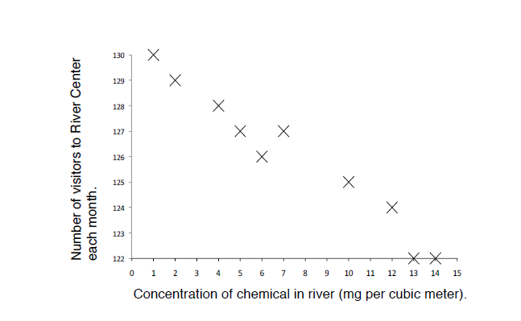
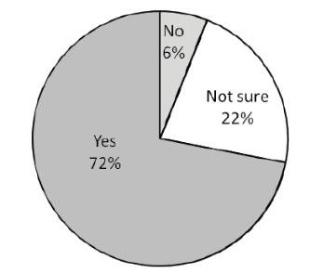
Muddying the Waters
He measured the chemical concentration in the river each month.
He also counted the number of people visiting the Center over several months.
At the same time the manager asked 18 visitors this question:
“The odor you can smell originates from the pollution in the river.
Is it spoiling your enjoyment of the Center?”
Pie chart showing the percentage of
visitors whose enjoyment was spoiled

Slide 39
Muddying the Waters
Do you think the manager’s argument is fair?
Now let’s look at some more data.
You will each be given an additional data
Evaluate your data. Does this data support the managers claim? Refute it? Use mathematics to create your argument.
Now share your data with your group members. Explain what your data says, and whether or not you believe it supports or refutes the managers claim. Using the sum of the evidence before you, does the manager have a case?

Slide 40
Statistics After Algebra 1/Integrated 1
What are some statistical questions students might ask that would allow them to practice with the HS statistics standards?

Slide 41
Statistics Resources
Please check the UCDMP resource page for documents and links to use as resources in your learning and teaching.
If you would be interested in attending a Secondary Statistics and Probability Institute in the summer of 2014, please state that on the feedback form at the end of the day today.

