Slide 1
Data Days
Strategic Alliance II
Sacramento, CA
University of California Davis

Slide 2
Data Driven Instruction
“… use data continuously, collaboratively, and effectively to improve teaching and learning mathematics and science” (p. 23, Love, 2004).
What type of data-driven instruction is going on in your contexts?
Ikemoto, G. S., & Marsh, J. A. (2007). chapter 5 Cutting Through the “Data‐Driven” Mantra: Different Conceptions of Data‐Driven Decision Making. Yearbook of the National Society for the Study of Education, 106(1), 105-131.
Love, N. (2004). Taking data to new depths. Journal of Staff Development, 25(4), 22-26.
Marsh, J. (2012). Interventions Promoting Educators’ Use of Data: Research Insights and Gaps. Teachers College Record, 14(11).

Slide 3
Introduction
History of Strategic Alliance II
Data Day Format (Actual Data Day format versus this after school session)
This summer the district created the Benchmark that they will use during the 2013-2014 school year.
Notes:
5 MIN

Slide 4
Collaboration around data
Explore – what do we see in this data? What questions does this data raise for us?
Explain – why did children use these strategies? Do we know for sure? What other data could we collect to confirm our theory?
Take Action – what should we do now that we have analyzed this data?

Slide 5
Norms for Collaboration
Develop a safe space for sharing opinions
Establish environment where professionals can be “critical friends”
Have a vocabulary for regulating ourselves and one another
Notes:
15 MIN

Slide 6
Paired Square
Form pairs
• Discuss one of the norms – either putting inquiry at the center or presume positive intentions
• Once you have completed the above – join up with another pair (Pair Squared) who discussed the other norm and share your thoughts
Notes:
What does this mean to you? Where have you seen this in action. Can you think of some examples? Paraphrase.

Slide 7
5th Grade Common Core Standard
CCSS.Math.Content.5.NF.B.6 Solve real world problems involving multiplication of fractions and mixed numbers, e.g., by using visual fraction models or equations to represent the problem.
Notes:
Multiplication could be a useful tool for solving this problem. Kept structure of problem same while changing numbers and objects

Slide 8
Card Stack and Shuffle
Write predictions of student successes or failures on note cards.
Place note cards into a pile and shuffle.
Pull cards from stack.
Have a discussion about why predictions may be true or untrue.
Notes:
Strategies, parts that are hard, where their misunderstandings could occur. Why do you think that?
15 MIN

Slide 9
The Dog Problem
There are thirty-two students in Ms. Smith’s class. Half of the students are pet-owners. Three fourths of the pet-owners have dogs. How many students have dogs? Use a picture or diagram to prove your answer.
Notes:
Kept relationship same, but changed objects and numbers

Slide 10
Story Problem Example 5th & 6th Grade
Distribute and analyze exemplar problems
Discuss student understandings
WHAT DO THEY KNOW?
HOW CAN THEY GROW?
Notes:
- SHARE 3 EXERTS FROM AUDIO: (EXPLORES UNDERSTANDING BUT DOESN’T TEACH TEACH) – Stress that written in summer after looking at standards! Variations of same problem over time. K-6 PD, so haven’t spent much time exclusively looking at fractions as a 4-6 grade group would. Conversation more superficial than if had spent more time with fractions. Ie. Lacking children’s thinking, hierarchy of strategies. Situate in our group in beginning!!!
- Teachers wrote this problem based on common core standards.
Find best conversations in audio to share with group about what our PD looks like. (Fractions of a set). Let group have own conversations about what the student is misunderstanding and what would help them learn. Why is this valuable PD?
CGI problem solving activity
Pro Dev tool = what is this all about?
10 MIN

Slide 11
Interesting Examples
Each person analyzes one student problem
What do they know?
How can they grow?
Participants share problems
Discuss student understandings
Notes:
#61, 1, 73, 18 Call up to present
15 MIN

Slide 12
Coding
Review examples
Code student work
Aggregate data
BREAK
Notes:
Distribute purple sheets. Review examples to demonstrate coding. Each individual codes own example. Issues are discussed.
#61 Incomplete representation/incorrect answer, 1 Incorrect representation/incomplete answer, 73 Symbols incorrect, 18 incorrect/incorrect
25 MIN

Slide 13
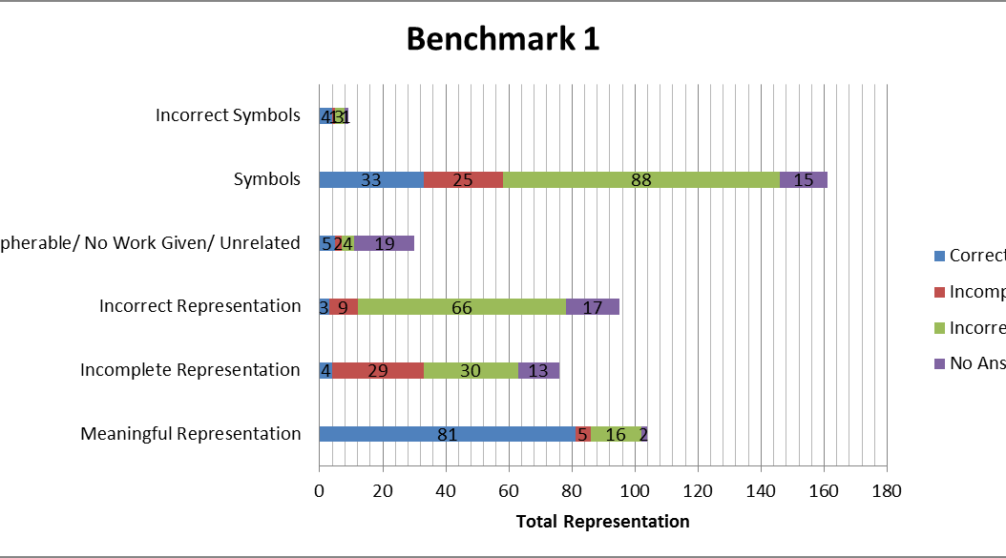
District-wide performance

Slide 14
Explain
Why are students answering the way that they are?
Why did children use these strategies? Do we know for sure? What other data could we collect to confirm our theory?

Slide 15
Take Action
What can we do to help our students reach their goals?
What should we do now that we have analyzed this data?
Notes:
15 MIN

Slide 16
Predict Student Success Rate on Assessment Tasks
Predict student success rate and mastery on problems related to standards (purple sheet).
Important to think through what students will do and what strategies they will use.
Notes:
Our standards in our district but can be done in any situation. Had to work within district constraints. District was required to write BM using Cal standards. This can be done with common core standards. Gets teachers looking at what each standard means for their students. Common core won’t have the multiple choice, but look at the question and say what is hard, will get, won’t get, similar to word problem. Heibert:
10 MIN

Slide 17
Predict Performance on Problems
Go through eight example problems and determine student success rate on each.
Small groups share out why they think students will be successful or unsuccessful at each problem.
Notes:
10 MIN

Slide 18
Review Actual Performance per item
Which problems did we over predict students success rate and which problems did we under predict student success rate?
Why might we have made some of these assumptions?
Notes:
This is what we had the teachers do. You can do this with your own students and own data.
EX: MIGHT UNDER PREDICT IF WE HAVEN’T TAUGHT IT YET, BUT SOMETIMES STUDENTS FIGURE IT OUT USING PRIOR KNOWLEDGE!!!
EX: Heibert: Sometimes teachers assume teacher picking up on relationships when they don’t always. OVER PREDICT IF THINK A PROLEM IS INTUITIVE WHEN REALLY IT IS A HUGE COMPREHENSION JUMP FOR STUDENTS ie. subtracting by double digits.
10 MIN

Slide 19
Review Performance by Standard
How do these scores compare to our initial prediction.
Why are we over predicting or under predicting?
Notes:
Ie. sometimes problems being tested are hardest of the problem bank for that standard. Just because a student is familiar with standard does not mean question adequately assesses that knowledge.
EX: Language too difficult. Problem written in a confusing way. Etc.
STANDARDS HELP YOU THINK ABOUT THE SKILLS ON A GENERAL LEVEL AND PROBLEMS CAN VARY FROM EASY RESPRESENTATIONS OR HARD RESPRENTATIONS OF THE PARTICULAR STANDARD.
5 MIN

Slide 20
Explain
Why are students answering the way that they are?
Why did children use these strategies? Do we know for sure? What other data could we collect to confirm our theory?
Notes:
10 MIN

Slide 21
Take Action
What can we do to help our students reach their goals?
What should we do now that we have analyzed this data?
What are the instructional implications of this data?
Notes:
I was excited to hear what Jim Heibert was saying yesterday, because with these Data Days you can use data to improve your teaching practice. “Turn teaching into a true profession” TEACHING = OBJECT OF STUDY

Slide 22
Discussion
What are the advantages and disadvantages of these different forms of assessment?
Thoughts and comments about our approach to engaging the teachers to think about these assessments.

Slide 23
Reflection
How can the activities we did today influence the way we use assessments?
Why are these activities valuable for professional development?
What did you gain from participating in this session?
Who does this influence?
Notes:
10 MIN

