Slide 2
WORKING WITH PARENTS AND FAMILIES TO SUPPORT THE COMMON CORE MATH STANDARDS

Slide 3
"Tell me and I'll forget. Show me and I may not remember. Involve me, and I'll understand.” Native American saying
Fail to involve parents and communities in the Core Standards and we may find we are reliving the past...

Slide 4
Remember WHOLE LANGUAGE?
Remember CLAS?
Remember NEW MATH?

Slide 5
What killed NEW MATH?

Slide 6
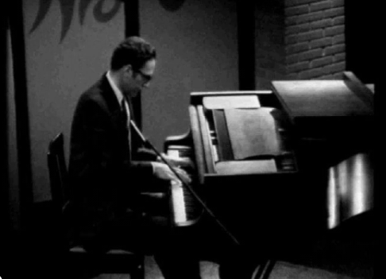
What killed NEW MATH?
Tom Lehrer

Slide 7
The NEW MATH SONG

Slide 8
Where do we begin to built support for the Core Mathematics Standards?
TEACHERS
ADMINISTRATORS
PARENTS

Slide 9
BASIC ASSUMPTIONS IN WORKING WITH PARENTS:
Parents are concerned, first and foremost, with their own child‘s education – not necessarily all Children

Slide 10
BASIC ASSUMPTIONS IN WORKING WITH PARENTS:
Parents only have their own personal experience as a reference to compare with their child’s!

Slide 11
BASIC ASSUMPTIONS IN WORKING WITH PARENTS:
Parents trust their own child’s teacher more than any other educator

Slide 12
BASIC ASSUMPTIONS IN WORKING WITH PARENTS:
Parents are sensitive, caring, intelligent people who want information about what you‘re doing with their children. They want to understand!

Slide 13
WHERE TO BEGIN?

Slide 14
A Problem from
MATH AT HOME A rancher has 48 meters of fencing to build a corral for her cows. Since her property is bordered by a river, what is the biggest rectangular area she can fence if she uses the river as one side of the corral?

Slide 15
Can the Common Core Standards help students with this problem? A rancher has 48 meters of fencing to build a corral for her cows. Since her property is bordered by a river, what is the biggest rectangular area she can fence if she uses the river as one side of the corral?

Slide 16
YES! If students, “Make sense of problems
and persevere in solving them*” A rancher has 48 meters of fencing to build a corral for her cows. Since her property is bordered by a river, what is the biggest rectangular area she can fence if she uses the river as one side of the corral?
*First Common Core Standard for Mathematical Practices

Slide 17
COMMON CORE STANDARDS for Mathematical Practices:
Make sense of problems and persevere in solving them.
Reason abstractly and quantitatively.
Construct viable arguments and critique the reasoning of others.
Model with mathematics.
Use appropriate tools strategically.
Attend to precision.
Look for and make use of structure.
Look for and express regularity in repeated reasoning.

Slide 18
…but what do the Standards for Mathematical Practices mean?
Make sense of problems and persevere in solving them.
Mathematically proficient students start by explaining to themselves the meaning of a problem and looking for entry points to its solution. They analyze givens, constraints, relationships, and goals. They make conjectures about the form and meaning of the solution and plan a solution pathway rather than simply jumping into a solution attempt. They consider analogous problems, and try special cases and simpler forms of the original problem in order to gain insight into its solution. They monitor and evaluate their progress and change course if necessary. Older students might, depending on the context of the problem, transform algebraic expressions or change the viewing window on their graphing calculator to get the information they need. Mathematically proficient students can explain correspondences between equations, verbal descriptions, tables, and graphs or draw diagrams of important features and relationships, graph data, and search for regularity or trends. Younger students might rely on using concrete objects or pictures to help conceptualize and solve a problem. Mathematically proficient students check their answers to problems using a different method, and they continually ask themselves, “Does this make sense?” They can understand the approaches of others to solving complex problems and identify correspondences between different approaches.

Slide 19
THE TASK…
In small groups, translate the first Standard for Mathematical Practice into jargon-free prose that you think would be successful in helping parents understand the power of this mathematical practice.

Slide 20
MY BEST ATTEMPT:
Good math students know that before they can begin solving a problem, they must first thoroughly understand the problem and understand which strategies might work best in finding a solution. They not only consider all the facts given in the problem, they form an idea of the solution—perhaps an estimation or approximation—and make a plan rather than simply jumping in without much thought. They first consider similar and related problems to gain insights. Older students might use algebraic equations or technology. Younger students might use concrete objects, drawings, or diagrams to help them “see” the problem. Good math students check their progress along the way, change course if necessary, and continually ask themselves, “Does this make sense?” Even after finding a solution, good math students try hard to understand how other students solved the same problem in different ways.

Slide 21
Sometimes a list is better:
Students need to make sense of problems and persevere…
They know that before they can begin solving a problem, they must first thoroughly understand the problem and which problem-solving strategies might work best in finding a solution.
They not only consider all the facts given in the problem, they form an idea of the solution—perhaps and estimation or approximation
They make a plan or strategy how they will solve a problem, rather than simply jumping in without a plan.
They first consider similar or related problems to gain insights into a new problem.
They use concrete objects, make drawings or diagrams, or use computers or graphing-calculators to help them “see” the problem.
They check their progress along the way, change course if necessary, and continually ask themselves, “Does this make sense?”
Good students, even after finding a solution, try hard to understand how other students solved the same problem in different ways.

Slide 22
…but that’s not enough…FIND MORE at http://www.cmc-math.org

Slide 23
Any questions?

Slide 24
Thank you.
pgiganti@berkeley.edu

Slide 25
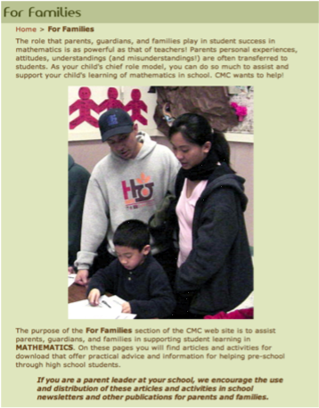
Turn to the CMC…FOR FAMILIES pages!

