Slide 1
The Vision of the Common Core: Embracing the Challenge
UCDMP Saturday Series 2013-2014
Secondary Session 4
March 15, 2014

Slide 2
Agenda
Morning: Grades 7-12
Welcome, Introductions and a Problem
Assessing Student Learning: Rubrics
Finding, Adapting and Creating Rubrics
Afternoon: Grades 6-8 and 9-12
Sharing Successes
Enhancing Classroom Dialogue: Constructing Arguments and Critiquing the Reasoning of Others
Accessing Resources for SMP 3
Feedback and Reflection

Slide 3
PRECISION PIZZA
A) Usually each person in a math study group eats a small round pepperoni pizza with a 6 inch diameter. There are five people in the study group and they want to share one pizza. Precision Pizza will make a round pizza of any diameter. To the nearest half inch, what is the diameter of the pizza that should be ordered from Precision Pizza so that everyone gets the usual amount? Show the work that leads to your answer.
B) Rather than ordering one large pizza, the students decide to order two pizzas, each with half the area of the large pizza. Joshua said that the sum of the circumferences of the two smaller pizzas was equal to the circumference of the large pizza. Barbara claimed he was mistaken. Who was right? Explain your answer.

Slide 4
Precision Pizza: Grading on a 4-point scale
In your group, talk about how this problem should be graded.
What are the big ideas in this problem?
What procedures or skills should students be using correctly?
What should constitute full credit? Partial credit?

Slide 5
What do you think?
What are some of the methods that you have used to assign a grade to student understanding? How effective were they?
Think about it and jot down 3 methods
Share your methods with your shoulder partner
As a pair, choose one method to share with your table
Share with other pairs at your table

Slide 6
Today’s Focus: Rubrics
Read and annotate “Guide to Scoring Rubrics”
* things you think are key ideas/important
? things you have questions about, or want to know more about
! things you agree with
- Things you do not completely agree with

Slide 7
Check them out
As a table group, discuss and prepare to present your rubric
What type of rubric is it?
What are the pros and cons of the rubric?
How might you use the rubric?
How might you improve the rubric?
Other comments about the rubric and/or it’s usefulness

Slide 8
PRECISION PIZZA revisited
Which Rubric would you use to score and why?

Slide 9
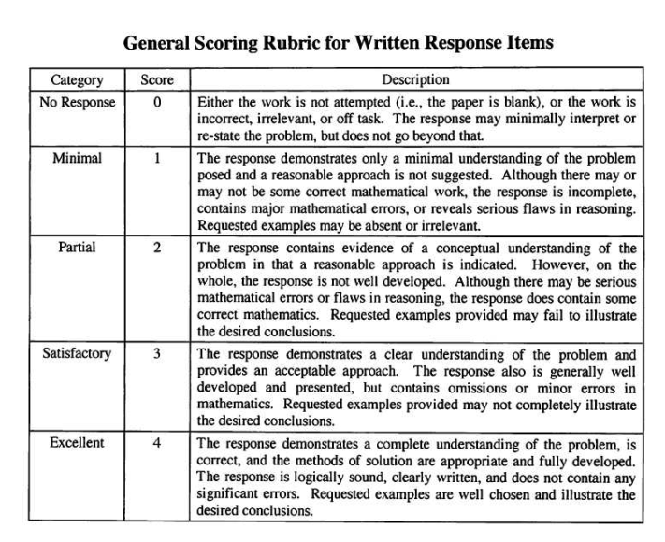

Slide 10
Create your own rubric
RubiStar: http://rubistar.4teachers.org/

Slide 11
Smarter Balanced Performance Task Specs
Scoring requirements
…to achieve score ranges for performance tasks that reflect the amount of work (and evidence) produced, every task will lead to scores for individual students with a total task score range equivalent to that of several constructed-response questions combined. For any particular task, this will be achieved by totaling points across scorable products, task parts/components, or product attributes, and not by a single holistic score.
from Smarter Balanced Assessment Consortium: Performance Task Specifications, April 16, 2012

Slide 12
Smarter Balanced Example

Slide 13
Smarter Balanced Example

Slide 14
Smarter Balanced Example

Slide 15
Smarter Balanced Example

Slide 16
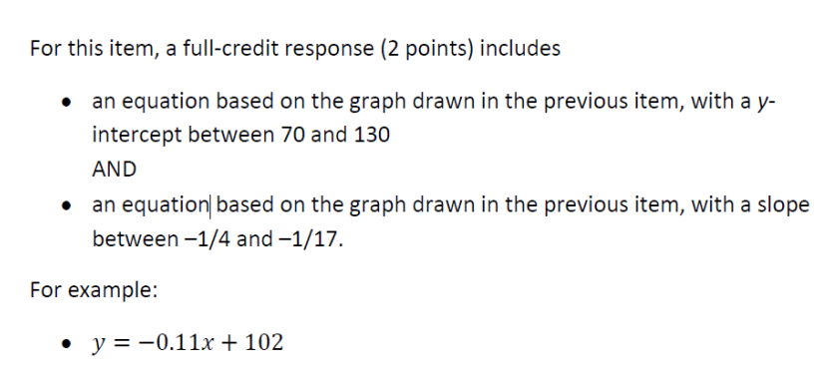
Smarter Balanced Example

Slide 17
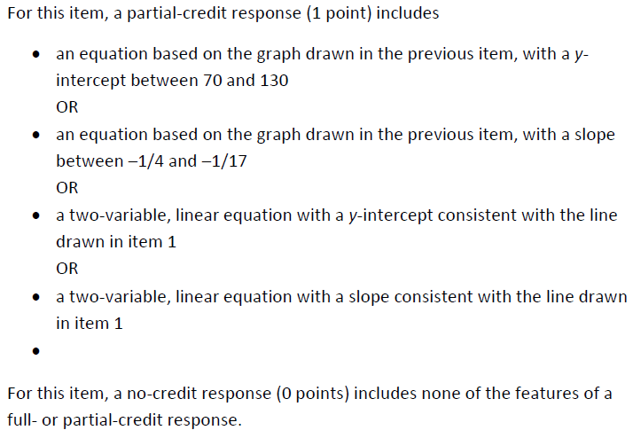
Smarter Balanced Example

Slide 18
Katie’s Pattern
Work out the Katie’s Pattern Task on your own
Review the Rubric on your own, and then with a partner
What questions do you have?
Score the T4 paper on your own, using the Rubric
Compare your score with your partner’s score

Slide 19
Katie’s Pattern

Slide 20
Katie’s Pattern

Slide 21
Katie’s Pattern

Slide 22
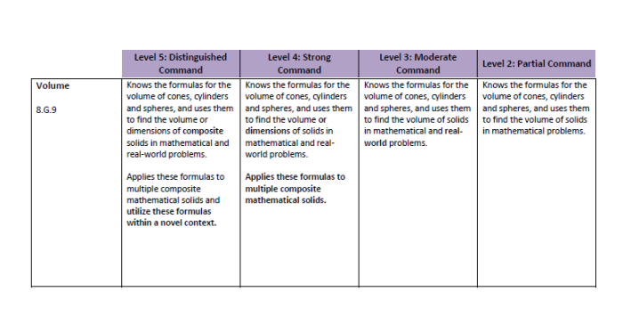
Scoring Standard Mastery

Slide 23
Scoring Standard Mastery
Choose a grade level, or course
Choose a standard, or cluster
Write a Standard Mastery Rubric

Slide 24
Rubric Scores to Traditional grades

Slide 25
Afternoon Sessions-12:45
Middle School: upstairs to the third floor…Rm 3106
High School: here in Rm 1147
At the end of the session, we will all end up here to turn in reflection forms, sign out and pick up PD certificates*.
*PD certificate CANNOT be reissued. Please pick your up and save it.

Slide 26
Sharing Success
This year, we have asked you to try out the ideas from the sessions in your classroom. We are all at different places in the transition to the Common Core and it is our belief that we all benefit from hearing where other teachers are at, both successes and struggles.

Slide 27
Sharing Success
At your table, please share your attempts to bring your classroom/school/district more in line with the CCSS-M.
Topics from the previous sessions include:
Using SBAC materials
Assessment FOR learning
Planning for Big Ideas
Using Mathematical Tasks
Incorporating Technology
Using Games
Building on Prior Knowledge

Slide 28
Orchestrating Productive Mathematical Discussions
Five practices for helping teachers move beyond show and tell

Slide 29
The Importance of Discussion
Mathematical discussions are a key part of current visions of effective mathematics teaching
To encourage student construction of mathematical ideas
To make student’s thinking public so it can be guided in mathematically sound directions
To learn mathematical discourse practices

Slide 30
Some Sources of the Challenge in Facilitating Discussions
Lack of familiarity
Reduces teachers’ perceived level of control
Requires complex, split-second decisions
Requires flexible, deep, and interconnected knowledge of content, pedagogy, and students

Slide 31
The Five Practices (+)
Anticipating (e.g., Fernandez & Yoshida, 2004; Schoenfeld, 1998)
Monitoring (e.g., Hodge & Cobb, 2003; Nelson, 2001; Shifter, 2001)
Selecting (e.g., Lampert, 2001; Stigler & Hiebert, 1999)
Sequencing (e.g., Schoenfeld, 1998)
Connecting (e.g., Ball, 2001; Brendehur & Frykholm, 2000)

Slide 32
Before the Practices: Setting Goals and Selecting Tasks
It involves:
Identifying what students are to know and understand about mathematics as a result of their engagement in a particular lesson
Being as specific as possible so as to establish a clear target for instruction that can guide the selection of instructional activities and the use of the five practices
It is supported by:
Thinking about what students will come to know and understand rather than only on what they will do
Consulting resources that can help in unpacking big ideas in mathematics
Working in collaboration with other teachers

Slide 33
Selecting a Task
It involves:
Identifying a mathematical task that is aligned with the lesson goals
Making sure the task is rich enough to support a discussion (i.e., a cognitively challenging mathematical task)
It is supported by:
Setting a clear and explicit goal for learning
Using the Task Analysis Guide which provides a list of characteristics of tasks at different levels of cognitive demand
Working in collaboration with colleagues

Slide 34
Task Analysis Guide

Slide 35
The Task

Slide 36
The Mathematical Goals of this Task
This lesson unit is intended to help you assess how well students are able to use geometric properties to solve problems. In particular, the lesson will help you identify and help students who have the following difficulties:
• Solving problems by determining the lengths of the sides in right triangles.
• Finding the measurements of shapes by decomposing complex shapes into simpler ones.
The lesson unit will also help students to recognize that there may be different approaches to geometrical problems, and to understand the relative strengths and weaknesses of those approaches

Slide 37
1. Anticipating
…..likely student responses to mathematical problems
It involves considering:
The array of strategies that students might use to approach or solve a challenging mathematical task
How to respond to what students produce
Which strategies will be most useful in addressing the mathematics to be learned
It is supported by:
Doing the problem in as many ways as possible
Discussing the problem with other teachers
Drawing on relevant research
Documenting student responses year to year

Slide 38
LEt’s Try Anticipating with this problem…
Doing the problem in as many ways as possible
Discussing the problem with other teachers

Slide 39
2. Monitoring
…students’ actual responses during independent work
It involves:
Circulating while students work on the problem and watching and listening
Recording interpretations, strategies, and points of confusion
Asking questions to get students back “on track” or to advance their understanding
It is supported by:
Anticipating student responses beforehand
Carefully listening and asking probing questions
Using recording tools

Slide 40
3. Selecting
…student responses to feature during discussion
It involves:
Choosing particular students to present because of the mathematics available in their responses
Making sure that over time all students are seen as authors of mathematical ideas and have the opportunity to demonstrate competence
Gaining some control over the content of the discussion (no more “who wants to present next?”)
It is supported by:
Anticipating and monitoring
Planning in advance which types of responses to select

Slide 41
4. Sequencing
…student responses during the discussion
It involves:
Purposefully ordering presentations so as to make the mathematics accessible to all students
Building a mathematically coherent story line
It is supported by:
Anticipating, monitoring, and selecting
During anticipation work, considering how possible student responses are mathematically related

Slide 42
5. Connecting
It involves:
Encouraging students to make mathematical connections between different student responses
Making the key mathematical ideas that are the focus of the lesson salient
It is supported by:
Anticipating, monitoring, selecting, and sequencing
During planning, considering how students might be prompted to recognize mathematical relationships between responses

Slide 43
Look at student work
Look at the samples of student work associated with this lesson.
If these were samples in your class, how would you purposefully order the presentations so as to make the mathematics accessible to all students? (Sequencing)
How would you help students build a mathematically coherent story line? (ssequencing)
How would you help students recognize the mathematical relationships between responses? (Connecting)

Slide 44
Why These Five Practices Likely to Help
Provides teachers with more control
Over the content that is discussed
Over teaching moves: not everything improvisation
Provides teachers with more time
To diagnose students’ thinking
To plan questions and other instructional moves
Provides a reliable process for teachers to gradually improve their lessons over time

Slide 45
Planning
For the rest of the session (until 3:45) work with your group to access tasks/lessons that will help you with SMP 3 Construct Viable Arguments and Critique the Reasoning of Others. If the resources don’t supply rubrics, see if one of the rubrics discussed earlier will work. If not, how can you adapt one of them so that it fits?
Explore resources and plan for implementation.
Plan to share out a summary of what you found and how you will use it.

Slide 46
Resources
SBAC
Mathematics Assessment Project
Illustrative Mathematics
Inside Mathematics
Mathematics Vision Project
Engage NY
Georgia Department of Education
Illinois Curriculum Model Units

Slide 47
Summer Opportunities for 7-12 Teachers
SAIM: Math Academy for teachers (and kids) grades 6-8
June 16-20 Learning and Planning (40 teachers) (DJUSD)
June 23-27 Implementing with KIDS! (10 teachers) (UCD)
Chance Encounters: Statistics and Probability in grades 7-12
July 14-18 (Vacaville District Office)
Bay Area math Project-Transformational Geometry grades 7-12
June 16-20 (American Canyon HS)

Slide 48
Feedback and Reflection
Please fill out the feedback form and turn it in as you sign out.
Resources from todays sessions will be available at the UCDMP resource link at http://education.ucdavis.edu/ucdmp-resources.
Thank you for coming and see you in May!

