Slide 1
The Vision of the Common Core: Embracing the Challenge
UCDMP Saturday Series 2013-2014
Secondary Session 2
November 2, 2013

Slide 2
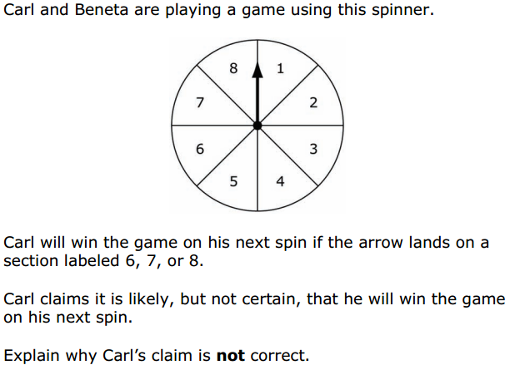

Slide 3
Agenda
Morning Session
  Introductions and a little math
  Assessment of learning vs. Assessment for learning
  Claim Three: Assessing students’ ability to
    Explain their reasoning,
    Construct viable arguments and
    Critique the reasoning of others.
Afternoon Sessions
Middle School:
  The use of games
  Planning for the CCSS-M
High School:
  Technology
  Planning for the CCSS-M

Slide 4
Some Information
Future Sessions:
  January 25, 2014
  March 15, 2014
  May 3, 2014
Teachers have the opportunity to purchase 2 CEU’s for attending 3 of the 5 Saturday sessions being offered, or 3 CEU’s for attending all 5 Saturday sessions being offered.

Slide 5
Assessments
What are various ways in which we assess:
  what students know, are able to do and understand?

Slide 6
Assessment and Learning
Assessment should be an integral part of teaching. It is the mechanism whereby teachers can learn how students think about mathematics as well as what students are able to accomplish.
Assessment should allow all students to show what they know, understand and can do.
Cockcroft Report 1982

Slide 7
Assessment
What are the characteristics of a “good” assessment?
According to the Shell Centre, high quality assessment has:
Curriculum balance
Curriculum value
Fitness for purpose

Slide 8
Two Types of Assessment
Assessment of Learning
Assessment for Learning

Slide 9
Summative Assessments: Assessment of learning
Focus:
To determine:
  how student groups are progressing
  how well program is working
Examples
  Graded class work or homework
  Quizzes
  End of unit tests
  Midterms
  District benchmarks
  Large Scale Assessments

Slide 10
Summative Assessments: Assessment of learning
Occur within, between, and at the end of instructional units
Used to identify strengths and gaps in curriculum and instruction
  Curriculum may be refined
  Teachers may modify instruction

Slide 11
Summative Assessments: Assessment of learning
Large Scale Assessments
Focus: To determine how schools, districts and states are progressing over time
Frequently high stakes
Examine trends over time
Used to develop long-term evaluation of curriculum and programs
Used to monitor school site, district and state progress

Slide 12
Summative Assessments: Assessment of learning
Large Scale Assessments
Examples:
  End of course exams
  CST
  NAEP
  SAT/ACT Exams
  AP Exams
  SBAC

Slide 13
Assessment for Learning:
Formative Assessment
Assessment for learning is one of the most powerful ways of improving learning and raising standards.
Black and Wiliam 1998

Slide 14
Assessment for Learning:
Formative Assessment
Occurs continuously in classrooms both within and between lessons
Is used to adjust teaching strategies
Provides students with useful and meaningful feedback

Slide 15
Assessment for Learning:
Formative Assessment
Focus:
To determine what learning comes next
Examples:
  Feedback
  Open questioning
  Exit tickets
  Observations
  Discussions
  Ungraded classwork/ homework

Slide 16
Assessment
Think of how and when you assess your students:
Which ones are assessments of learning?
Which ones are assessments for learning?

Slide 17
Assessment 3-2-1
“What a Difference a Word Makes”
Read the article and record:
3 statements you find interesting
2 statements that surprise you
1 statement that inspires you

Slide 18
Sharing
Go around the group and share one of the following:
One of the statements you find interesting
One of the statements that surprise you
The statement that inspires you
Pick one thing from your group to share with the whole group

Slide 19
Large Scale Assessment
WYTIWYG!
What You Test Is What You Get!

Slide 20
Goals of Assessment
“We must ensure that tests measure what is of value, not just what is easy to test. If we want students to investigate, explore, and discover, assessment must not measure just mimicry mathematics.”
Everybody Counts
Notes:
20

Slide 21
SBAC Details
Students will be tested on four claims:
  Claim 1: Concepts and Procedures (≅40%) (DOK 1,2*)
  Claim 2: Problem Solving (≅20%) (DOK 2*,3)
  Claim 3: Communicating Reasoning (≅20%) (DOK 2,3*,4)
  Claim 4: Modeling and Data Analysis (≅20%) (DOK 2,3*4)
DOK refers to the Depth of Knowledge Level, * indicates predominance

Slide 22
Claim 3: Communicating Reasoning (20%)
Claim 3 refers to a recurring theme in the CCSSM content and practice standards—the ability to construct and present a clear, logical, convincing argument. For older students, this may take the form of a rigorous, deductive proof based on clearly stated axioms. For younger students, this will involve more informal justifications. Assessment tasks that address this claim will typically present a claim and ask students to provide, for example, a justification or counterexample.

Slide 23
Claim 3: Communicating Reasoning (20%)
Claim 3 will be assessed using a combination of SR, CR, TE, PT, and ER items/tasks that focus on mathematical reasoning. Some tasks will require students to construct chains of reasoning without specific guidance being provided throughout the task.

Slide 24
Claim 3: Communicating Reasoning (20%)
Students can clearly and precisely construct viable arguments to support their own reasoning and to critique the reasoning of others
Test propositions or conjectures with specific examples.
Construct, autonomously, chains of reasoning that justify or refute propositions or conjectures.
State logical assumptions being used.
Use the technique of breaking an argument into cases.
Distinguish correct logic or reasoning from that which is flawed,
and—if there is a flaw in the argument—explain what it is.
Base arguments on concrete referents such as objects, drawings, diagrams, and actions.
Determine conditions under which an argument does and
does not apply.

Slide 26
Scoring Rubric:
Responses to this item will receive 0–2 points, based on the following:
2 points: The student shows thorough understanding of how to use understanding of likelihood and probability to critique the reasoning of others. The student explains why Carl’s claim is incorrect and describes an appropriate event for Beneta.
1 point: The student shows partial understanding of how to use understanding of likelihood and probability to critique the reasoning of others. The student explains why Carl’s claim is incorrect. OR The student describes an appropriate event for Beneta.
0 points: The student shows inconsistent or no understanding of how to use likelihood and probability to critique the reasoning of others. The student fails to provide a correct explanation or event.

Slide 27
Sample Top-Score Response:
Carl’s claim is incorrect. The probability that Carl will spin a 6 or higher is 0.375. This means that it is more likely that Carl will spin a number less than 6 on his next turn.
For Beneta, event X could be “the arrow lands on a section labeled with a number greater than 2.”

Slide 28
Which Assessment Targets Does this Assess?
Primary Claim: 3
  Target:
Secondary Claim: 1
  Target(s):

Slide 29
Claim 3: Communicating Reasoning (20%)
Samir was assigned to write an example of a linear functional relationship. He wrote this example for the assignment.
  The relationship between the year and the population of a county when the population increases by 10% each year
A. Complete the table to create an example of the population of a certain county that is increasing by 10% each year.
B. State whether Samir’s example represents a linear functional relationship. Explain your reasoning.

Slide 30
Scoring Rubric:
Responses to this item will receive 0-2 points, based on the following:
2 points: The student shows a thorough understanding of how to distinguish between linear and nonlinear relationships. The student correctly completes the table showing a 10% increase in population each year, states that the relationship is not linear, and provides a clear and complete explanation of why the relationship is not linear. Rounding to the nearest whole number for the population is permitted.
1 point: The student shows a partial understanding of how to distinguish between linear and nonlinear relationships. The student makes calculation errors in the table but gives a response in Part B that corresponds with the numbers in the table OR the student completes the table correctly but provides an incorrect explanation in Part A.
0 points: The student shows inconsistent or no understanding of how to distinguish between linear and nonlinear relationships. The student makes major errors when completing the table and gives a response in Part B that does not correspond to the values entered in the table.

Slide 31
Sample Top-Score Response

Slide 32
Which Assessment Targets Does this Assess?
Primary Claim: 3
  Target:
Secondary Claim: 1
  Target(s):

Slide 33
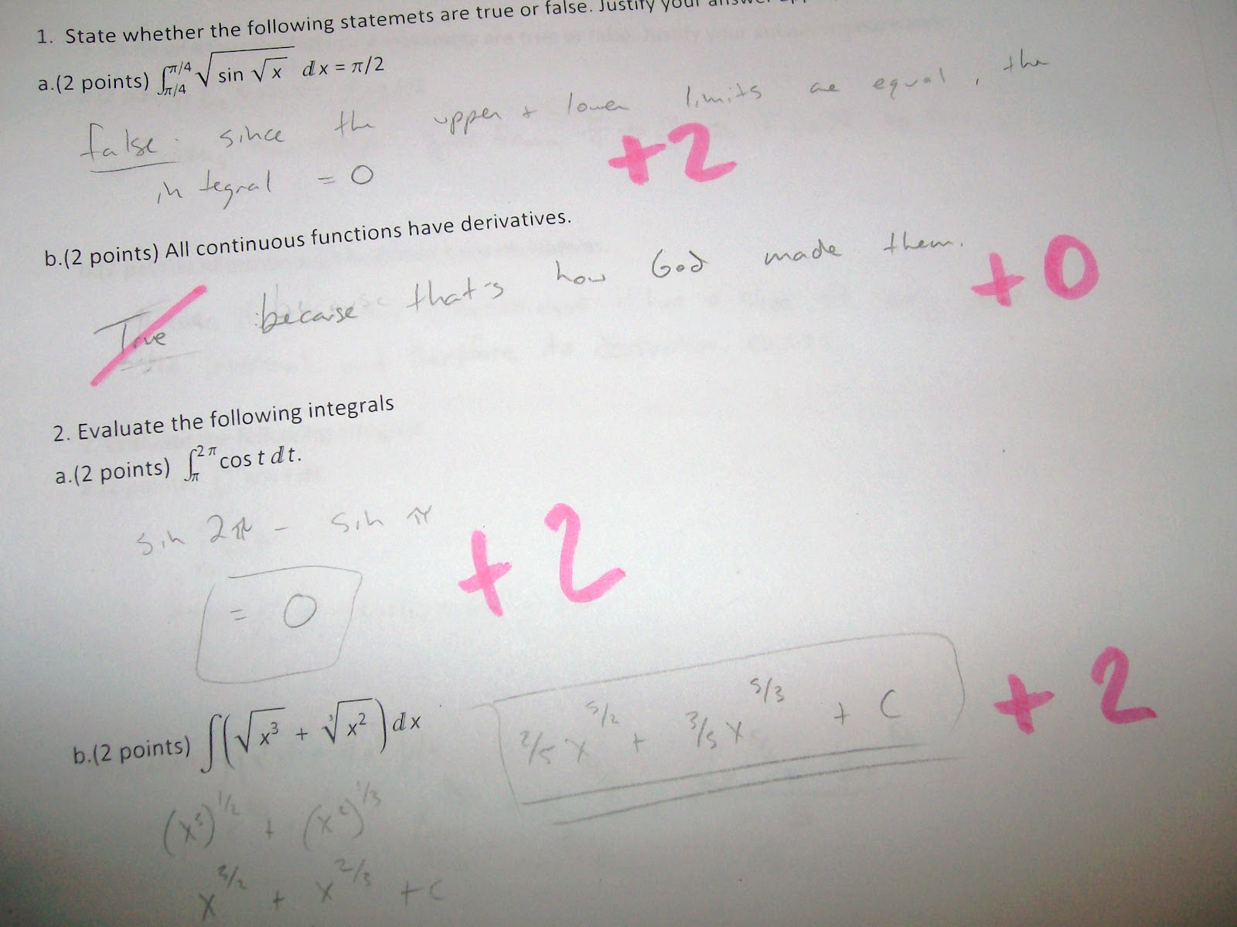
A Note on “Grading” for Learning
Paul Black is professor emeritus in the School of Education. King’s College, London. His comments relate to an article “Inside the Black Box” 1998
Comments Only
Grade Only
Comments and Grade

Slide 34
Shifting to Assessment for Learning
Now read the handout “How Students Should be Taught Mathematics…”
Reflect on the comments Dr. Black made as well as the writings of Dr. Boaler
  Make some notes on the following question:
    What might you try in your classroom as a result of this information?

Slide 35
Using Technology to Engage Students in Learning Mathematics
UCDMP Saturday Series 2013-2014
High school session 2
November 2, 2013

Slide 36
Let’s Investigate a Problem
Using GeoGebra on the iPad or on your own computer, construct a parallelogram.
Now construct the angel bisectors of all four vertices.
  What polygon is formed? Is it consistent or varied? Is it really what it appears to be? Why?
If you finish this quickly and want another challenge, start with an isosceles trapezoid and do the same thing.

Slide 37
Desmos and Dan Meyer
Go to :
https://class.desmos.com/class/eamle
And follow the instructions to investigate the Penny Problem

Slide 38
Planning: Using Technology to Engage Students
What technologies do you have at your disposal?
Get into a group based on a technology you can employ in the next few weeks.
Plan a lesson/activity using technology to engage students.
Let us know your plan.
Next session we will have you report out on your successes.

