Slide 1
The Vision of the Common Core: Embracing the Challenge
UCDMP Saturday Series 2013-2014
Secondary Session 3
January 25, 2014

Slide 2
January 25, 2014 AM – Focus on Assessment: Participants will examine the role of mathematical tasks, focusing on the use of these tasks both as a regular part of classroom instruction and as a tool to assess students’ problems solving abilities and explanations. PM – Planning units/lessons aligned to common core: – In grade-span groups, teachers from grades K-5 and High School will investigate how using students’ prior knowledge can help them access new content and develop the deeper understanding needed to meet the demands of the CCSS-M. – Grades 6-8 teachers will examine a variety of technologies available to help students explore and develop conceptual understanding of key mathematics concepts. – All groups will spend time planning ways to implement the ideas discussed in the session as well as reviewing student work brought as evidence from implementation of prior planning.

Slide 3
Agenda
Morning: Grades 7-12
Welcome, Introductions and a Problem
Introduction to Claim 2: Problem Solving
Finding, Adapting and Using Tasks
Afternoon: Grades 9-12
Sharing Successes
Building on Prior Knowledge
Planning for Implementation

Slide 4
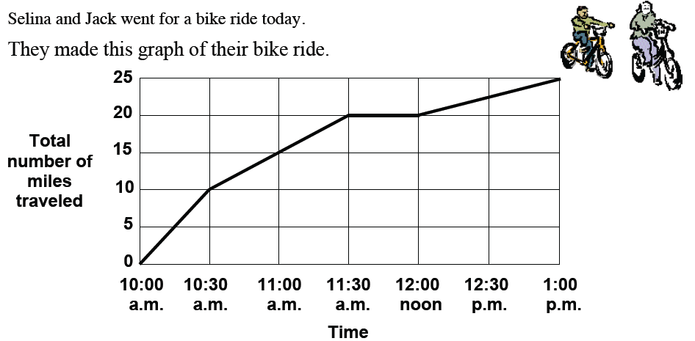
Bike ride

Slide 5
SBAC Claims
Students will be tested on four claims:
Claim 1: Concepts and Procedures (≅40%) (DOK 1,2*)
Claim 2: Problem Solving (≅20%) (DOK 2*,3)
Claim 3: Communicating Reasoning (≅20%) (DOK 2,3*,4)
Claim 4: Modeling and Data Analysis (≅20%) (DOK 2,3*4)
DOK refers to the Depth of Knowledge Level, * indicates predominance

Slide 6
SBAC Claim 2
Students can solve a range of complex well-posed problems in pure and applied mathematics, making productive use of knowledge and problem solving strategies.
Assessment items and tasks focused on Claim 2 include well-posed problems in pure mathematics and problems set in context. Problems are presented as items and tasks that are well-posed (that is, problem formulation is not necessary) and for which a solution path is not immediately obvious. These problems require students to construct their own solution pathway rather than follow a provided one. Such problems will therefore be unstructured, and students will need to select appropriate conceptual and physical tools to use.

Slide 7
Claim TWO Sample Items
For each problem on the following slides, identify the grade level, domain and assessment target as well as the problem type.
What do students need to know, understand and/or be able to do in each problem?

Slide 8
MAT.07.ER.2.0000G.F.501
Consider a circle that has a circumference of centimeters (cm).
Part A What is the area, in cm², of this circle? Show all work necessary to justify your response.
Part B What would be the measure of the radius, in cm, of a circle with an area that is 20% greater than the circle in Part A? Show all work necessary to justify your response.
The total cost of an order of shirts from a company consists of the cost of each shirt plus a one-time design fee. The cost of each shirt is the same regardless of how many shirts are ordered. The company provides the following examples to customers to help them estimate the total cost of an order of shirts:
• 50 shirts cost $349.50
• 500 shirts cost $2370
Part A Based on the examples, what is the cost of each shirt, not including the one-time design fee? Explain how you found your answer.
Part B What is the cost of the one-time design fee? Explain how you found your answer.
MAT.08.ER.2.0000F.C.130

Slide 9
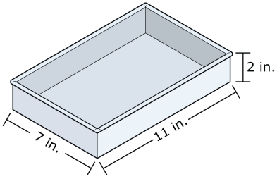
MAT.HS.CR.2.0ASSE.A.005
The figure below is made up of a square with height, h units, and a right triangle with height, h units, and base length, b units.
The area of this figure is 80 square units.
Write an equation that solves for the height, h, in terms of b. Show all work necessary to justify your answer.
Hannah makes 6 cups of cake batter. She pours and levels all the batter into a rectangular cake pan with a length of 11 inches, a width of 7 inches, and a depth of 2 inches.
One cubic inch is approximately equal to
0.069 cup. What is Depth of the batter in
the pan when it is completely poured in?
Round your answer to the nearest in.
MAT.HS.CR.2.0NUMQ.A.603

Slide 10
What is a Mathematical Task?
A mathematical task is a problem or set of problems that focuses students’ attention on a particular mathematical idea and/or provides an opportunity to develop or use a particular mathematical habit of mind.

Slide 11
Worthwhile Mathematics Tasks
The teacher of mathematics should pose tasks that are based on—
sound and significant mathematics;
knowledge of students' understandings, interests, and experiences;
knowledge of the range of ways that diverse students learn mathematics

Slide 12
Worthwhile Mathematics Tasks
and that —
engage students' intellect;
develop students' mathematical understanding and skills;
stimulate students to make connections and develop a coherent framework for mathematical reasoning;
promote communication about mathematics;
represent mathematics as an ongoing human activity;
display sensitivity to, and draw on, students' diverse background experiences and dispositions;
promote the development of all students' dispositions to do mathematics.

Slide 13
Using Tasks in the classroom
Mathematical Tasks Framework
Student
LEARNING
TASKS as
they appear
in
instructional
materials
TASKS
as set up by
teachers
TASKS
as
implemented
by students
Stein et al., 2000

Slide 14
What is meant by cognitive demand?
-The kind and level of thinking required of students in order to successfully engage with and solve the task.

Slide 15
Task Categories (Stein et al.)
Lower level demands | Higher level demands
Memorization | Procedures With Connections
Procedures Without Connections | Doing Mathematics

Slide 16
“Problems can change in their nature as they are worked out during the lesson. Teachers can transform problems so that the focus shifts from one kind of mathematical process to another.”
TIMSS 1999 Video Study, p. 119

Slide 17
“Simply selecting and beginning a lesson with a high level task did not guarantee that students would actually think and reason in cognitively complex ways… A variety of factors were found to conspire to reduce the level of cognitive demand of a task once it was unleashed into the classroom environment.”
Stein, et al., p. 24

Slide 18
In contrast [to all other nations in the study], virtually none of the making connections problems in the United states were discussed in a way that made the mathematical connections or relationships visible for students.”
TIMSS Video Study, p. 120

Slide 19
In their enactment during the lessons in the United States, all of the tasks intended for higher levels of cognitive demand slid downward into opportunities to practice procedures or simply give answers.

Slide 20
Why is cognitive demand so important?
It is the level and kind of thinking in which students engage that determines what they will learn – and what they believe math is all about
Stein et al., 2000

Slide 21
Student learning can not be expected to deepen or become more conceptually rich unless students are regularly, actively, and productively engaged with cognitively challenging problems.

Slide 22
Cognitive demand does not reside in the task. A high-level task is necessary but not sufficient for high-level thinking.

Slide 23
Student
LEARNING
TASKS as
they appear
in
instructional
materials
TASKS
as set up by
Teachers
Task features
Cognitive demand
TASKS
as
implemented
by students
Enactment of task features
Cognitive processing
Factors influencing set up
Teacher goals
Teacher knowledge-subject, students
Factors influencing implementation
Classroom norms
Task conditions
Teacher instructional habits/dispositions
Student Learning habits/dispositions

Slide 24
Using Tasks in the classroom
Formative assessment
Exploring new concepts
Support learning
Summative Assessment

Slide 25
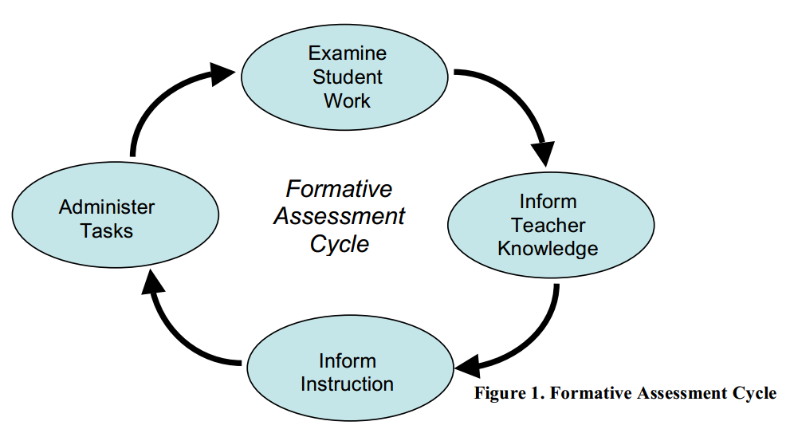
Tasks for Formative Assessment

Slide 26
Lets Look at Some student Work
Look at the student work in the packet provided
What does the work tell you about what each student knows?
If this was representative of your class, what teaching activities might you plan?

Slide 27
Using Tasks in the classroom
Formative assessment
Exploring new concepts
Support learning
Summative Assessment

Slide 28
Let’s do a problem
Ms. Alvarado’s class will raise rabbits for their spring science fair. They have 24 feet of fending with which to build a rectangular pen to keep their rabbits.
If Ms. Alvarado’s students want their rabbits to have as much room as possible, how long would each of the sides of the pen be?
How long would each of the sides of the pen be if they only had 16 feet of fencing?
How would you go about determining the pen with the most room for any amount of fencing?
Organize your work so that someone else who reads it will understand.

Slide 29
Using Tasks in the classroom
Formative assessment
Exploring new concepts
Support learning
Summative Assessment

Slide 30
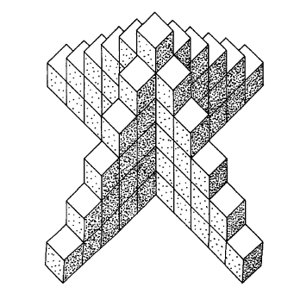
Skeleton Tower
How many cubes are needed to build this tower?
How many cubes are needed to build a tower like this, but 12 cubes high?
How would you make a calculate the number of cubes needed for a tower n cubes high?

Slide 31
Using Tasks in the classroom
Formative assessment
Exploring new concepts
Support learning
Summative Assessment

Slide 32
Water Tank or Water Tower?
The population of Carroll is approximately 20,000 and has remained constant for the last 20 years. Carroll currently uses an outdated water supply system to get its water from a nearby river. The outdated system will be replaced by a system that draws from a reservoir.
Members of the finance committee on the Carroll town council are responsible for investigating the costs of a new water treatment plant. As one of the finance committee members, you must make a recommendation that will best meet the needs of the town at this time. The two options are as follows:
• Building a water tank on Lewis Mountain
• Building a water tower at a connection point on the edge of town

Slide 33
Claim 4: Modeling and Data Analysis
Claim 2: Problem Solving
Primary Content Domain: Geometry
Secondary Content Domain(s): Ratios and Proportional Relationships, Statistics and Probability
Assessment Target(s):
4 A: Apply mathematics to solve problems arising in everyday life, society, and the workplace.
1 H: Understand and apply the Pythagorean theorem.
1 I: Solve real-world and mathematical problems involving volume of cylinders, cones, and spheres.
1 A (Gr. 7): Analyze proportional relationships and use them to solve real-world and mathematical problems.
1 G (Gr. 7): Use random sampling to draw inferences about a population.
1 A (Gr. 6): Understand ratio concepts and use ratio reasoning to solve problems.
2 A: Apply mathematics to solve well-posed problems arising in everyday life, society, and the workplace.
2 B: Select and use appropriate tools strategically.
4 B: Construct, autonomously, chains of reasoning to justify mathematical models used, interpretations made, and solutions proposed for a complex problem.

Slide 34
Resources for Tasks aligned to the common core
http://www.ode.state.or.us/search/page/?id=3747
http://schools.nyc.gov/Academics/CommonCoreLibrary/TasksUnitsStudentWork/default.htm
http://nrich.maths.org/7701
http://www.insidemathematics.org/
http://www.illustrativemathematics.org/
http://map.mathshell.org/materials/background.php
http://www.mathematicsvisionproject.org/

Slide 35
Sharing Success
We have asked you to try new things the past couple sessions. In September, we asked you to plan a unit or series of lessons based on a single problem (like Snakes) and in November we asked you to use technology in your classroom. We would like you to share out what you have tried and how it went.

Slide 36
Feedback and Reflection
Please fill out the feedback form and turn it in as you sign out.
Resources from todays sessions will be available at the UCDMP resource link at http://education.ucdavis.edu/ucdmp-resources.
Thank you for coming and see you in March!

