Slide 1
The Vision of the Common Core: Embracing the Challenge
UCDMP Saturday Series 2013-2014
Secondary Session 1
September 21, 2013

Slide 2
Agenda
Welcome, Introductions and a Problem
Update on Testing in California for Spring 2014
SBAC: What we all need to know
A Focus on Claim One: Implications for teaching
Lunch
SNAKES!
Planning Lessons Aligned to the Common Core
  Understanding the Standards
  Seeing the Big Picture
  Using Resources
Feedback and Reflection

Slide 3
Three students saved money for four weeks
Antwan saved the same amount of money each week for 4 weeks. He made this graph to show how much money he saved.
Carla saved the same amount of money each week for 4 weeks. She made this table to show how much money she saved.
Omar saved the same amount of money each week for 4 weeks. He wrote the equation below to show how much he saved. In the equation, S is the total amount of money saved, in dollars, and w is the number of weeks.
Identify the student who saved the greatest amount of money each week and the student who saved the least amount of money each week.

Slide 4
Grade 8 Mathematics Sample TE Item form claim 2

Slide 5
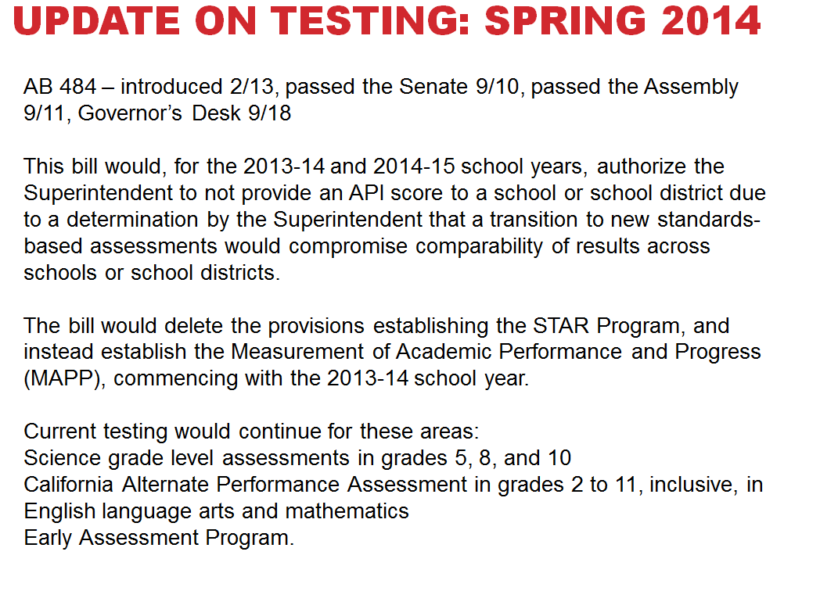

Slide 6
Overview of the upcoming tests
Two Testing Consortiums
The SMARTER Balanced Assessment Consortium(SBAC)
The Partnership for the Assessment of Readiness for College and Careers (PARCC)

Slide 7
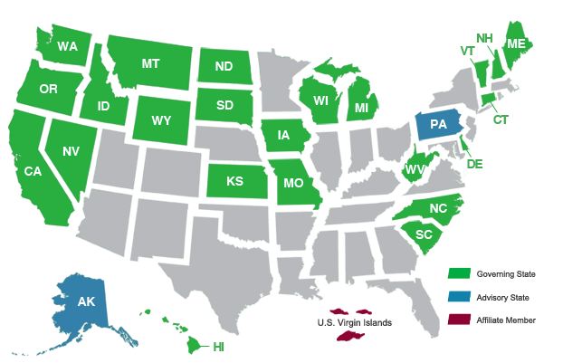
Overview of the upcoming tests: SBAC
PARCC Member State
Did not Adopt CCSS Adopted CCSS but Not in Either Consortium

Slide 8
SBAC Details
Who will be tested?
Summative testing will occur at grades 3-8 and 11 (optional 9th and 10th grade tests will be made available for additional cost)
What types of items/questions will be on the SBAC summative assessment?
Selected Response Items (SR) contain a series of options from which to choose correct responses.
Constructed Response (CR) is a general term for items requiring the student to generate a response as opposed to selecting a response. Both short and extended constructed response (ER) items will be used. ER items/tasks will contribute to the performance task component; CR items will contribute to the computer-adaptive component.
Technology Enhanced Items employ technology to assess content, cognitive complexity, and Depth of Knowledge not assessable otherwise.
Performance tasks…specifications call for multi-part, multi-session activities during which students individually will produce several scorable responses, products, or presentations.

Slide 9
SBAC Details
What time of year will the new assessments be administered?
The details of the exact length of the testing window have yet to be determined. It is anticipated that each student will have up to two opportunities to test in order to demonstrate proficiency. The adaptive nature of the online assessment components (not including performance tasks) allows for flexibility in the testing window.
How long will it take a student to complete the summative assessment?
The end-of-year summative assessment consists of two parts: (1) a computer adaptive portion and (2) performance tasks. It is anticipated that the computer adaptive test will be similar in length or shorter than the current summative tests, which take about an hour for each content area.

Slide 10
SBAC Details
What will be tested?
Students will be tested on four claims:
Claim 1: Concepts and Procedures (≅40%) (DOK 1,2*)
Claim 2: Problem Solving (≅20%) (DOK 2*,3)
Claim 3: Communicating Reasoning (≅20%) (DOK 2,3*,4)
Claim 4: Modeling and Data Analysis (≅20%) (DOK 2,3*4)
DOK refers to the Depth of Knowledge Level, * indicates predominance

Slide 11
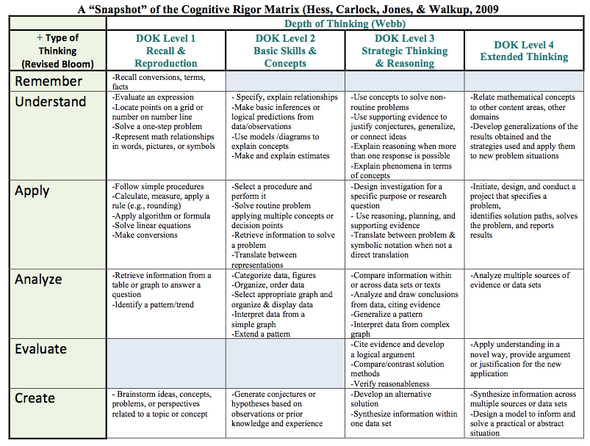

Slide 12
Let’s See What the test will be like
Find a partner who teaches at the same grade level as you.
Grab a computer or iPad and turn it on.
Open either Internet Explorer or Safari (Chrome has been having issues)
Go to www.smarterbalanced.org

Slide 13
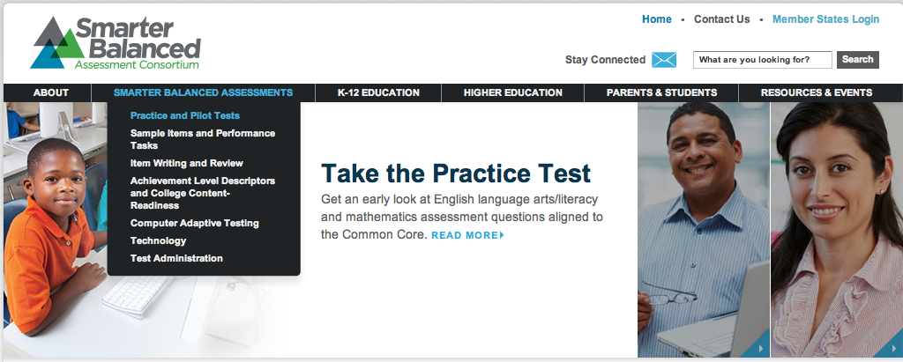

www.smarterbalanced.org

Slide 14
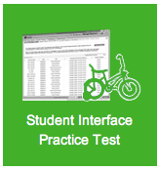
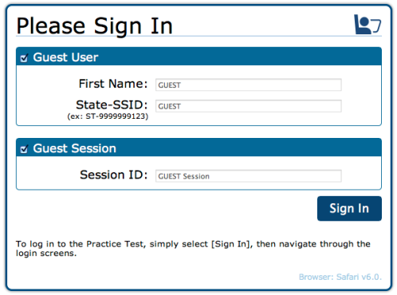
www.smarterbalanced.org
Just Click Sign in

Slide 15
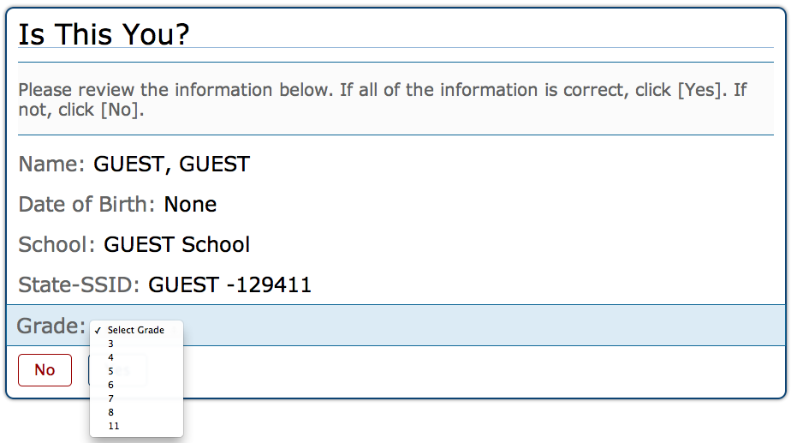
www.smarterbalanced.org
Select your grade level and click YES

Slide 16
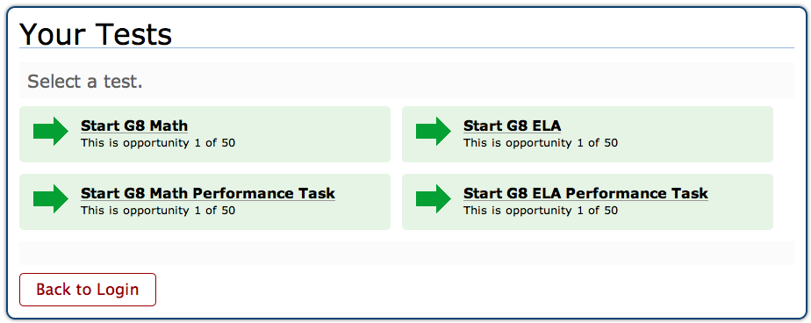
Select the appropriate test
After you take the selected response/constructed response portion, take a look at the performance task.

Slide 17
A Note About this Practice Test
Although this is computer based, it is NOT computer adapted.
When you finish a segment, the computer will prompt you to go back and check your answers before you continue.
When you get to the end of the practice test, you will be prompted to review your work before submitting the test.
You will not be given any feedback on your answers.

Slide 18
Implications for teaching
When you finish your practice test, talk with your partner about the following:
What type of items were “sampled”? (Selected response, constructed response, technology enhanced, and performance task items)
What DOK were these items?
How does this test compare to the CST’s your students have been taking for the past decade? Are their similarities? Differences?
How might this change what you do on a daily basis with your students?
How might this change your assessment practices?
Now find another pair at a different grade level and discuss your reactions to this sample test.

Slide 19
SBAC: A Focus on Claim One
“Students can explain and apply mathematical concepts and interpret and carry out mathematical procedures with precision and fluency.”
Approximately 40%

Slide 20
Assessment Targets
Claim 1: Students can explain and apply mathematical concepts and interpret and carry out mathematical procedures with precision and fluency.
Grade Level | Number of Assessment Targets
3 | 11
4 | 12
5 | 11
6 | 10
7 | 9
8 | 10
11 | 16
Notes:
The number of Claim 1 assessment targets varies across grade levels. The assessment targets for each grade level are presented in detail in the Content Specifications and are explored in greater detail in the Grade Level Considerations training modules. For now, note that careful thought went into examining the progression of mathematical knowledge and skills as students progress from early elementary grades through high school and as students develop college and career readiness. This progression informed the development of each grade level assessment target. Also note that for high school, assessment targets are established for grade 11 only and reflect the skills and knowledge students are expected to demonstrate in order to be college and career ready.
To help use assessment targets to inform the development and review of items and tasks, let’s take a closer look at the structure of an assessment target.

Slide 21
Claim 1: Students can explain and apply mathematical concepts and interpret and carry out mathematical procedures with precision and fluency
7th Grade
Ratios and Proportional Relationships
A. Analyze proportional relationships and use them to solve real-world and mathematical problems.
The Number System
B. Apply and extend previous understandings of operations with fractions to add, subtract, multiply, and divide rational numbers.
Expressions and Equations
C. Use properties of operations to generate equivalent expressions.
D. Solve real-life and mathematical problems using numerical and algebraic expressions and equations.

Slide 22
Claim 1: Students can explain and apply mathematical concepts and interpret and carry out mathematical procedures with precision and fluency
7th Grade Continued
Geometry
E. Draw, construct and describe geometrical figures and describe the relationships between them.
F. Solve real-life and mathematical problems involving angle measure, area, surface area, and volume.
Statistics and Probability
G. Use random sampling to draw inferences about a population.
H. Draw informal comparative inferences about two populations.
I. Investigate chance processes and develop, use, and evaluate probability models.

Slide 23
Claim 1: Students can explain and apply mathematical concepts and interpret and carry out mathematical procedures with precision and fluency
8th Grade
The Number System
A. Know that there are numbers that are not rational, and approximate them by rational numbers.
Expressions and Equations
B. Work with radicals and integer exponents.
C. Understand the connections between proportional relationships, lines, and linear equations.
D. Analyze and solve linear equations and pairs of simultaneous linear equations.
Functions
E. Define, evaluate, and compare functions.
F. Use functions to model relationships between quantities.

Slide 24
Claim 1: Students can explain and apply mathematical concepts and interpret and carry out mathematical procedures with precision and fluency
8th Grade Continued
Geometry
G. Understand congruence and similarity using physical models, transparencies, or geometry software.
H. Understand and apply the Pythagorean theorem.
I. Solve real-world and mathematical problems involving volume of cylinders, cones and spheres.
Statistics and Probability
J. Investigate patterns of association in bivariate data

Slide 25
Claim 1: Students can explain and apply mathematical concepts and interpret and carry out mathematical procedures with precision and fluency
High School
Number and Quantity
A. Extend the properties of exponents to rational exponents.
B. Use properties of rational and irrational numbers.
C. Reason quantitatively and use units to solve problems.
Algebra
D. Interpret the structure of expressions.
E. Write expressions in equivalent forms to solve problems.
F. Perform arithmetic operations on polynomials.
G. Create equations that describe numbers or relationships.
H. Understand solving equations as a process of reasoning and
explain the reasoning.
I. Solve equations and inequalities in one variable.
J. Represent and solve equations and inequalities
graphically.

Slide 26
Claim 1: Students can explain and apply mathematical concepts and interpret and carry out mathematical procedures with precision and fluency
High School Continued
Functions
K. Understand the concept of a function and use function notation.
L. Interpret functions that arise in applications in terms of a context.
M. Analyze functions using different representations.
N. Build a function that models a relationship between two quantities.
Geometry
O. Prove geometric theorems.
Statistics and Probability
P. Summarize, represent and interpret data on a single count or measurement

Slide 27
Claim One Sample Items
For each problem on the following slides, identify the grade level, domain and assessment target as well as the problem type.
What do students need to know, understand and/or be able to do in each problem?

Slide 28
MAT.08.SR.1.000EE.B.203
MAT.08.CR.1.000F.E.135 C1 TE

Slide 29
MAT.07.SR.1.000SP.H.164

Slide 30
MAT.HS.CR.1.00FBF.N.275
MAT.08.SR.1.000EE.B.203

Slide 31
MAT.08.SR.1.000EE.D.204
MAT.08.CR.1.00EE.B.494

Slide 32
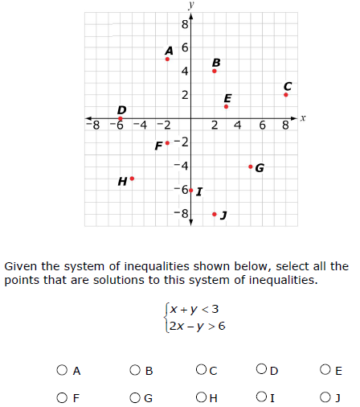
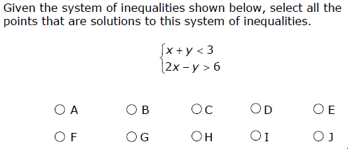
MAT.HS.SR.1.0REI.J012

Slide 33
MAT.HS.SR.1.00SID.P.084

Slide 34
MAT.07.CR.1.000EE.C.296
MAT.07.SR.1.000NS.B.163

Slide 35
MAT.HS.TE.1.0AREI.I.008

Slide 36
Implications for teaching
After looking at these Claim One sample items, talk with your group about the following:
What are the differences between these assessment items and the assessment items with which our students are familiar?
What are your feelings about these differences? Good? Bad? Indifferent?
What immediate changes can you make to help your students with the transition to this new type of testing?

Slide 37
The Vision of the Common Core: Embracing the Challenge
UCDMP Saturday Series 2013-2014
High school session 1
September 21, 2013

Slide 38
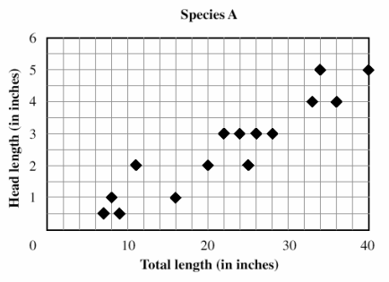
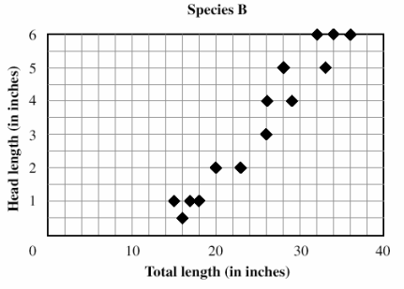
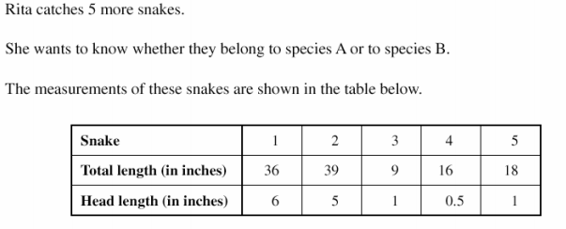
S-ID.6a Fit a function to the data; use functions fitted to data to solve problems in the context of the data.

Slide 39
Snakes!
Share your solution to the problem with your neighbor. Do you agree on the species? Do you have the same justification?
Are both justifications viable? Could they be made more so?

Slide 41
Planning Lessons Aligned to the CCSS: Understanding the Standards
Course Overview

Slide 42
Planning Lessons Aligned to the CCSS: Understanding the Standards
Conceptual Category

Slide 43
Planning Lessons Aligned to the CCSS: Understanding the Standards
Domain

Slide 44
Planning Lessons Aligned to the CCSS: Understanding the Standards
Cluster

Slide 45
Planning Lessons Aligned to the CCSS: Understanding the Standards
Modeling
Looking at the standards in this cluster, what do students need to know, understand and be able to do?

Slide 46
A note on understanding: Connecting the Standards for Mathematical Practice to the Standards for Mathematical Content
The Standards for Mathematical Content are a balanced combination of procedure and understanding. Expectations that begin with the word “understand” are often especially good opportunities to connect the practices to the content. Students who lack understanding of a topic may rely on procedures too heavily. Without a flexible base from which to work, they may be less likely to consider analogous problems, represent problems coherently, justify conclusions, apply the mathematics to practical situations, use technology mindfully to work with the mathematics, explain the mathematics accurately to other students, step back for an overview, or deviate from a known procedure to find a shortcut. In short, a lack of understanding effectively prevents a student from engaging in the mathematical practices.

Slide 47
A note on understanding: Connecting the Standards for Mathematical Practice to the Standards for Mathematical Content
In this respect, those content standards which set an expectation of understanding are potential “points of intersection” between the Standards for Mathematical Content and the Standards for Mathematical Practice. These points of intersection are intended to be weighted toward central and generative concepts in the school mathematics curriculum that most merit the time, resources, innovative energies, and focus necessary to qualitatively improve the curriculum, instruction, assessment, professional development, and student achievement in mathematics.

Slide 48
A note on understanding: The CCSS
These Standards define what students should understand and be able to do in their study of mathematics. Asking a student to understand something means asking a teacher to assess whether the student has understood it. But what does mathematical understanding look like?
apply
model
extend
explain
Illustrate
interpret
analyze
justify
construct
assess
prove
derive

Slide 49
Planning Lessons Aligned to the CCSS
To understand mathematics, students must see that:
  Mathematics is Connected
  Mathematics Can be Approached in a Variety of Ways
  Mathematics is Built on Basic Ideas
  Mathematics is Coherent
To teach mathematics for understanding, we must provide opportunities for our students to see these things.
Let’s look back at Snakes and how it can be used to teach for understanding.

Slide 50
Let’s Take a Look at a High School Standard
Interpreting Categorical and Quantitative Data
S-Id Summarize, represent, and interpret data on two categorical and quantitative variables
6. Represent data on two quantitative variables on a scatter plot, and describe how the variables are related.
  a. Fit a function to the data; use functions fitted to data to solve problems in the context of the data. Use given functions or choose a function suggested by the context. Emphasize linear, quadratic, and exponential models.

Slide 51
S-ID.6a Fit a function to the data; use functions fitted to data to solve problems in the context of the data.

Slide 52
Snakes-What other mathematics could be exploited in this problem?
S-ID6c. Fit a linear function for a scatter plot that suggests a linear association.
S-ID.7 Interpret the slope (rate of change) and the intercept (constant term) of a linear model in the context of the data. •
A-CED.2 Create equations in two or more variables to represent relationships between quantities; graph equations on coordinate axes with labels and scales. •
F-IF.4 For a function that models a relationship between two quantities, interpret key features of graphs and tables in terms of the quantities, and sketch graphs showing key features given a verbal description of the relationship. Key features include: intercepts; intervals where the function is increasing, decreasing, positive, or negative; relative maximums and minimums; symmetries; end behavior; and periodicity.
F-BF.1 Write a function that describes a relationship between two quantities. •
F-LE.1 Distinguish between situations that can be modeled with linear functions and with exponential functions. •
F-LE.2 Construct linear and exponential functions, including arithmetic and geometric sequences, given a graph, a description of a relationship, or two input-output pairs (include reading these from a table). • …

Slide 53
Let’s Take a Look at a Middle
School Standard
Statistics and Probability 8.SP
Investigate patterns of association in bivariate data.
2. Know that straight lines are widely used to model relationships between two quantitative variables. For scatter plots that suggest a linear association, informally fit a straight line, and informally assess the model fit by judging the closeness of the data points to the line.

Slide 54
S-ID.6a. Fit a function to the data; use functions fitted to data to solve problems in the context of the data.

Slide 55
Snakes-What other mathematics could be exploited in this problem?
8-F-1. Understand that a function is a rule that assigns to each input exactly one output. The graph of a function is the set of ordered pairs consisting of an input and the corresponding output.
8-F-2. Compare properties of two functions each represented in a different way (algebraically, graphically, numerically in tables, or by verbal descriptions).
8-F-4. Construct a function to model a linear relationship between two quantities. Determine the rate of change and initial value of the function from a description of a relationship or from two (x, y) values, including reading these from a table or from a graph. Interpret the rate of change and initial value of a linear function in terms of the situation it models, and in terms of its graph or a table of values.
8-F-5. Describe qualitatively the functional relationship between two quantities by analyzing a graph

Slide 56
Snakes-What other mathematics could be exploited in this problem?
8-SP-1. Construct and interpret scatter plots for bivariate measurement data to investigate patterns of association between two quantities. Describe patterns such as clustering, outliers, positive or negative association, linear association, and nonlinear association.
8-SP-3. Use the equation of a linear model to solve problems in the context of bivariate measurement data, interpreting the slope and intercept.
8-AEE-8.a Understand that solutions to a system of two linear equations in two variables correspond to points of intersection of their graphs, because points of intersection satisfy both equations simultaneously.
8-AEE-b. Solve systems of two linear equations in two variables algebraically, and estimate solutions by graphing the equations. Solve simple cases by inspection.
8-AEE-c. Solve real-world and mathematical problems leading to two linear equations in two variables

Slide 57
Let’s Take a Look at a Middle
School Standard
Statistics and Probability 8.SP
Investigate patterns of association in bivariate data.
2. Know that straight lines are widely used to model relationships between two quantitative variables. For scatter plots that suggest a linear association, informally fit a straight line, and informally assess the model fit by judging the closeness of the data points to the line.

Slide 58
S-ID.6a. Fit a function to the data; use functions fitted to data to solve problems in the context of the data.

Slide 59
Snakes-What other mathematics could be exploited in this problem?
8-F-1. Understand that a function is a rule that assigns to each input exactly one output. The graph of a function is the set of ordered pairs consisting of an input and the corresponding output.
8-F-2. Compare properties of two functions each represented in a different way (algebraically, graphically, numerically in tables, or by verbal descriptions).
8-F-4. Construct a function to model a linear relationship between two quantities. Determine the rate of change and initial value of the function from a description of a relationship or from two (x, y) values, including reading these from a table or from a graph. Interpret the rate of change and initial value of a linear function in terms of the situation it models, and in terms of its graph or a table of values.
8-F-5. Describe qualitatively the functional relationship between two quantities by analyzing a graph

Slide 60
Snakes-What other mathematics could be exploited in this problem?
8-SP-1. Construct and interpret scatter plots for bivariate measurement data to investigate patterns of association between two quantities. Describe patterns such as clustering, outliers, positive or negative association, linear association, and nonlinear association.
8-SP-3. Use the equation of a linear model to solve problems in the context of bivariate measurement data, interpreting the slope and intercept.
8-AEE-8.a Understand that solutions to a system of two linear equations in two variables correspond to points of intersection of their graphs, because points of intersection satisfy both equations simultaneously.
8-AEE-b. Solve systems of two linear equations in two variables algebraically, and estimate solutions by graphing the equations. Solve simple cases by inspection.
8-AEE-c. Solve real-world and mathematical problems leading to two linear equations in two variables

Slide 61
Planning Lessons Aligned to the CCSS
From Snakes you could build a series of lessons where students gain understanding of all the standards linked to linear relationships between two variables.
From the resources available online, you could find more problems where students interpret given data, activities where students collect and analyze their own data, or data sets where student create their own questions and use the available data to answer those questions. In each case, you would ask students to interpret the meaning of the slope of their line, describe the proportional relationship between the two variables, show that relationship in both a table and a graph, etc.
These lessons could be combined with non-linear examples to create a unit on understanding relationships in data.

Slide 62
Planning Lessons Aligned to the CCSS
Now it’s your turn
Look at the overview of a course you are teaching this year (or will probably be teaching next year).
Select a conceptual category, domain and then cluster at which to look more deeply.
Identify what students need to know, understand and be able to do within that cluster.
Find a problem that “addresses” one or more standards in that cluster and determine all the other standards that are linked it.

Slide 63
Planning Lessons Aligned to the CCSS
Create a poster with the results of your planning
The course
The conceptual category, the domain and the cluster
What students need to know, understand and be able to do.
The standard / standards
The problem
The other standards that are linked to it.

Slide 64
Feedback and Reflection
Please fill out the feedback form and turn it in as you sign out.
Resources from todays sessions will be available at the UCDMP resource link at http://education.ucdavis.edu/ucdmp-resources.
Thank you for coming and see you in November!

