Slide 1
A Portrait of California's Adolescents and the Schools that Serve Them
Sherrie Reed, Justin Luu, Alexandria Hurtt,
Erin Olafsson-Goldberg, & Michal Kurlaender
The research reported here was conducted under research partnership agreements between the University of California, Davis (Michal Kurlaender, PI) and the California Department of Education and the California Community Colleges Chancellor’s Office, respectively. Research was funded by the Stuart Foundation and by the Institute of Education Sciences, U.S. Department of Education, through Grant R305E150006 to the Regents of the University of California. California Education Lab is grateful to College Futures Foundation for their ongoing support. The findings and conclusions here are those of the authors and do not necessarily reflect the positions or policies of the U.S. Department of Education, the California Education Lab, or the agencies providing the data.

Slide 2
A Portrait of California’s Adolescents
DATA and METHODS
This presentation consists of descriptive statistics calculated from the most recent school- and district-level data publicly available from the California Department of Education. School- and district-level data were aggregated to locale-level (suburban, urban, rural, and town) using the locale codes assigned to each district by the National Center for Education Statistics. Findings from previously published work (as cited) result from analysis of student-level data provided by the California Department of Education. No findings in this report should be considered as causal or deterministic in nature.
California Adolescents | August 2022
2
Notes:
This slide has to be in any deck that you put together with our data…even if it is at the end or hidden from the presentation to the Board.
In this work we define adolescents as students in grades 7 – 12 in California public schools, where data is readily available.
There is not systematic accounting of students in homeschools and private schools. We are researching where data may exist or how to estimate the numbers of adolescents in these other settings. More to come in later deliverable.

Slide 3
Defining “Adolescent”
School Age
Adolescent
  California Children’s Report Card
      Children ages 0 to 26
    Children Now
      Children ages 0 to 17
    Often this age group is not defined by actual age, but instead by grade level (TK-12th)
  Middle School Students
      Typically ages 10 to 14
      Grade levels 6-8
  High School Students
      Typically ages 14 to 18
      Grade levels 9-12
    Broad definition
      Ages 10 to 22
California Adolescents | August 2022

Slide 4

4
Schooling Options
California Schools
Private
Public
Online
Classroom-Based
Affidavit
Charter
Traditional
Resources Provided
Independent Study & Online
Start own school
Classroom-Based
Independent Study & Online
Classroom-Based
Independent Study & Online
Supply own resources
Home School
California Adolescents | August 2022
Notes:
Students in California have many options for schooling. Moreover, these options have dramatically expanded since the onset of the pandemic necessitated online learning. In fact, previously many independent study and online options were limited to charters and private schools.
Aside from traditional classroom based public schools, they have the option to enroll in a traditional public, charter, or private independent study program, or file a private school affidavit to register as their own private school. Families who choose to enroll in an existing public program are provided with a homeschool curriculum and support, free of charge. A private option might also provide these resources with a price tag attached. Families who choose to file an affidavit to register as their own school will need to supply these resources themselves.

Slide 5
Student Enrollment in California Private and Home Schools
California Adolescents | August 2022
5

Slide 6
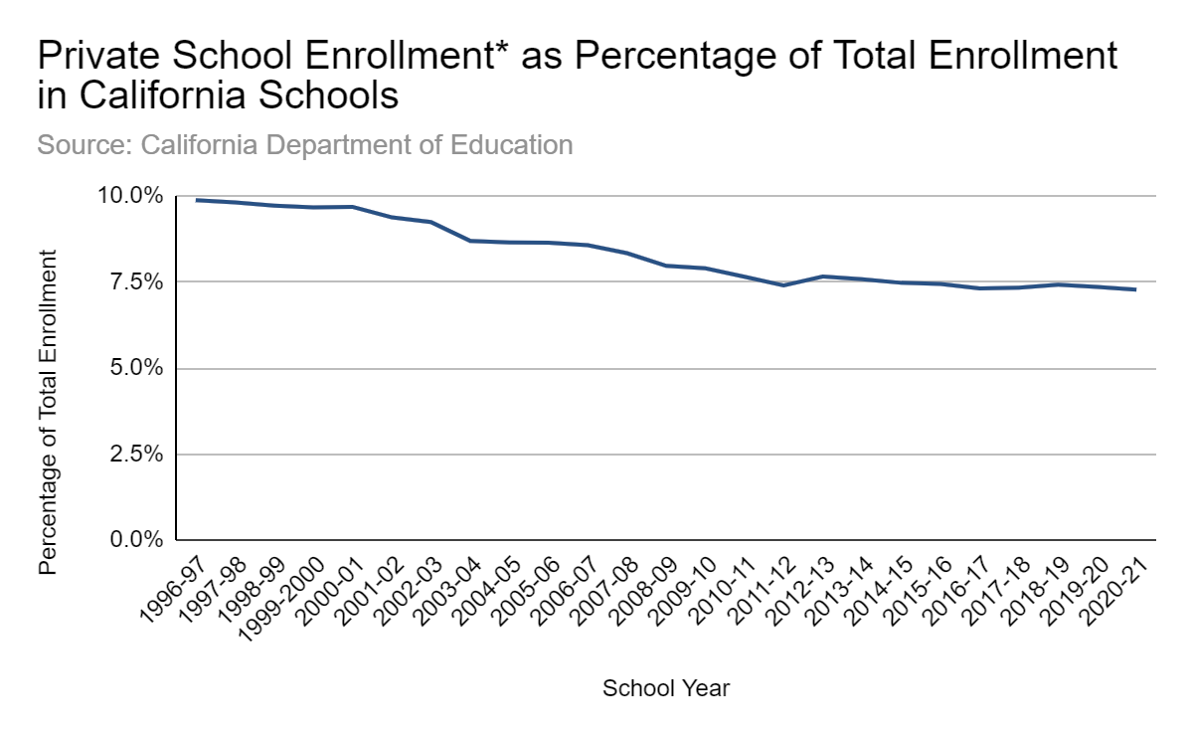
6
Private School Enrollment in California
*Includes private schools with six or more students
Based on private school data from the California Department of Education.
California Adolescents | August 2022
Notes:
The National Center for Education Statistics (NCES) reported in 2019 (nationally) 90.8% of students were enrolled in a public school (5% at public charters) and 9.2% were enrolled in a private school (7.4% at religious schools).
The California Department of Education (CDE) reported private school enrollment for the 2020-2021 school year was 470,000 or 7.3% of the total state enrollment. This number is lower than previous years when looking at data going back to the late 90’s showing the private school enrollment percentage as 9.9%.

Slide 7
Defining “Home School” & Identifying Students
7
There are several ways a student can participate in a homeschool program:
  Homeschool “programs” may file a private school affidavit
  Independent study and online options offered by traditional public schools, charter, and private schools
  Parents of homeschooled students may also indicate in census records their children are homeschooled
Challenges:
  Overlap in schooling options and accounting students’ enrollment
California Adolescents | August 2022

Slide 8
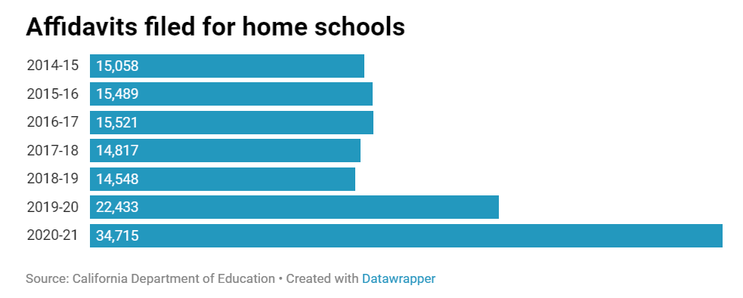
Homeschooling in California
8
Figure from EdSource (2021). Based on data from the California Department of Education.
California Adolescents | August 2022
Notes:
In California there has been a recent trend of families seeking to homeschool their children.
According to the California Department of Education, between the 2014-2015 and 2019-2020 school years, the number of private school affidavits filed was around 15,000. An increase was seen in the 2019-2020 school year with around 22,500 affidavits filed, and an estimated 35,000 affidavits during the 2020-2021 school year.
While homeschooling rates appear to be increasing, it is too early to say to what magnitude
The inconsistency and complexity of gathering data adds to the challenge of determining the extent of this increase

Slide 9
Homeschool by the Numbers
Homeschooling Households
9
California
United States
April 2020: 8.6%
Sept. 2020: 8.7%
April 2020: 5.4%
Sept. 2020: 11.1%
Source: Census Bureau’s Household Pulse Survey (2021)
California Adolescents | August 2022
Notes:
The inconsistency and complexity of gathering data adds to the challenge of determining the extent of this increase
This increase in the rate of homeschooling was seen to differing amounts nationwide since the pandemic began. The Census Bureau’s Household Pulse Survey shows in September 2020, 8.7% of California students were enrolled in a homeschool program. This is only a 0.1 percentage point change in the percent of homeschoolers in California between April 2020 (Week 1) and September 2020 (Week 16) while many other states such as Alaska, Florida, Oklahoma, and Vermont showed significant changes ranging from 12.4% to 17.9%.
In the United States as a whole, in April 2020 5.4% of children were homeschooled and by September 2020 that number increased to 11.1% according to the Household Pulse Survey.

Slide 10
Characteristics of Homeschooling Students
10
Homeschool students are increasingly a more diverse group
  The emergence of accessible programs, access to and growth in technology use, and increased empowerment to align schooling with personal needs and values has contributed to this trend
Homeschooling is present regardless of religious or political affiliation, gifted or special education status, or socioeconomic status
For those that wish to homeschool but do not, this may be exacerbated by limited knowledge about resources/regulations
California Adolescents | August 2022

Slide 11
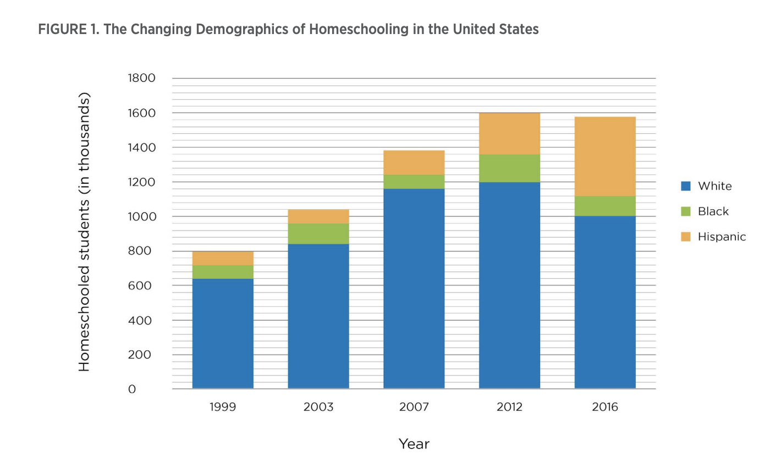
Homeschooling: Historical Trends
11
The Changing Demographics of Homeschooling in the U.S.
Figure from Center on Reinventing Public Education (2019). Based on data from the National Center for Education Statistics.
California Adolescents | August 2022

Slide 12
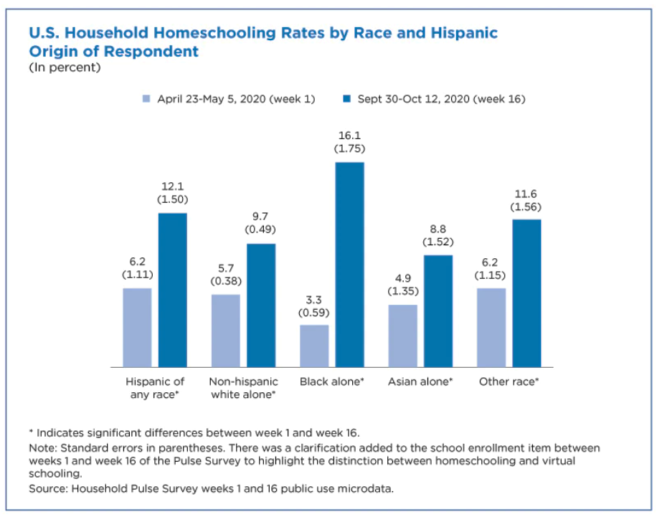
Homeschooling: Current Trends
Source: Census Bureau’s Household Pulse Survey (2021)
California Adolescents | August 2022

Slide 13
Public Schools
Serving Adolescents
California Adolescents | August 2022
13

Slide 14
Student Enrollment in California Public Schools & Their Characteristics
14
California Adolescents | August 2022
Notes:
The numbers presented here come from

Slide 15
15
Public School Enrollment is Growing Over Time
California Adolescents | August 2022
Notes:
Enrollment in California public schools grew steadily between 1982 (earliest data available) and early 2000s, then leveled off.

Slide 16
16
California Public Schools
Elementary schools
  Grades K-6, 4-6, 5-6
Middle schools/Junior high schools
  Grades 5-8, 6-7, 6-8, 6-7, 7-8, 7-9
High schools
  Grades 9-12, 10-12
Other combinations
  Grades K-12, K-8, 6-12, 7-12, 8-12
California Adolescents | August 2022
Notes:
When we pull in 6th graders, we end up pulling in almost all the schools in the state, which is not all that useful when considering the types of schools serving adolescents. Therefore, our description of schools and students includes students in grades 7-12. Where data is available, we compare patterns for students in grades 6-12 to students in grade 7-12 and find that the percentages less than a half of a percentage point different

Slide 17
 | Number of Total Schools | Number of Schools Serving Grades 6-12 | Enrollment Grades 6-12 | Number of Schools Serving Grades 7-12 | Enrollment Grades 7-12
Traditional | 8,823 | 6,009 | 3,168,768 | 4,018 | 2,738,009
Charter | 1,260 | 957 | 351,617 | 989 | 349,305
Magnet | 538 | 367 | 327,742 | 311 | 311,085
Virtual | 183 | 180 | 64,654 | 176 | 56,200
Community Day | 202 | 196 | 15,583 | 188 | 15,341
Juvenile Justice | 51 | 19 | 1,941 | 51 | 2,121
Opportunity | 19 | 51 | 2,124 | 18 | 1,896
Special Ed. | 141 | 134 | 13,466 | 127 | 12,390
Other | 835 | 796 | 122,995 | 780 | 115,320
Total | 10,071 | 7,205 | 3,324,877 | 5,182 | 2,885,077
School Type
Landscape
California Adolescents | August 2022
Notes:
- There are a variety of types of schools that serve public schools students in California.
- The categories presented in this tables are not mutually exclusive. For example, a school might be charter school and virtual.
The majority are traditional public schools.
The number of charter schools account for 13% of schools serving students in grades 6 -12 and 19% of schools serving students in grades 7 – 12
There are numerous, small schools in California with the explicit purpose of serving special needs students. Community day schools, juvenile justice programs, opportunity schools and special education schools serve students with severe medical or behavioral challenges and needs.
Other schools include youth authority, Regional Occupational Programs, homebound/hospitalization programs, adult schools

Slide 18
18
School Type Varies by Locale
California Adolescents | August 2022
Notes:
See notes on slide 8 for definition of Locales (urban, suburban, town, rural)
Charter schools and magnet schools (schools of choice) are more likely to be located in urban areas.

Slide 19
19
School Type Varies by County
California Adolescents | August 2022
Notes:
The availability of schools of choice (charter and magnet schools) varies across counties.

Slide 20
20
Schools of Choice
Students in Grades 7-12
California Adolescents | August 2022
Notes:
The number of schools of choice and the number of students served is growing.
In this graph the numbers on the y-axis represent the number of students served in public schools of choice (including charter schools, magnet schools and virtual schools)
In this graph the numbers on the on color shaded bars represents the number of schools in each category

Slide 21
21
Schools for High Needs Students
Students in Grades 7-12
California Adolescents | August 2022
Notes:
The number of community day schools, juvenile justice schools and special education schools is declining
The number of students served in community day schools and juvenile justice schools is also decreasing
The reasons for the declines is unknown but could be related to decreased student need, consolidation of programs, or changes in discipline policies and penal code related to juveniles
Note: special education schools do NOT serve ALL students eligible for special education services in the state. Rather, these schools serve the students with the most profound and severe needs (such as developmental delay) or most specialized needs (such as the State School for the Blind). Many students eligible for and receiving special education services are enrolled in traditional public schools.

Slide 22
22
California Adolescents are Racially Diverse
Students in Grades 7 - 12
California Adolescents | March 2022
Notes:
- 55.4% Latino/a/x
- 22.2% White
- 12.4% Asian American & Pacific Islander
5.3% African American/Black
3.6% multiple races
0.5% Native American
Less than .2 pct pts different for grades 6 - 12

Slide 23
23
Racial Diversity is Shifting Over Time
Students in Grades 7-12
California Adolescents | August 2022
Notes:
% of students in grades 7 – 12 who are Latino/a/x are growing overtime
Whereas the % of students who are white is decreasing.
Rates of other racial/ethnic subgroups remain largely the same overtime.
Same trends for students in grades 6 - 12

Slide 24
24
Racial Diversity Varies Across Locale
Students in Grades 7-12
California Adolescents | August 2022
Notes:
The National Center for Education Statistics, part of the Institute of Education Sciences at the U.S. Department of Education, classifies schools and districts into four major locale codes. Commonly used in education research, NCES locale codes are a measure of location relative to populous areas. Codes are derived from US Census Bureau data about the population and the distance from urban areas. The four major locale codes, which may be further divided into 3 subcategories based on population size, are defined as follows:
City – Territory inside an urbanized area and inside a principal city (e.g., Los Angeles)
Suburb – Territory outside a principal city and inside an urbanized area (e.g., Pomona)
Town – Territory inside an urban cluster but outside an urbanized area (e.g., McKinleyville)
Rural – Census-defined rural territory (e.g., Anderson Valley)
For more information see: https://nces.ed.gov/ccd/CCDLocaleCode.asp

Slide 25
25
Racial Diversity Varies Across Counties
Students in Grades 7-12
California Adolescents | August 2022
Notes:
Racial diversity varies dramatically across counties in California
Highest rate of Latino/a/x students in Imperial County & Monterey County
Highest rate of White students in Sierra, Tuolumne and Plumas Counties
We will provide this information in table format in future report/deliverable for more ease of reading.

Slide 26
Racial Diversity Varies Across Districts within Counties
Students in Grades 7-12 in Districts in Orange County
California Adolescents | August 2022

Slide 27
Racial Diversity Varies Across Schools within Districts
Students in Grades 7-12 in Schools in Anaheim Union
California Adolescents | August 2022

Slide 28
28
Racial Composition by School Type
Students in Grades 7-12
California Adolescents | August 2022
Notes:
White and Latinx students are overrepresented in charter schools compared to traditional public schools
Virtual schools serve proportionately more white students than any other school type.
Black students are overrepresented in juvenile justice programs.

Slide 29
 |  | Grade Levels Included
 |  | K-12 | 6-12 | 7-12
Public Schools |  | 10,071 | 7,205 | 5,182
Total Students |  | 6,002,393 | 3,324,877 | 2,889,560
Female |  | 48.7% | 48.7% | 48.6%
Socioeconomically Disadvantaged | Free & Reduced-Price Meals | 55.7% | - | -
 | English Learners | 17.7% | 13.5% | 12.6%
 | Foster Youth | 0.5% | - | -
 | Homeless | 3.1% | - | -
 | Migrant | 0.8% | - | -
California Public Schools
&
Students
California Adolescents | August 2022
Notes:
There are 10,071 public schools in California, serving just over 6 million students in grades K-12.
5,182 of those schools serve nearly 3 million students in grades 7 – 12 (those who we consider adolescents)
49% of students are female, 51% are male (CDE only collects binary indicator of gender assigned at birth)
56% of all students are socioeconomically disadvantaged (SED).
18% of K-12 students are EL, 13% in 7 -12 graders are EL.
CDE does not provide public use data by grade level for SED, foster, homeless, migrant. So, we only have rates for all students in grades K-12. Other research and experience suggest similar (or slightly lower) rates for grades 7 – 12.

Slide 30
30
K-12 Education and Immigration Status
Difficult to determine exact figures due to underreporting and privacy laws
About 13.3% of K-12 students in California are estimated to have undocumented parents
Additional estimates suggest 92% of children that are undocumented and between the ages of 3 to 17 are enrolled in school
  Ages 3-12: 88%
  Ages 13-17: 95%
Source: Migration Policy Institute (2021); Pew Research Center (2019)
California Adolescents | August 2022
Notes:
Immigrant generations: sociological variable that is hypothesized to influence the assimilation of immigrants and their descendants. It combines the traditional census measures of nativity (birthplace),
birthplace of parents, and duration of residence of the foreign born. The general logic is to distinguish between1st generation (the foreign born), 2nd generation (the native born children of foreign born (or mixed) parents) and 3rd and higher generations (the native born children of native born parents)

Slide 31
A Closer Look at English Learners
 | Description* | Grade Levels Included
 | Description | K-12 | 7-12
English Learner (EL) | A student in K-12 for whom there is a report of a language other than English on the Home Language Survey (HLS) and who, upon initial assessment, is determined to require additional English language skills in listening, speaking, reading, and/or writing necessary to succeed in the school's regular instructional programs. | 17.7% | 12.6%
Fluent English Proficient (FEP) | A student in K-12 for whom a language other than English is reported on the HLS and who, upon initial assessment is determined to be proficient in English. (aka Initial Fluent English Proficient or IFEP) | 21.8% | 32.0%
Reclassified Fluent English Proficient (RFEP) | A student in K-12 who, upon entering public school, is identified as an EL and subsequently reclassified/redesignated as proficient in English. | 17.6% | 27.6%
Long Term English Learner (LTEL) | An EL student to which all of the following apply: (1) is enrolled on Census Day (the first Wednesday in October) in grades 6-12; (2) has been enrolled in a U.S. school for 6+ years; (3) has remained at the same English language proficiency level for two or more consecutive prior years, or has regressed to a lower English language proficiency level; and (4) for students in grades 6-9, has scored at the “Standard Not Met” level on the prior year administration of the CAASPP-ELA. | 6.0% | 10.0%
*Adapted from CDE Glossary
California Adolescents | August 2022

Slide 32
Students’ Academic Performance and College & Career Readiness
California Adolescents | August 2022
32

Slide 33
33
Indicators of College and Career Readiness
Multiple measures used at the state and district level
  Assessment performance (i.e., CAASPP)
  College/Career Indicator (CCI), California School Dashboard
  Coursework performance (e.g., A-G course completion)
  College admissions exams (e.g., PSAT, SAT, ACT)
Different indicators suggest different levels of preparedness
Persistent disparities by race/ethnicity, socioeconomic status, and EL status
California Adolescents | August 2022
Notes:
-There are a lot of different measures used to assess college and career readiness. In this section, we present a few.

Slide 34
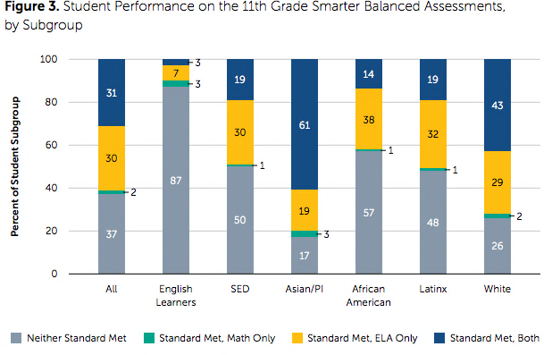
34
Standardized Assessment Performance
Student Performance on the 11th Grade Smarter Balanced Assessments, by Subgroup
Source: Strengthening the Road to College
California Adolescents | August 2022
Notes:
In 11th grade, all students take the statewide standardized assessment in English Language Arts (ELA) and Math. These assessments known as the Smarter Balanced Assessments are included in the California Assessment of Student Performance and Progress (and accountability framework based on a collection of assessments).
Less than 1/3 of all 11th graders meet the standards in both ELA and math. And another 1/3 meeting the standards in one of the subject areas. That leave 37% of all 11th graders who do meet the grade level standards in ELA and Math, and likely unprepared or underprepared for college.
Asian American and Pacific Islander students demonstrate the highest performance with 61% of students meeting standards in both ELA and math, followed by White students at 43%.
Alarmingly, 48% of Latinx students and 57% of African American/Black students do not meet standards in either subject. And 87% of English Learners do not meet the standards.

Slide 35
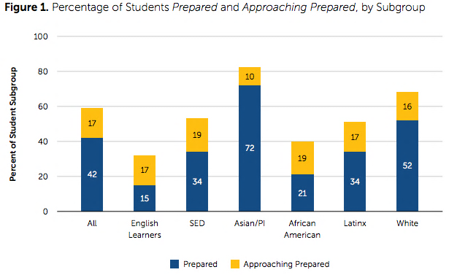
35
College & Career Readiness Indicator
Percentage of Students Prepared and Approaching Prepared, by Subgroup
Source: Strengthening the Road to College
California Adolescents | August 2022
Notes:
For accountability purposes, the California Department of Education measures college and career readiness through the College and Career Readiness Indicator (CCI).
The CCI consists of eight pathways through which a student can be deemed “prepared” or “approaching prepared” for college/career. The next slide provides the eight pathways.
42% of high school graduates in CA are ”prepared” for college and 17% were considered “approaching prepared”
The rates of preparedness are lower for students from socioeconomically disadvantaged backgrounds and those that are English Learners.
When considering variation by student race, Asian American/Pacific Islander students have the highest rates of preparedness and African American/Black students have the lowest.

Slide 36
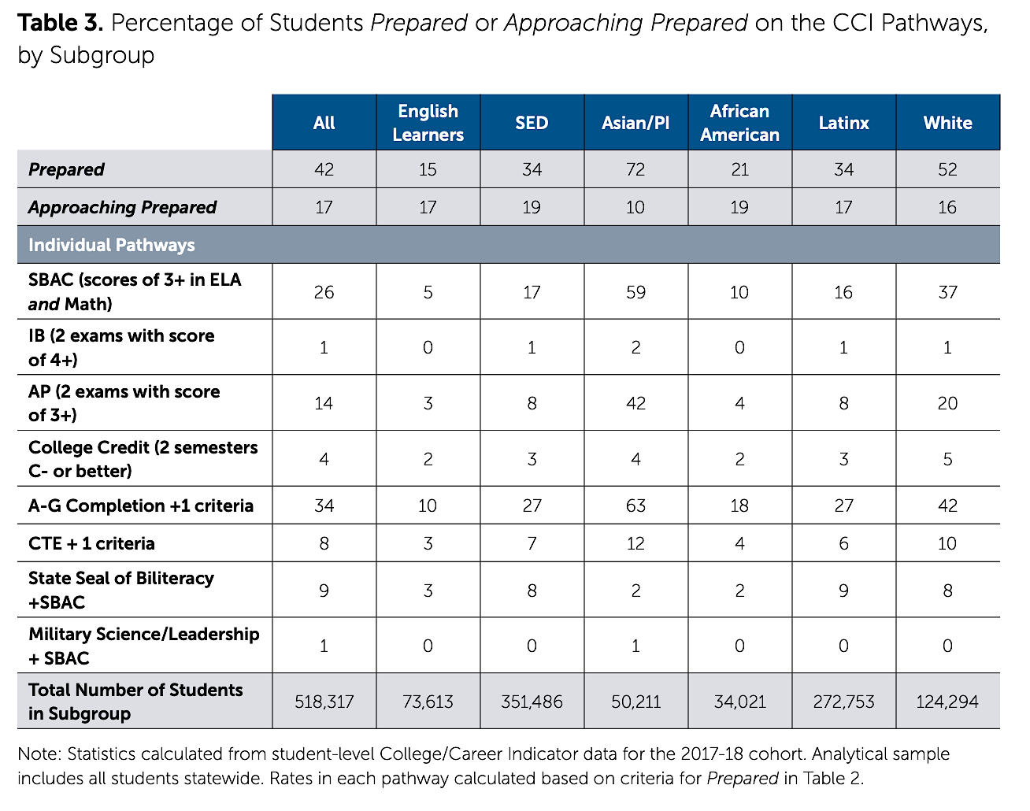
Percentage of Students Prepared and Approaching Prepared on the CCI Pathways, by Subgroup
College & Career Readiness Indicator
Source: Strengthening the Road to College
California Adolescents | August 2022
Notes:
This table displays the percent of high school graduates in each subgroup that met the prepared criteria in each of the eight pathways of the CCI.
For more information on the pathways, see our report Strengthening the Road to College

Slide 37
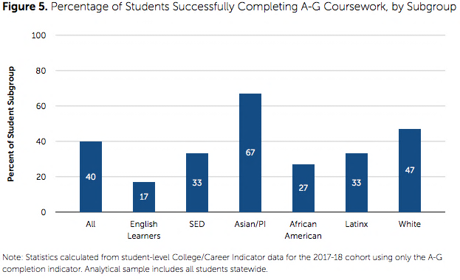
37
A-G Coursework
Percentage of Students Successfully Completing A-G Coursework, by Subgroup
Source: Strengthening the Road to College
California Adolescents | August 2022
Notes:
A-G courses are the UC/CSU approved high school courses that students much take in order to be eligible for admission to the State’s public four-year universities.
40% of students statewide complete the full set of A-G courses.
As with other indicators of academic performance and college readiness, rates are lower for English Learners and students from socioeconomically disadvantaged backgrounds.
When considering variation by student race, Asian American/Pacific Islander students have the highest rates of A-G course completion and African American/Black students have the lowest.

Slide 38
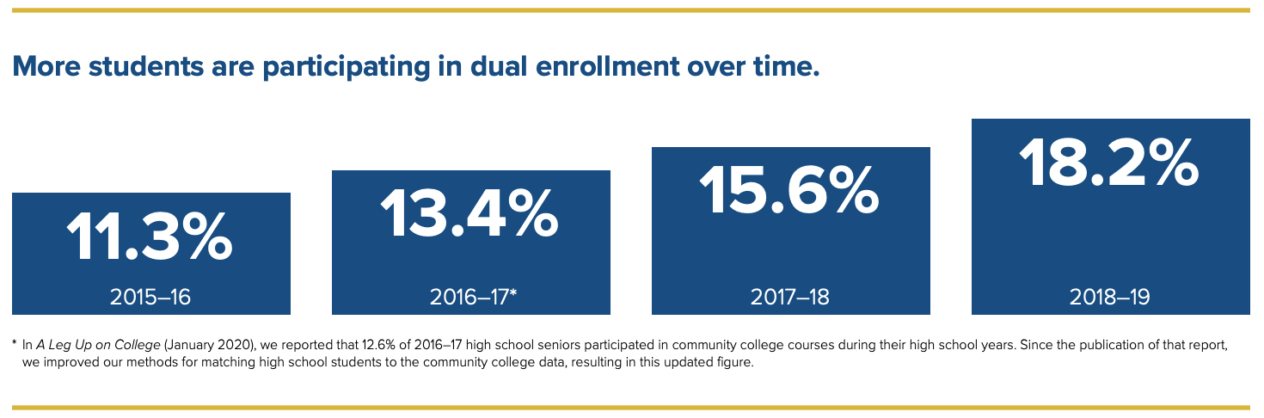
38
Participation in Dual Enrollment is Growing
Source: A Rising Tide
California Adolescents | August 2022
Notes:
Dual enrollment offers an important opportunity for high school students to gain experience with college-level coursework and the college environment while earning both high school and college credit. Most commonly, dual enrollment takes place with community colleges (though there are a few programs with the CSU system). The results report on dual enrollment include only community colleges.
Participation in dual enrollment in increasing overtime. In 2015-16, 11.3% of high school graduates participated in dual enrollment at some point during their 4 years of high school. For the 2018-19 graduating cohort, 18.2% of students participated.

Slide 39
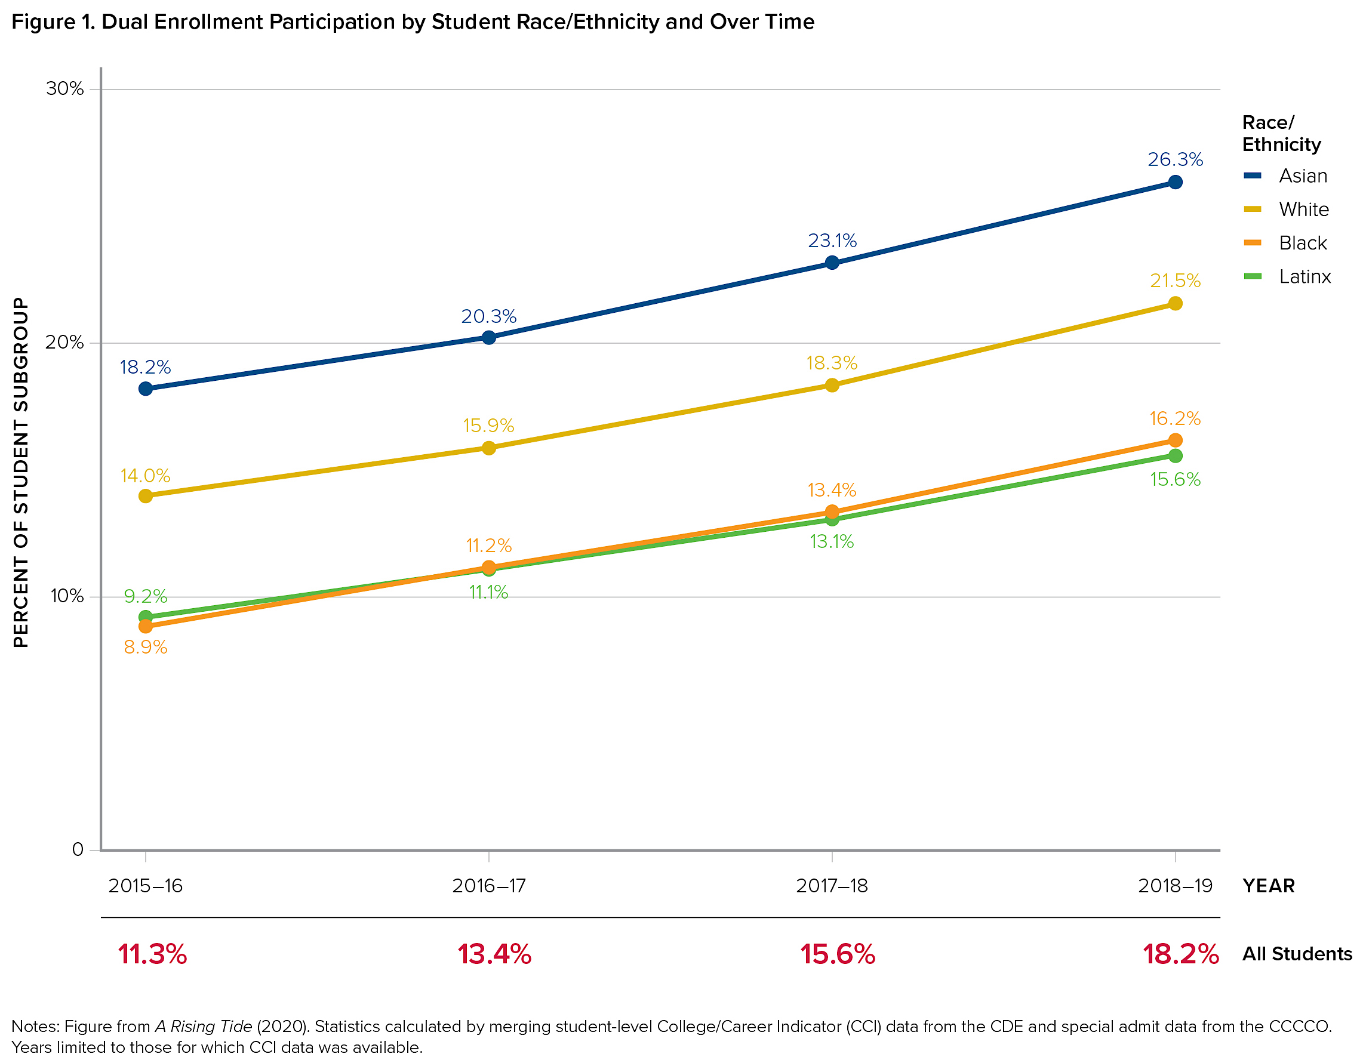
Dual Enrollment Participation by Student Race/Ethnicity and Over Time
Persistent Disparities by Race in Dual Enrollment
Source: A Foot in the Door
California Adolescents | August 2022
Notes:
Dual enrollment participation is increasing for all students in all racial/ethnic subgroups.
But, the gaps in participation observed between racial/ethnic subgroups are persisting.
Asian American/Pacific Islander students participate at a higher rate (26.3%) than students in all other racial/ethnic subgroups. Black and Latinx students participate at the lowest rates (16.2% and 15.6%, respectively).

Slide 40
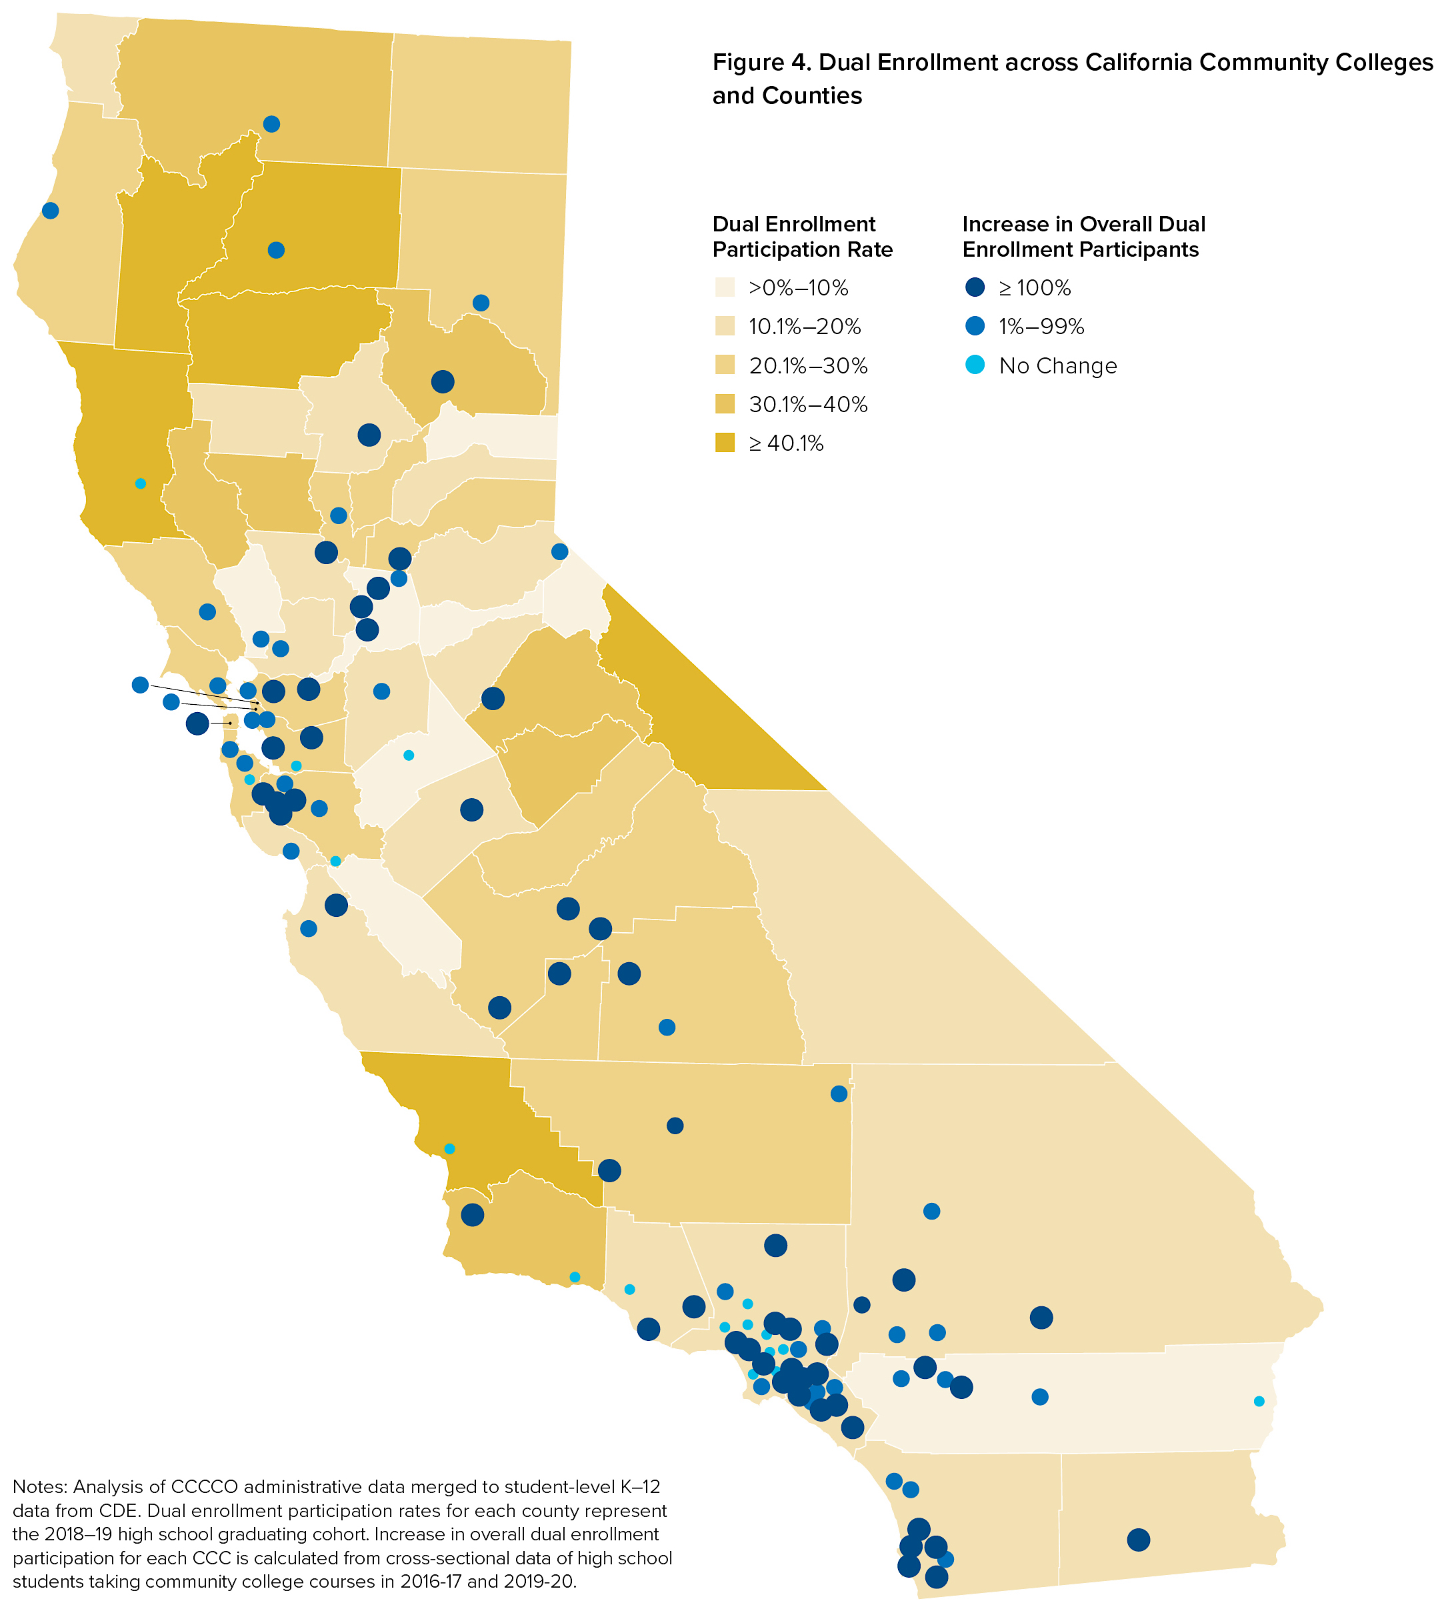
Dual Enrollment across California Community Colleges and Counties
Dual Enrollment
Varies by County
Source: A Foot in the Door
California Adolescents | August 2022
Notes:
- Rates of dual enrollment participation vary across counties in California.

Slide 41
College Enrollment & Persistence
California Adolescents | August 2022
41

Slide 42




63% of public high school students enroll in college
42
27%
4-Year College
36%
2-Year College
37%
No College
Graph from: Where California High School Students Attend College
California Adolescents | August 2022
Notes:
Consider an 11th grade cohort.
Of this cohort, just over 80% (or, about 4 out of 5) will graduate from high school =
An even smaller proportion will enter college.
In yellow, you see the largest proportion will enroll in community colleges.
A smaller proportion – a little over a quarter – will enroll in 4-year colleges.
So, 37% of high school students will not enroll in college at all.

Slide 43
Of the 63% of High School Students Who Enroll in College, 57% Enroll in Community College
43
Source: Where California High School Students Attend College
California Adolescents | August 2022
Notes:
Note: this slide the denominator is students who go to college (whereas the last one was based on a full 11th grade high school cohort).

Slide 44
Enrollment Varies by Race/Ethnicity
44
Source: Where California High School Students Attend College
California Adolescents | August 2022
Notes:
Rates of college enrollment vary by student race/ethnicity.
Highest rates of college enrollment are observed among Asian American/Pacific Islander students… and these higher rates are driven by 4-year college enrollment, as AA/PI students have the lowest rate of enrollment in community college.
Black and Latinx students have similar rates, lower than their AAPI and White peers

Slide 45
College Enrollment Varies By County
California Adolescents | August 2022
Source: Where California High School Students Attend College
Notes:
- College enrollment rates vary across counties

Slide 46

Enrollment Varies Across Counties
46
Source: Where California High School Students Attend College

Slide 47
Percent of Students by Semesters Enrolled in College
47
High School Graduates Who Participate in College*
*Summers not included
California Adolescents | August 2022
Notes:
This graph shows the number of semesters of college enrolled for high school students who enroll in college within 16 months of graduation
19.2% of high school graduates who go to college complete 8 semesters in 6 years and 13.4% complete 10 semesters. About 35% of students complete fewer than 8 semesters. Etc.

Slide 48
Rates of Degree Completion
48
High School Graduates Who Participate in College
California Adolescents | August 2022
Notes:
This graph provides rates of college degree attainment in 6 years amongst high school graduates who first enroll in college within 16 months of graduation.
Over 40% of students who start earn a degree (38.2% earn a bachelor’s and 6.6% earned a associates).
Degree attainment rates are highest for American Asian/Pacific Islander students ad lowest for Latinx students.

Slide 49
A Portrait of California’s Adolescents and the Schools that Serve Them
Sherrie Reed, Justin Luu,
Michal Kurlaender, and Alexandria Hurtt
The research reported here was conducted under research partnership agreements between the University of California, Davis (Michal Kurlaender, PI) and the California Department of Education and the California Community Colleges Chancellor’s Office, respectively. Research was funded by the Stuart Foundation and by the Institute of Education Sciences, U.S. Department of Education, through Grant R305E150006 to the Regents of the University of California. California Education Lab is grateful to College Futures Foundation for their ongoing support. The findings and conclusions here are those of the authors and do not necessarily reflect the positions or policies of the U.S. Department of Education, the California Education Lab, or the agencies providing the data.

